Slide 1
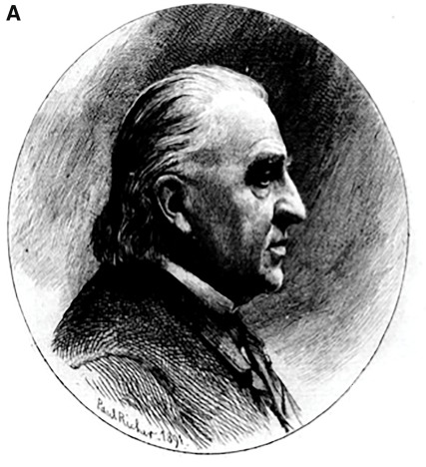
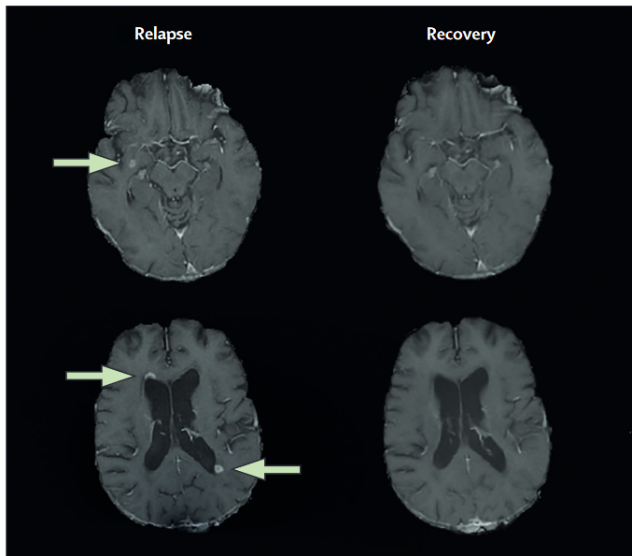

Definitions of progression: Cognition and other non-motor outcomes
Tom Fuchs, MD PhD
Notes:
Outline
Cross-sectional: Establishing cutoff's to identify significant impairment for individual patients.
z-score normalization and demographic correction with regression-based norms
Applications for cognition
Applications for PROs
Longitudinal: identifying statistically significant worsening in individual patients
Rates of change, practice effects, testing intervals, and repeated forms
Test-retest error and reliable change
misuse of "clinically meaningful change" - intended for group-level
Cognitive reliable change
PRO reliable change
Cognitive PIRA
preliminary results and needs for the future

Slide 2
Outline
Single Time-Point Impairment
Longitudinal Change
PIRA and RAW

Slide 3
Outline
Single Time-Point Impairment
Longitudinal Change
PIRA and RAW

Slide 4
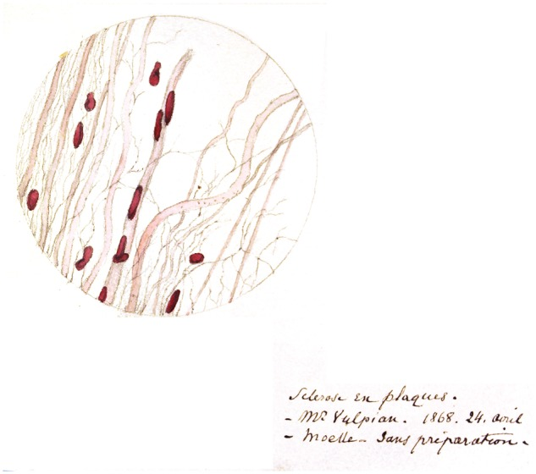
Cognition in Multiple Sclerosis
“Marked enfeeblement of the memory" and "conceptions that formed slowly".
MS Center Amsterdam
Notes:
Known for over hundred years

Slide 5
Prevalence of Cognitive Impairment
MS Center Amsterdam
Notes:
Known for over hundred years

Slide 6






Importance of Cognition
Kalb et al., MSJ, 2018
MS Center Amsterdam
Notes:
Known for over hundred years

Slide 7
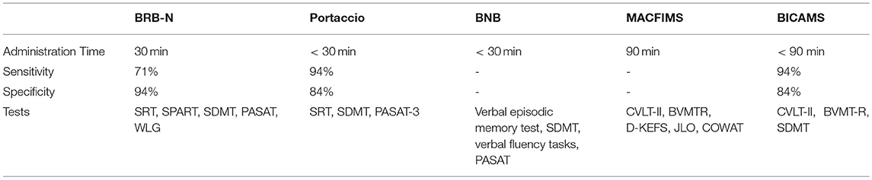
Single Time-Point Measure of Impairment
Notes:
Main point: Different batteries reveal different things.
Lesions can be anywhere – so any cognitive dysfunction is possible, though some patterns reveal themsevels.

Slide 8
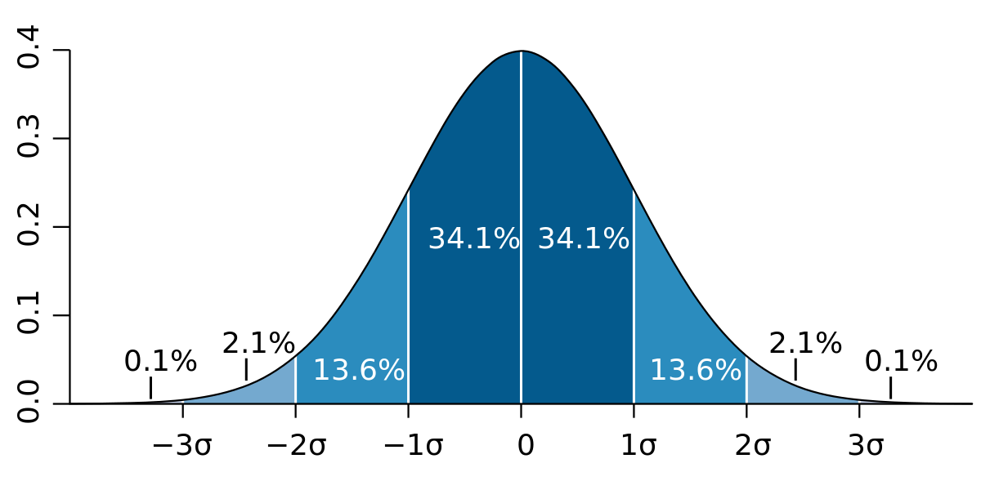
Single Time-Point Measure of Impairment
Hancock et al., MSARD, 2022
Notes:
https://www.sciencedirect.com/science/article/pii/S2211034821007458
Comparing diagnostic criteria for the diagnosis of neurocognitive disorders in multiple sclerosis

Slide 9
Single Time-Point Measure of Impairment
“1.5 standard deviations below the normative mean in two or more cognitive domains”
Hancock et al., MSARD, 2022
Notes:
https://www.sciencedirect.com/science/article/pii/S2211034821007458
Comparing diagnostic criteria for the diagnosis of neurocognitive disorders in multiple sclerosis

Slide 10
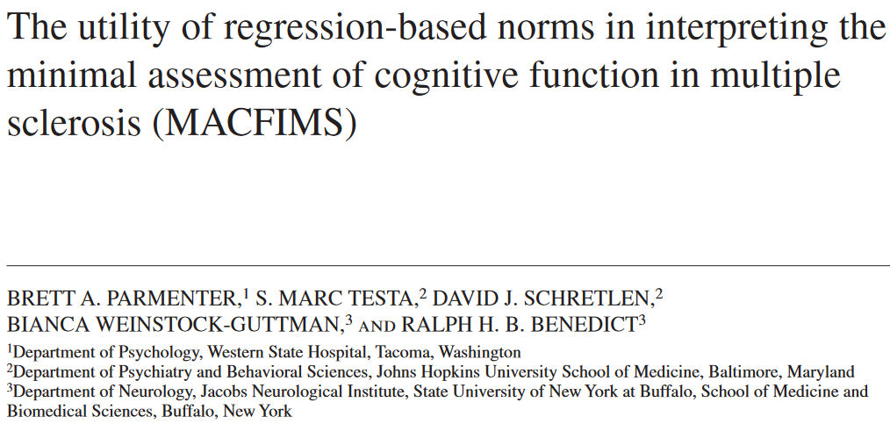
Single Time-Point Measure of Impairment
“1.5 standard deviations below the normative mean in two or more cognitive domains”
Parmenter et al., 2009, JINS
Notes:
https://www.sciencedirect.com/science/article/pii/S2211034821007458
Comparing diagnostic criteria for the diagnosis of neurocognitive disorders in multiple sclerosis

Slide 11
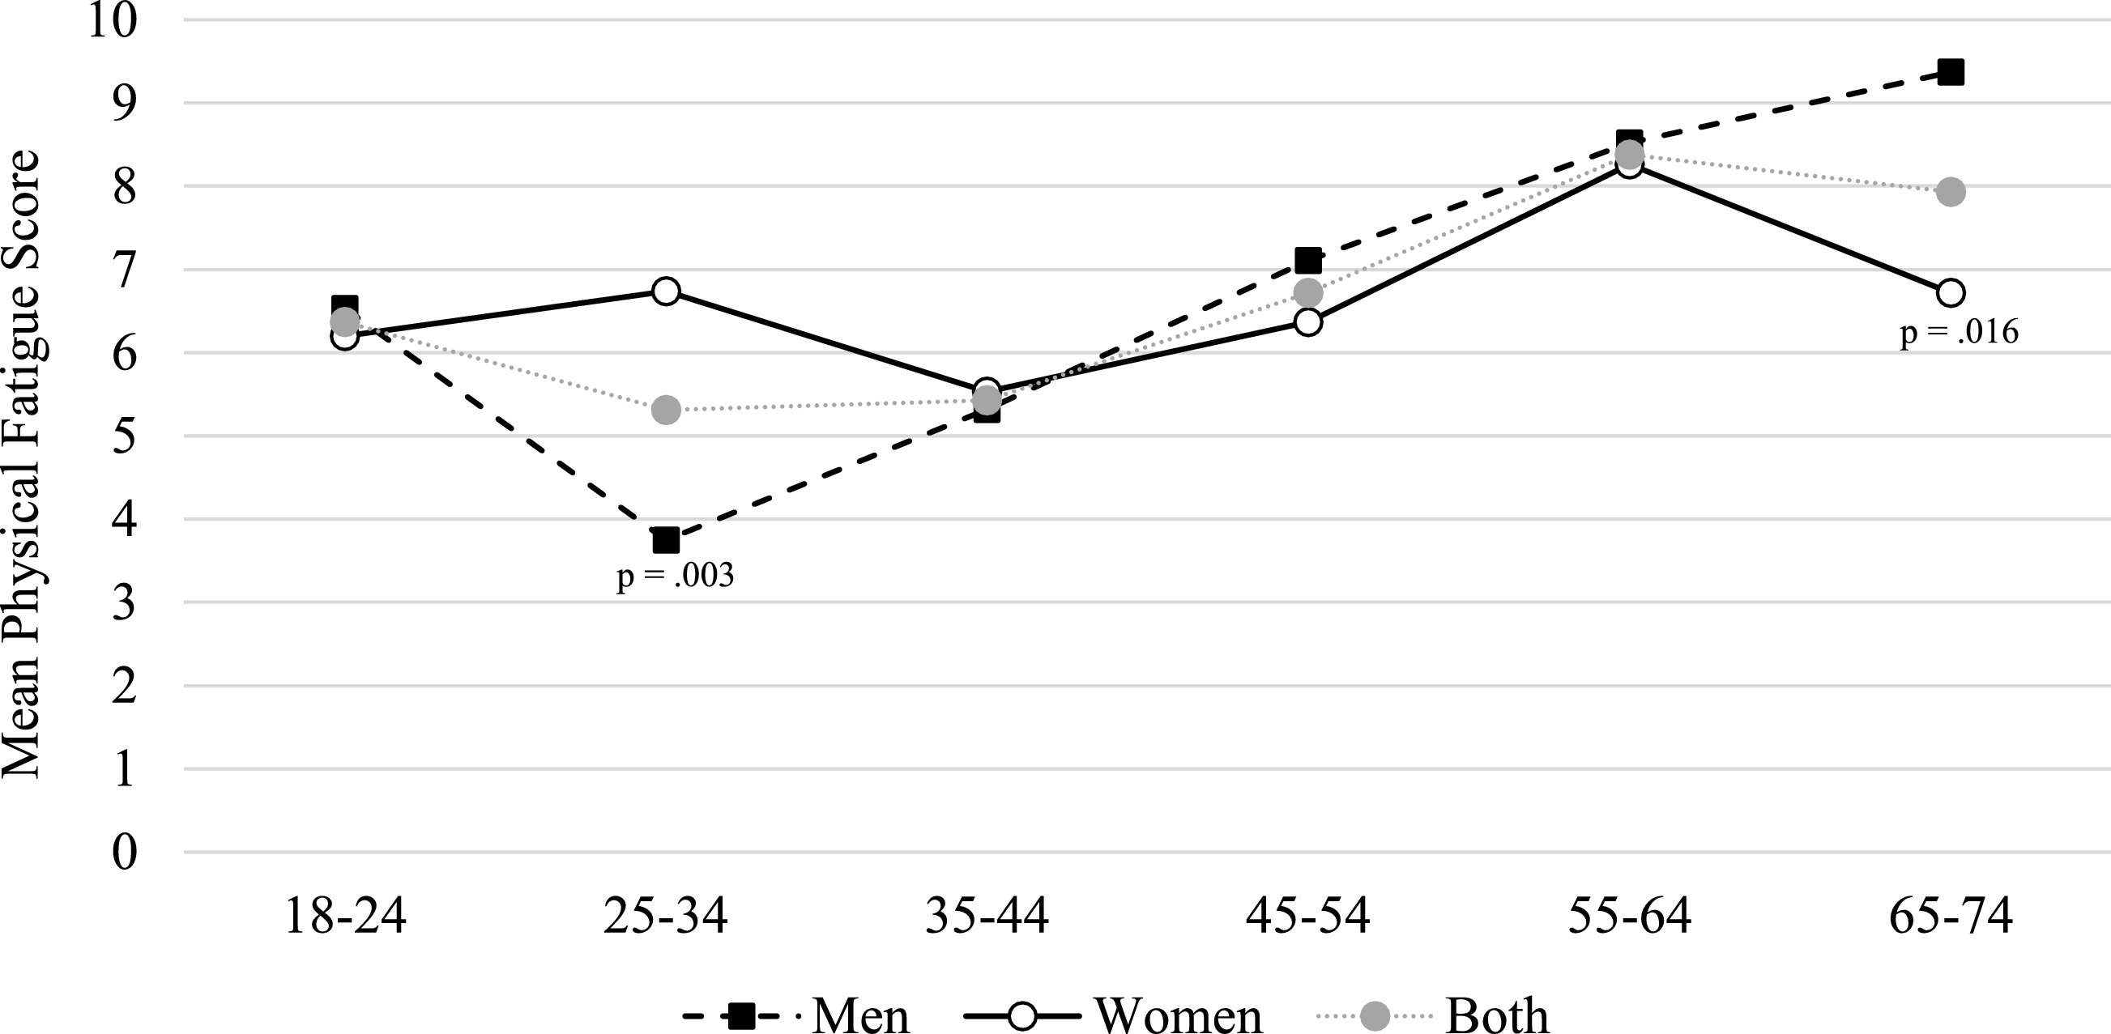
Demographic-Corrected Norms for PROs
Strober et al., 2020, MSARD
Notes:
Modified fatigue impact scale
Tired of not knowing what that fatigue score means? Normative data of the Modified Fatigue Impact Scale (MFIS)
https://www.sciencedirect.com/science/article/pii/S2211034820306507?casa_token=dkAbX5TyzWYAAAAA:lXjkyRFJC-XfXabQipHXmtUbwCZql3BU41sC1Io5oRHTApHp6Xz4ztgKy9VQlTixraIGONOIXxo

Slide 12
Demographic-Corrected Norms for PROs
Strober et al., 2020, MSARD
Notes:
Tired of not knowing what that fatigue score means? Normative data of the Modified Fatigue Impact Scale (MFIS)
https://www.sciencedirect.com/science/article/pii/S2211034820306507?casa_token=dkAbX5TyzWYAAAAA:lXjkyRFJC-XfXabQipHXmtUbwCZql3BU41sC1Io5oRHTApHp6Xz4ztgKy9VQlTixraIGONOIXxo

Slide 13
Demographic-Corrected Norms for PROs
Strober et al., 2020, MSARD
Notes:
Tired of not knowing what that fatigue score means? Normative data of the Modified Fatigue Impact Scale (MFIS)
https://www.sciencedirect.com/science/article/pii/S2211034820306507?casa_token=dkAbX5TyzWYAAAAA:lXjkyRFJC-XfXabQipHXmtUbwCZql3BU41sC1Io5oRHTApHp6Xz4ztgKy9VQlTixraIGONOIXxo

Slide 14
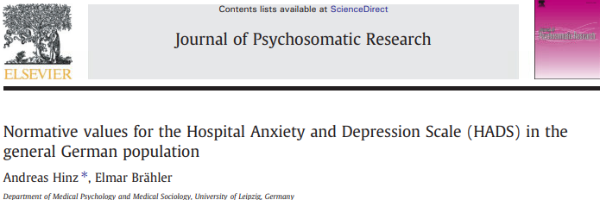
Demographic-Corrected Norms for PROs
Andreas Hinz et al., JPR, 2011
Notes:
Normative values for the Hospital Anxiety and Depression Scale (HADS) in the general German popular
https://www.sciencedirect.com/science/article/pii/S0022399911000079?casa_token=6jI_YRolOaoAAAAA:smIy3x8ZVUfLCWxmJNpmywA93temDBotnf4rVwV901EBPOm2Pz7210Pd3av88jC2sM8Uc4kDLrQtion

Slide 15
Outline
Single Time-Point Impairment
Longitudinal Change
PIRA and RAW

Slide 16
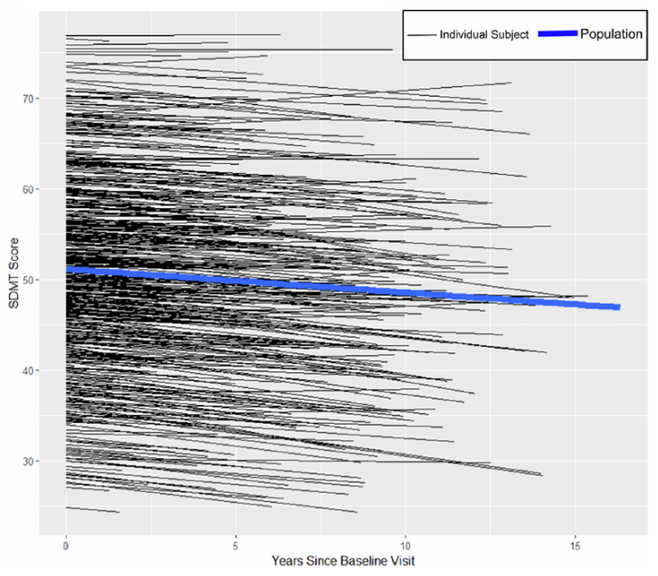
Longitudinal Decline vs Practice
MS Center Amsterdam
Notes:
0.5 pt decline per year.
Practice effects get in the way – so must be weary of repeat testing, especially in the age of app-based testing.

Slide 17
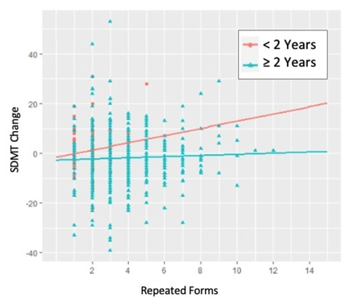
Longitudinal Decline vs Practice
MS Center Amsterdam
Notes:
Practice effects get in the way. Worse at briefer intervals, especially with repeated forms.
– so must be weary of repeat testing, especially in the age of app-based testing.

Slide 18
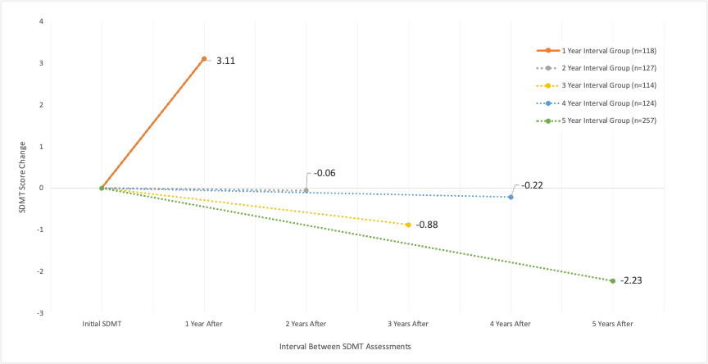
Longitudinal Decline vs Practice
MS Center Amsterdam
Notes:
Decline at whole patient sample group level observed only with wide intervals (individual patients vary).

Slide 19
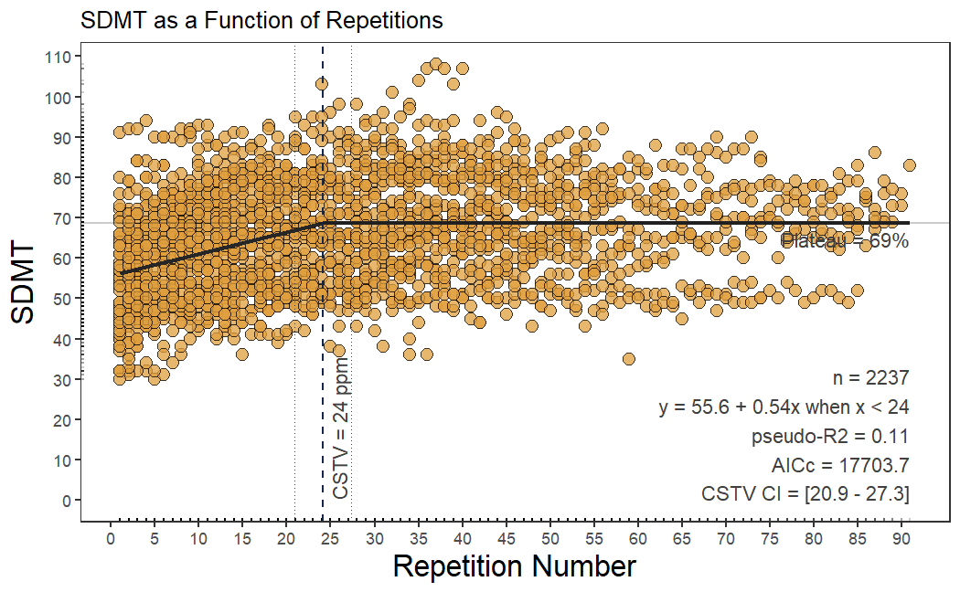
Practice & Test-Retest Error
Novakova et al., unpublished
Notes:
For longitudinal, must account for Expected error on repeated testing

Slide 20
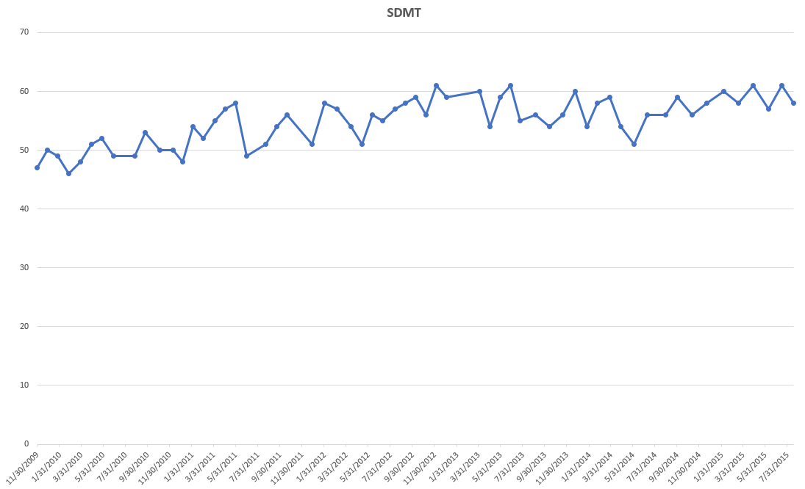
Practice & Test-Retest Error
Novakova et al., unpublished
Notes:
For longitudinal, must account for Expected error on repeated testing

Slide 21
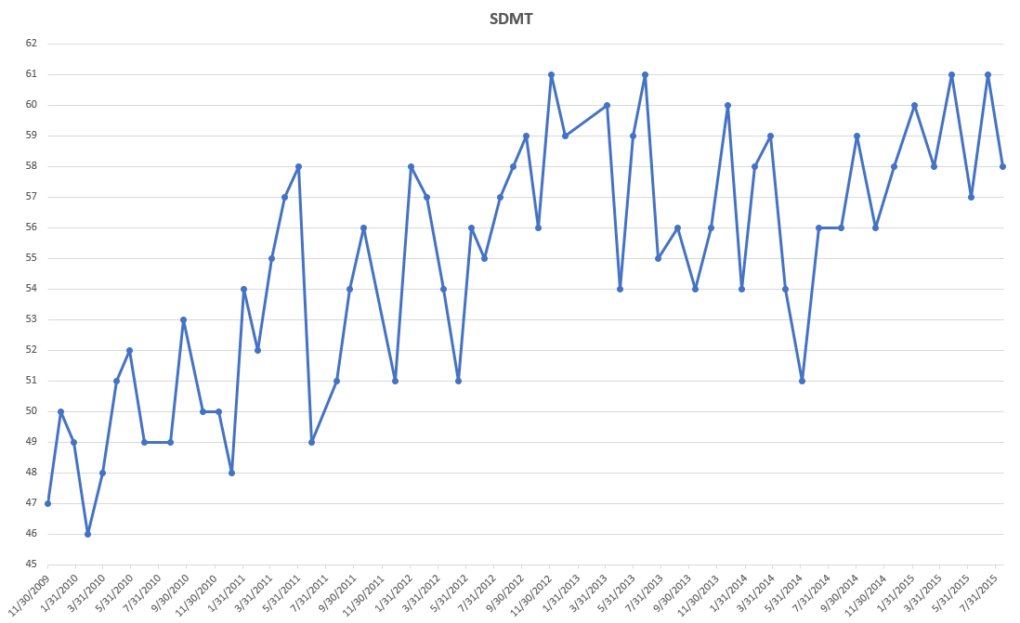
Practice & Test-Retest Error
Novakova et al., unpublished
Notes:
For longitudinal, must account for Expected error on repeated testing

Slide 22
Practice & Test-Retest Error
Novakova et al., unpublished
Notes:
For longitudinal, must account for Expected error on repeated testing

Slide 23
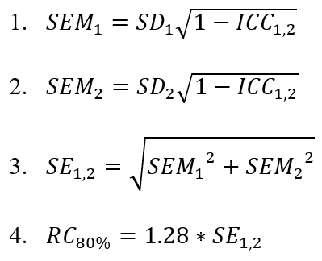
Reliable Change
Weinstock et al., MSJ, 2021
Notes:
Way around the problem: RCI. Where ICC is the inter-correlation coefficient between the first and second assessment, SD₁ is the standard deviation at the first assessment and SD₂ is the standard deviation at the second assessment.

Slide 24
Reliable Change
 | SD₁ | SD₂ | ICC_{1,2} | SEM₁ | SEM₂ | SE | RCI 80% Confidence | RCI cutoff for Individual Patient Use
SDMT | 12.2 | 13.1 | 0.84 | 4.8 | 5.2 | 7.1 | 8.1 | 8
BVMT-R | 6.7 | 7.7 | 0.70 | 3.7 | 4.2 | 5.6 | 7.2 | 7
CVLT-II | 11.9 | 10.6 | 0.69 | 6.7 | 6.0 | 8.9 | 11.4 | 11
Weinstock et al., MSJ, 2021
Notes:
Way around the problem: RCI. Where ICC is the inter-correlation coefficient between the first and second assessment, SD₁ is the standard deviation at the first assessment and SD₂ is the standard deviation at the second assessment.

Slide 25
Reliable Change
 | SD₁ | SD₂ | ICC_{1,2} | SEM₁ | SEM₂ | SE | RCI 80% Confidence | RCI cutoff for Individual Patient Use
SDMT | 12.2 | 13.1 | 0.84 | 4.8 | 5.2 | 7.1 | 8.1 | 8
BVMT-R | 6.7 | 7.7 | 0.70 | 3.7 | 4.2 | 5.6 | 7.2 | 7
CVLT-II | 11.9 | 10.6 | 0.69 | 6.7 | 6.0 | 8.9 | 11.4 | 11
Fuchs et al., MSJ, in press
Notes:
Way around the problem: RCI. Where ICC is the inter-correlation coefficient between the first and second assessment, SD₁ is the standard deviation at the first assessment and SD₂ is the standard deviation at the second assessment.

Slide 26

Reliable Change
Benedict et al., BICAMS.net, 2012

Slide 27
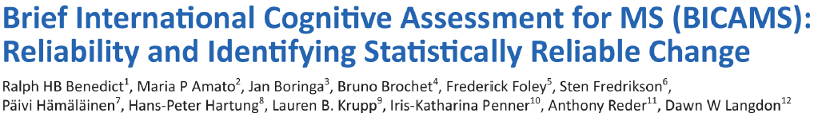
Reliable Change
Benedict et al., BICAMS.net, 2012

Slide 28
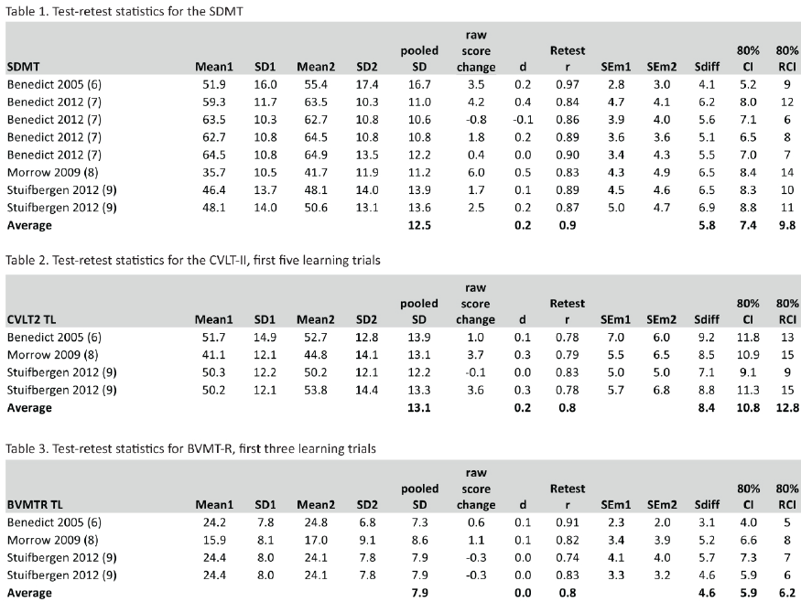
Reliable Change
Benedict et al., BICAMS.net, 2012

Slide 29
Reliable Change
Benedict et al., BICAMS.net, 2012

Slide 30
Reliable Change
Benedict et al., BICAMS.net, 2012

Slide 31
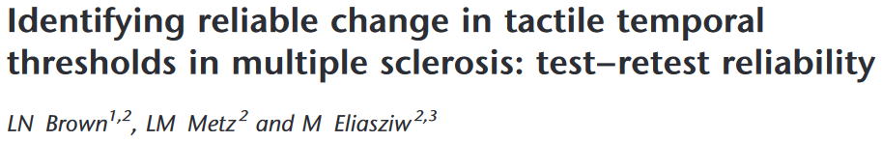
Reliable Change, Sensory Processing
Brown et al., MSJ, 2006

Slide 32
Reliable Change, Sensory Processing
“The threshold indicating change beyond chance or measurement error with 95% certainty was 19ms”
Brown et al., MSJ, 2006

Slide 33
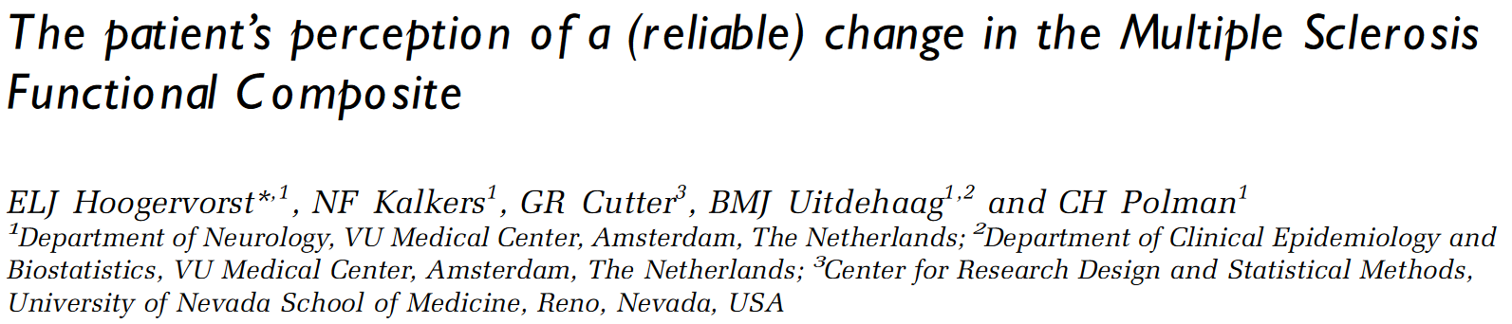
Reliable Change, PROs
Hoogervorst et al., MSJ, 2004
Notes:
https://journals.sagepub.com/doi/abs/10.1191/1352458504ms972oa?casa_token=92R9N8ZPBSUAAAAA:7CgxkTws-D2BfNL5Z7XGWI3pKQEAIlk0WUZesPpgEY-xub0Kfbz8gWG-05YoH3iIgs5LMIJ1E7a5
The patient's perception of a (reliable) change in the Multiple Sclerosis Functional C omposite

Slide 34
Reliable Change, PROs
“Reliable change is associated with a likewise change in patient perceived disability, the smallest reliable change being identified by at least 20% change in each MSFC component.”
Hoogervorst,. . Polman, et al., MSJ, 2004
Notes:
https://journals.sagepub.com/doi/abs/10.1191/1352458504ms972oa?casa_token=92R9N8ZPBSUAAAAA:7CgxkTws-D2BfNL5Z7XGWI3pKQEAIlk0WUZesPpgEY-xub0Kfbz8gWG-05YoH3iIgs5LMIJ1E7a5
The patient's perception of a (reliable) change in the Multiple Sclerosis Functional C omposite

Slide 35
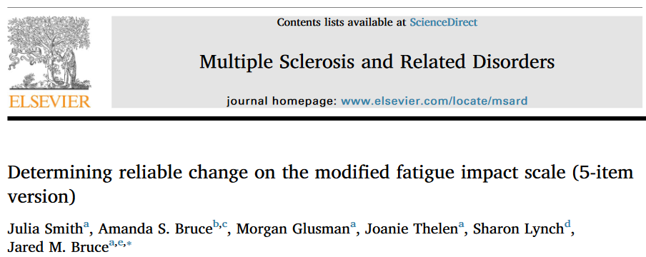
Reliable Change, PROs
Smith et al., MSARD, 2018
Notes:
MFIS reliable?
https://www.sciencedirect.com/science/article/pii/S2211034817303486?casa_token=zpQo9rfYcM8AAAAA:5wyUYSyC6Q5GegKntftRObhbYVpaDKniHxtBDT58dPWwxoh9aLs-wKNMLiJ5BeEReX5WpIboMA
Determining reliable change on the modified fatigue impact scale (5-item version)

Slide 36
Reliable Change, PROs
“Differences of 5 points on the MFIS-5 represent statistically meaningful change at the . . 0.80 confidence interval”
Smith et al., MSARD, 2018
Notes:
MFIS reliable?
https://www.sciencedirect.com/science/article/pii/S2211034817303486?casa_token=zpQo9rfYcM8AAAAA:5wyUYSyC6Q5GegKntftRObhbYVpaDKniHxtBDT58dPWwxoh9aLs-wKNMLiJ5BeEReX5WpIboMA
Determining reliable change on the modified fatigue impact scale (5-item version)

Slide 37
Reliable Change
Portaccio. . . Amato et al., MSJ 2024
Notes:
MACFIMS, but is it applicable at individual patient level
https://journals.sagepub.com/doi/full/10.1177/13524585241249084?casa_token=PY_qvGRa7PoAAAAA%3AkzX8YjdwzW5Fbcbyr9TxDqz9zUZEXC2qi4f5lM6rckhkKYn_ZFdqso-H4oUWib2NAcZxXG8_V69B
Meaningful cognitive change for the Minimal Assessment of Cognitive Function in Multiple Sclerosis

Slide 38
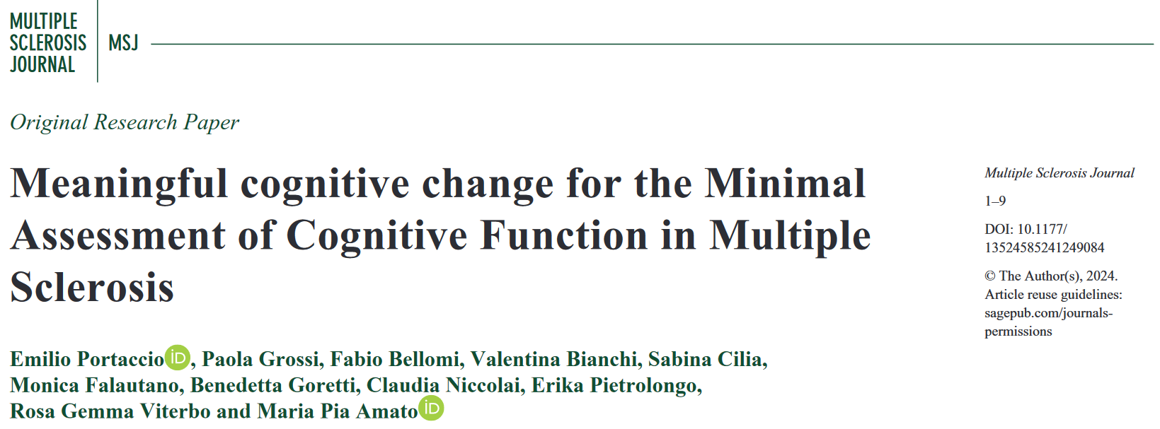
Reliable Change
Portaccio. . . Amato et al., MSJ 2024
Notes:
MACFIMS, but is it applicable at individual patient level
https://journals.sagepub.com/doi/full/10.1177/13524585241249084?casa_token=PY_qvGRa7PoAAAAA%3AkzX8YjdwzW5Fbcbyr9TxDqz9zUZEXC2qi4f5lM6rckhkKYn_ZFdqso-H4oUWib2NAcZxXG8_V69B
Meaningful cognitive change for the Minimal Assessment of Cognitive Function in Multiple Sclerosis

Slide 39
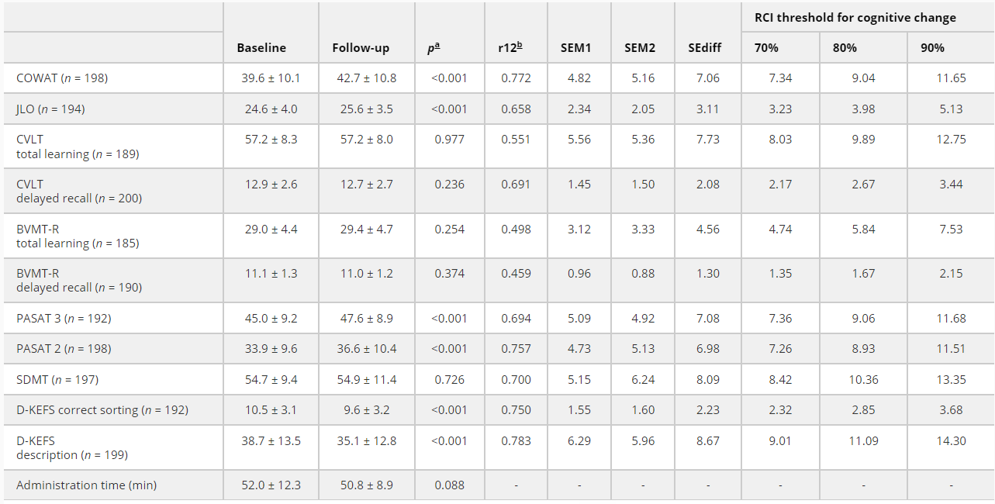
Reliable Change
Portaccio. . . Amato et al., MSJ 2024
Notes:
MACFIMS, but is it applicable at individual patient level
https://journals.sagepub.com/doi/full/10.1177/13524585241249084?casa_token=PY_qvGRa7PoAAAAA%3AkzX8YjdwzW5Fbcbyr9TxDqz9zUZEXC2qi4f5lM6rckhkKYn_ZFdqso-H4oUWib2NAcZxXG8_V69B
Meaningful cognitive change for the Minimal Assessment of Cognitive Function in Multiple Sclerosis

Slide 40
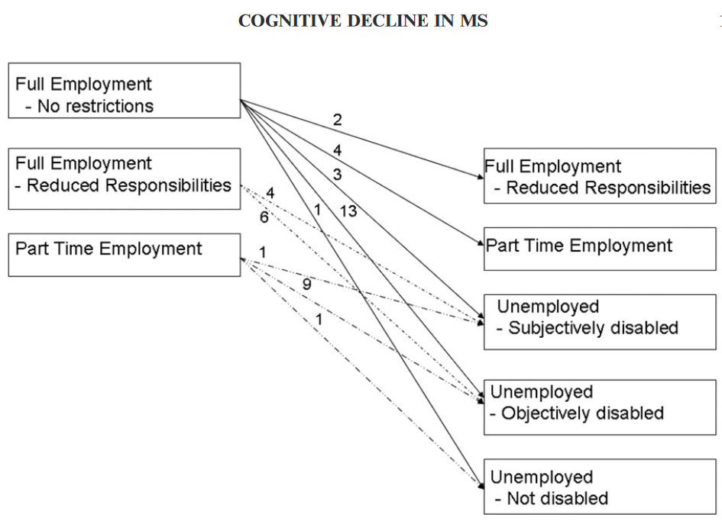
Clinical Anchoring
Morrow et al., The Clinical Neuropsychologist, 2010
Notes:
Misuse of group-level data. Recall natural error on test-retest seen in Swiss. This is a lie. Don’t do this.
Predicting loss of employment over three years in multiple sclerosis: clinically meaningful cognitive decline
https://www.tandfonline.com/doi/full/10.1080/13854046.2010.511272?casa_token=EUD5wQ7Re0UAAAAA%3Az6C2uXdd_C2xLLRoqVlBpLkSqc_QStrvgYPLzNp0QnUygY42hQ4Mp59ccSw2DIQsJLaXpanSLXgi

Slide 41
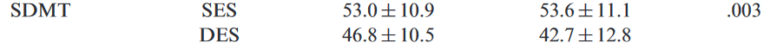
Clinical Anchoring
Morrow et al., The Clinical Neuropsychologist, 2010
Notes:
Misuse of group-level data. Recall natural error on test-retest seen in Swiss. This is a lie. Don’t do this.
Predicting loss of employment over three years in multiple sclerosis: clinically meaningful cognitive decline
https://www.tandfonline.com/doi/full/10.1080/13854046.2010.511272?casa_token=EUD5wQ7Re0UAAAAA%3Az6C2uXdd_C2xLLRoqVlBpLkSqc_QStrvgYPLzNp0QnUygY42hQ4Mp59ccSw2DIQsJLaXpanSLXgi

Slide 42

Clinical Anchoring
Morrow et al., The Clinical Neuropsychologist, 2010
Notes:
Misuse of group-level data. Recall natural error on test-retest seen in Swiss. This is a lie. Don’t do this.
Predicting loss of employment over three years in multiple sclerosis: clinically meaningful cognitive decline
https://www.tandfonline.com/doi/full/10.1080/13854046.2010.511272?casa_token=EUD5wQ7Re0UAAAAA%3Az6C2uXdd_C2xLLRoqVlBpLkSqc_QStrvgYPLzNp0QnUygY42hQ4Mp59ccSw2DIQsJLaXpanSLXgi

Slide 43
Clinical Anchoring
Novakova et al., unpublished
Notes:
Misuse of group-level data. Recall natural error on test-retest seen in Swiss. This is a lie. Don’t do this.
Predicting loss of employment over three years in multiple sclerosis: clinically meaningful cognitive decline
https://www.tandfonline.com/doi/full/10.1080/13854046.2010.511272?casa_token=EUD5wQ7Re0UAAAAA%3Az6C2uXdd_C2xLLRoqVlBpLkSqc_QStrvgYPLzNp0QnUygY42hQ4Mp59ccSw2DIQsJLaXpanSLXgi

Slide 44
Clinical Anchoring
Novakova et al., unpublished
Notes:
Misuse of group-level data. Recall natural error on test-retest seen in Swiss. Clinical anchoring is only useful on the level of individual patients if we also account for the test-retest qualities of each test.
This is a lie. Don’t do this.
Predicting loss of employment over three years in multiple sclerosis: clinically meaningful cognitive decline
https://www.tandfonline.com/doi/full/10.1080/13854046.2010.511272?casa_token=EUD5wQ7Re0UAAAAA%3Az6C2uXdd_C2xLLRoqVlBpLkSqc_QStrvgYPLzNp0QnUygY42hQ4Mp59ccSw2DIQsJLaXpanSLXgi

Slide 45

Clinical Anchoring
Novakova et al., unpublished
Notes:
Misuse of group-level data. Recall natural error on test-retest seen in Swiss. Real decline takes time. Clinical anchoring is only useful on the level of individual patients if we also account for the test-retest qualities of each test.
This is a lie. Don’t do this.
Predicting loss of employment over three years in multiple sclerosis: clinically meaningful cognitive decline
https://www.tandfonline.com/doi/full/10.1080/13854046.2010.511272?casa_token=EUD5wQ7Re0UAAAAA%3Az6C2uXdd_C2xLLRoqVlBpLkSqc_QStrvgYPLzNp0QnUygY42hQ4Mp59ccSw2DIQsJLaXpanSLXgi

Slide 46
Outline
Single Time-Point Impairment
Longitudinal Change
PIRA and RAW

Slide 47
Cognition During Relapse
Notes:
Decline during relapses that improves at time of recovery.

Slide 48
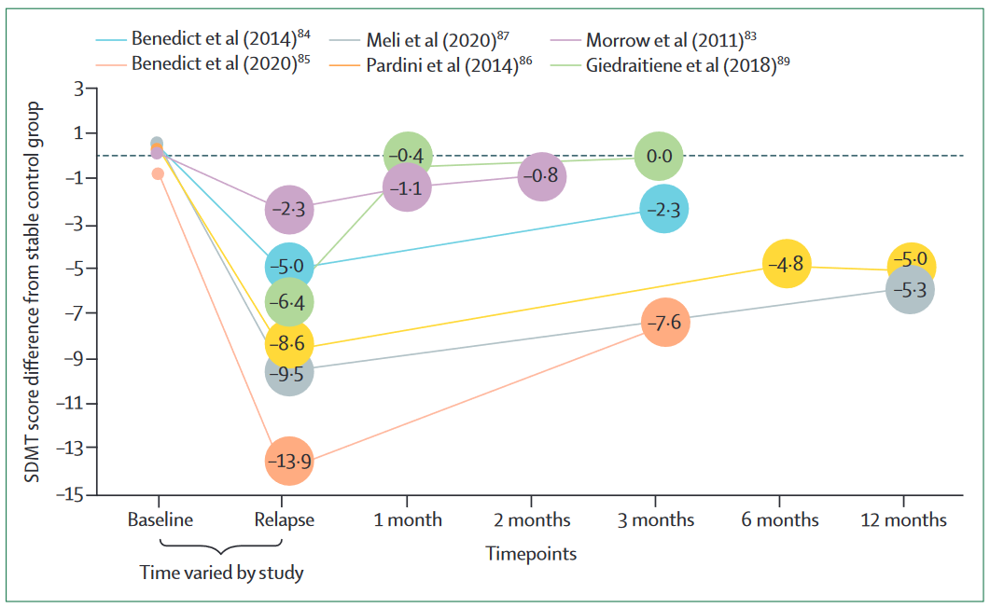
Cognition During Relapse
Notes:
Decline during relapses that improves at time of recovery.

Slide 49
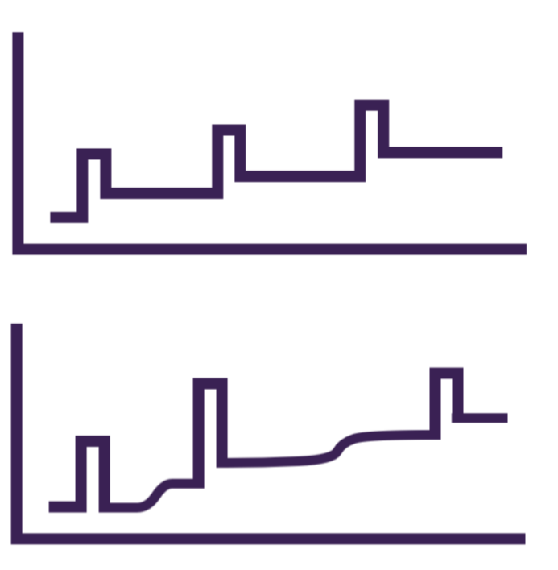
Cognitive PIRA
MS Center Amsterdam
Notes:
Though more decline occurring independent of captured relapse.

Slide 50
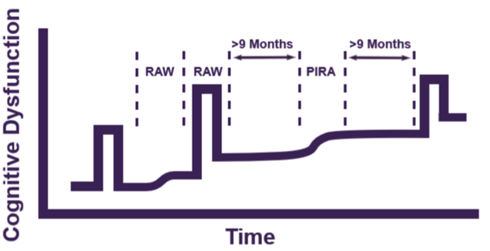
Cognitive PIRA
MS Center Amsterdam
Notes:
Though more decline occurring independent of captured relapse.

Slide 51
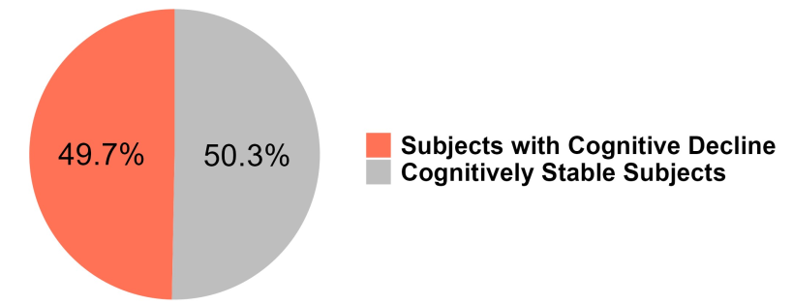
Cognitive PIRA
MS Center Amsterdam
Notes:
Though more decline occurring independent of captured relapse.

Slide 52
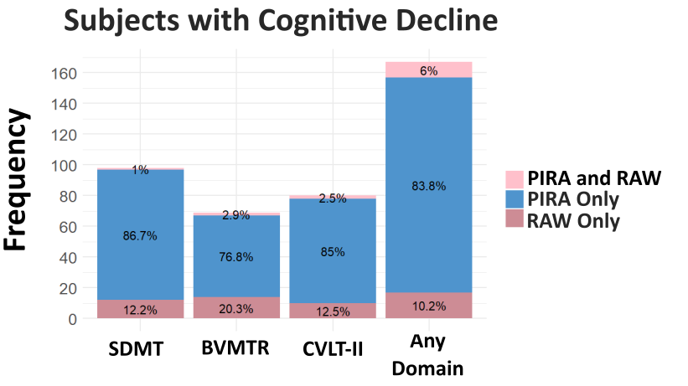
Cognitive PIRA
MS Center Amsterdam
Notes:
Though more decline occurring independent of captured relapse.

Slide 53
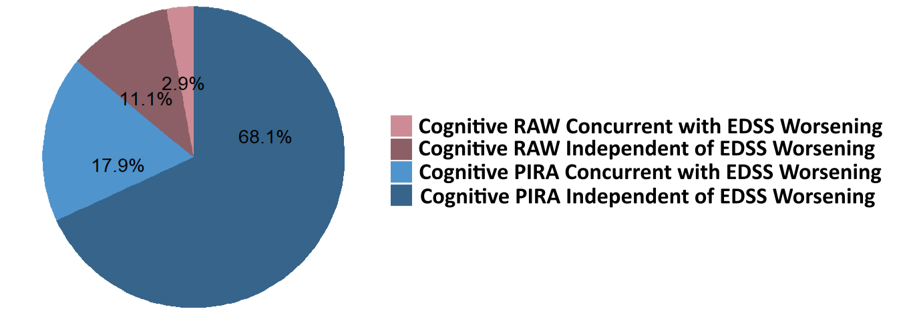

Cognitive PIRA
MS Center Amsterdam
Notes:
Though more decline occurring independent of captured relapse.

Slide 54
Cognitive PIRA
 | Standardized β | p
Independent Factors
Number of cognitive assessments | 0.137 | <0.001
Assessment density (mean years between cognitive assessments) | 0.112 | <0.001
Covariates
Age (years) | -0.032 | 0.341
Sex | -0.101 | 0.166
Disease duration (years) | -0.048 | 0.152
DMT use | -0.016 | 0.799
Baseline EDSS | 0.001 | 0.978
Baseline SDMT | 0.013 | 0.697
Education (years) | 0.001 | 0.981
MS Center Amsterdam
Notes:
Though more decline occurring independent of captured relapse.

Slide 55
Conclusions
Single-Time Point Impairment
Normalization and demographic correction are important for identifying statistically-meaningful difference
Longitudinal Change
Statistically meaningful change for an individual patient is specific to the test-retest properties of each test/questionnaire
PIRA and RAW
PIRA predominates

Slide 56





Thank you for your
attention!
Any questions?
Tom Fuchs, MD PhD
t.Fuchs@amsterdamumc.nl
References: ¹Author et al. YEAR; ²Author et al. YEAR; ³Author et al. YEAR

