Slide 1

Patterns of Structural and Functional Connectivity Predict Response to Cognitive Rehabilitation 2 Years Later in Multiple Sclerosis
Tom A Fuchs^{1,2}, Ralph HB Benedict², Stefano Ziccardi⁵, ✝Alexander Bartnik^{1,2}, ✝Rebecca Campbell^{1,2}, ✝Jose Escobar^{1,2}, ✝Devon Oship^{1,2}, ✝Jeta Pol², ✝Curtis Wojcik², ✝Faizan Yasin², Bianca Weinstock-Guttman², Robert Zivadinov¹⁻³, Michael G Dwyer¹⁻⁴
✝indicates equal contribution, listed in alphabetical order
1Buffalo Neuroimaging Analysis Center, Department of Neurology, Jacobs School of Medicine and Biomedical Sciences, University at Buffalo, State University of New York, Buffalo, NY, USA; 2Jacobs Multiple Sclerosis Center, Department of Neurology, School of Medicine and Biomedical Sciences, University at Buffalo, State University of New York, Buffalo, NY, USA;
3Center for Biomedical Imaging at Clinical Translational Science Institute, University at Buffalo, State University of New York, Buffalo, NY, USA;
4Department of Biomedical Informatics, University at Buffalo, State University of New York, Buffalo, NY, USA;
5Neurology Section, Department of Neuroscience, Biomedicine and Movement Sciences, University of Verona, Italy
Notes:
RB: alternate forms of SDMT.
Curtis: correlation btwn gmv and efficacy in sub-groups.
MD: Lack of control group - frame it more as a difficult decision to maximize power for correlations in this exploratory study
De emphasize overall sdmt change

Slide 2
Disclosures
Tom Fuchs, Stefano Ziccardi, Alexander Bartnik, Rebecca Campbell, Jose Escobar, Devon Oship, Jeta Pol, Curtis Wojcik, and Faizan Yasin have nothing to disclose.
Robert Zivadinov received personal compensation from Teva Pharmaceuticals, Biogen Idec, EMD Serono, Genzyme-Sanofi, Claret Medical, IMS Health and Novartis for speaking and consultant fees. He received financial support for research activities from Teva Pharmaceuticals, Genzyme-Sanofi, Novartis, Claret Medical, Intekrin and IMS Health
Bianca Weinstock-Guttman received honoraria as a speaker and as a consultant for Biogen Idec, Teva Pharmaceuticals, EMD Serono, Genzyme, Sanofi, Novartis and Acorda. Dr Weinstock-Guttman received research funds from Biogen Idec, Teva Pharmaceuticals, EMD Serono,Genzyme, Sanofi, Novartis, Acorda.
Ralph H. B. Benedict has received research support from Accorda, Genzyme, Biogen, and Mallinckrodt, and is on the speakers’ bureau for EMD Serono, consults for Biogen, Genentech, Roche, Sanofi, and Novartis, and receives royalties for Psychological Assessment Resources
Michael G Dwyer received personal compensation from Novartis and Claret Medical for speaking and consultant fees. He received financial support for research activities from Novartis
Notes:
10 seconds

Slide 3
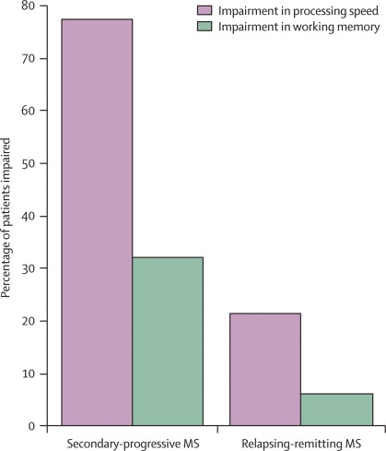
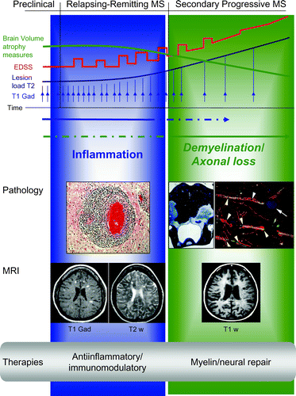
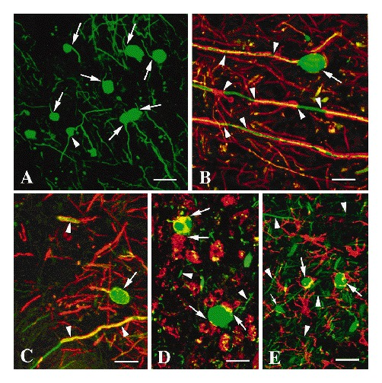
Multiple Sclerosis
¹
²
³
¹Mireia & Martin, Annual Review of Immunology 2005; ²Trapp, et al., NEJM, 1998; ³Chiaravalloti, et al., Lancet Neur, 2008

Slide 4
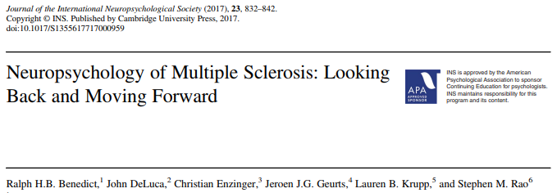
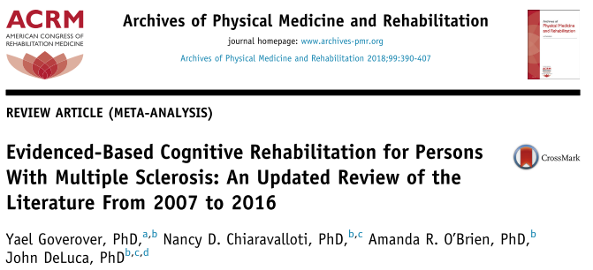
Cognitive Rehabilitation in Multiple Sclerosis: Compensation vs Restoration
Cognitive rehabilitation in MS can be broken up into two major categories, those which train patients with compensatory techniques and those which aim to strengthen/restore cognitive constructs.^{1,2}
  Compensatory techniques such as the story memory technique have been applied with Class I evidence³ based on randomized-controlled trials to improve memory functions.
  Restorative rehabilitations have also shown efficacy for improving cognitive functions such as working memory and processing speed. 1 study showed class II evidence and 3 studies had class III evidence (AAN guidelines)
¹Benedict, et al., JINS 2017; ²Goverover, et al., APMR; ³Chiaravalloti, et al., 2019, MSJ
Notes:
Mnemonics.
RB: remove musical mneumonics. Don’t use “medding around”

Slide 5
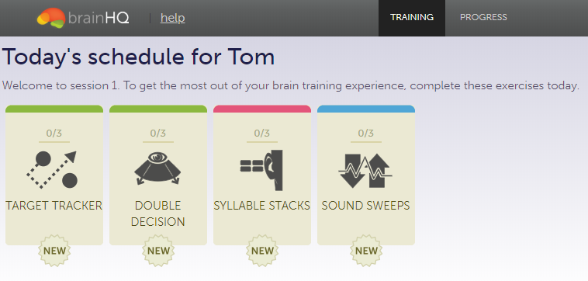
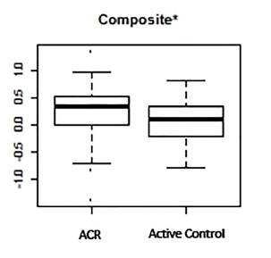
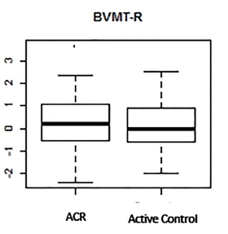
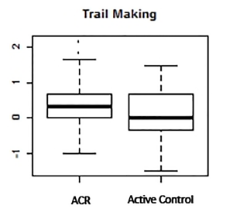


Home Computer-Based Adaptive Cognitive Remediation (ACR) Improved Cognitive Function in MS Patients
Well-validated. Home-based. Accessed on home computers without any installation. Affordable and easy to use. Adaptive to patient performance.
Participants in the ACR (n=74) versus active control (n=61) training program had significantly greater improvement in the primary outcome of cognitive functioning (mean change in composite z score±SD: 0.25 ±0.45 vs. 0.09±0.37, P=0.03, estimated difference = 0.16 with 95% CI: 0.02±0.30)
Individual responses to rehabilitation varied. It is currently unclear whether this heterogeneity is random or is driven by underlying patient characteristics.
Charvet LE et al. PLoS One. 2017
Notes:
RB: not pasat. Is a composite. Add slide on MS/cognition in MS.
RB: imprecise language on talking about BrainHQ. Tighten that up. Remind that Charvet used – and show not only what patients are more likely to respond. anD ALSO to present brainHQ in more real world. They bought computers for everybody and tracked what they were doing. This was as if you’d sign up for brainHq and did it. We just paid and called once a week to encourage. This a real world application. And that why we wanted to know.
Here – “I want to tell you about one study in particular. One advantage of this study is that this is home based. Computer-mediated cognitive training. Which is why we are interested in it.
Talk about brainHQ and how it works. Inexpensive and how people access it.
Some detail about the study results. On right show figure of the results.
“what we wanted to do was discover individual characteristics that predict success in BrainHQ.

Slide 6
Research Question
In a real-world setting, what are the individual differences in patients that may be well suited to a restorative cognitive training intervention like BrainHQ?
Demographics?
Clinical/Neuropsychological Characteristics?
Brain MRI?
Notes:
RB: If we were to re-do this. Could we determine which patients do better?
Objective.
“what we wanted to do was discover individual characteristics that predict success in BrainHQ.

Slide 7
Methods: Subjects
51 MS subjects recruited from the Jacobs Multiple Sclerosis Center, as part of a large Cardiovascular, Environmental, and Genetics (CEG) study¹
Mean age MS: 53.86,
Mean disease duration: 21.07
Median EDSS: 3.0
Inclusion criteria
Diagnosis of relapsing-remitting, secondary-progressive or primary-progressive MS, English language proficiency, over 18 years of age, access to computer and internet at home, computer competency, high quality MRI available from CEG study
Exclusion criteria
Substance dependence/abuse, psychiatric disorders, history of neurological disease other than MS, motor or sensory defect that might interfere with cognitive test performance
¹Kappus, et al., JNNP, 2015

Slide 8
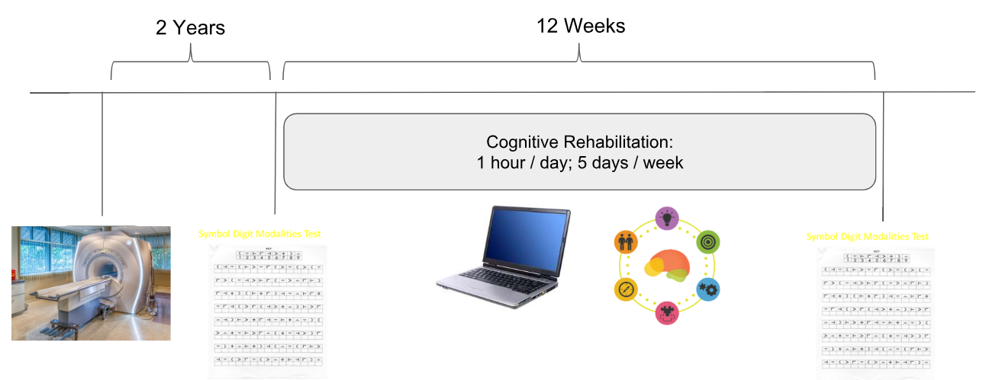
Study Design, Single-Arm Repeated Measures
Neuropsychological assessment pre- and post-rehabilitation included the Symbol Digit Modalities Test (SDMT)¹, oral form, a measure of cognitive processing speed. Alternating forms.
Primary Outcome: post-rehabilitation improvement on SDMT
Secondary outcomes: According to recommendations by the Brief International Cognition Assessment for Multiple Sclerosis (BICAMS)
  Improvements on learning trials for Brief Visuospatial Memory Test Revised (BVMTR) and the California Verbal Learning Test II (CVLT-II). These improvements not expected given the selection of exercises.
¹Smith, Western Psychological Services, 1982.

Slide 9
Predicting Success in Cognitive Training
Demographics
Age, Sex, Education
Disease Phenotype
Clinical and Neuropsychological
Physical Disability – EDSS
Cognitive Disorders
  Cognitive Processing Speed
  Executive Dysfunction
Personality - NEOFFI - Conscientiousness
  Orderliness, Goal-Striving, Dependability
Symbol Digit Modalities Test
Brain MRI
Conventional Whole Brain Metrics (e.g. T2 Lesion Volume)
Structural Connectivity/Disconnectivity
Functional Connectivity
Notes:
RB: FFM and list the traits. Conscientiousness component.

Slide 10
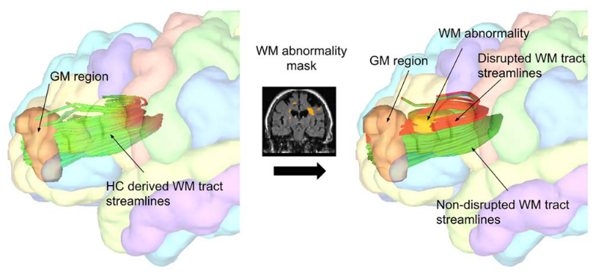
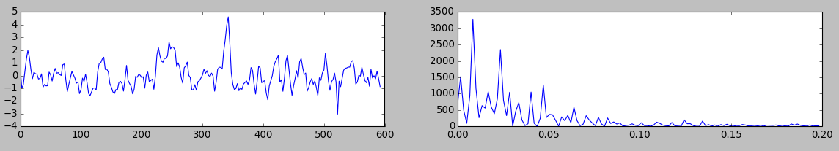
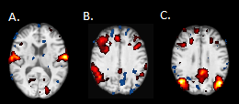
MRI Data Processing
Fuchs, et al., 2018; HBM
Structural: Measured white matter tract disruption caused by lesions between pairs of GM regions, using the network modification tool¹
Relative to database of 73 healthy control tractograms in Montreal Neurological Institute space
Applied for all pairs of 86 standard cortical & subcortical FreeSurfer-derived brain regions, resulting in 86x86 connectivity (disconnectivity) matrices
Functional: N=25, Measured resting-state functional connectivity using FSL tools
Cut volumes 1 & 2, slice time correction, motion correction, intensity normalization, temporal filtering, field map unwarping, spatial smoothing, regressed mean WM, mean CSF, and motion parameter, and ICA hand classification and denoising, ICA labeling of resting-state networks²
¹Kuceyeski, et al., Brain connectivity, 2013; ²Smith, et al., PNAS, 2009
Notes:
RB: have published data in HBM – for abnormal Conscientiousness. Bring that out. Fuchs et al. HBM 2018. We showed that this network predicts abnormality in C in MS. That’s a reason we wanted to look at C and use NeMo tool in this study.
RB: “these are known by most of you. But one of these more novel we’ve been working with in Buffalo. Describe NeMo.”

Slide 11
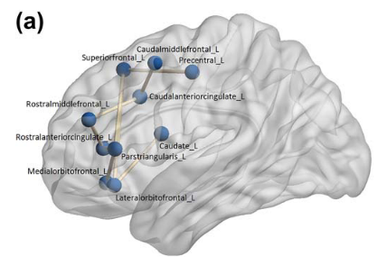
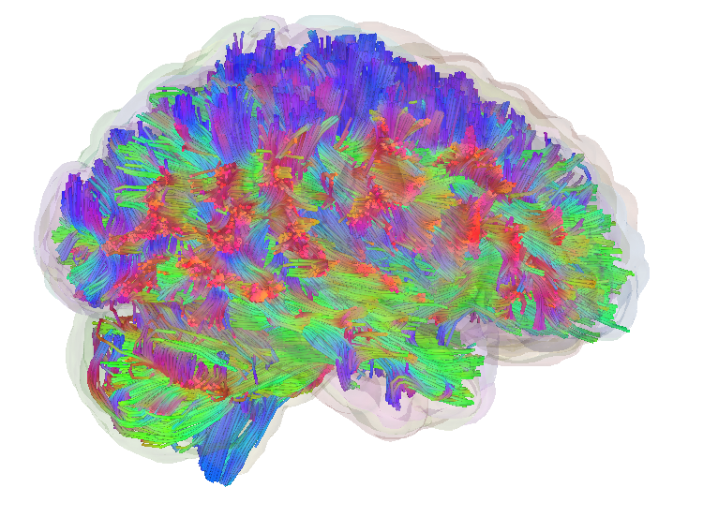
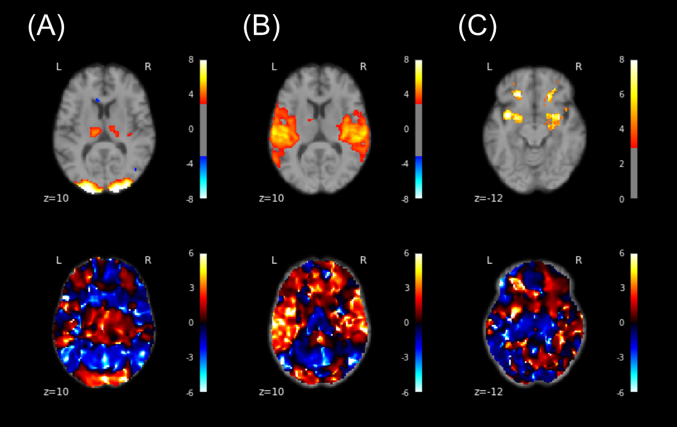
Statistical Analyses
Covariates:
age & sex
age, sex, and GMV
Structural Connectivity/Disconnectivity (WM tract disruption) analyzed using Network Based Statistics (NBS)¹
Used to control for multiple comparisons
Finds a network of connected regions whose disruption is significantly associated with the outcome
Functional Connectivity analyzed using FSL Dual Regression²
Used to control for multiple comparisons
Finds patterns of functional connectivity with known resting-state networks associated with the outcome
¹Zalesky, et al., Neuroimage, 2010; ²Nickerson, et al., Front Neurosci, 2017
Notes:
GMV controlled because most often is the global MRI measure which correlates best with cognition, and we were interested in effects which are more locally specific.
RB: How about just one slide which

Slide 12
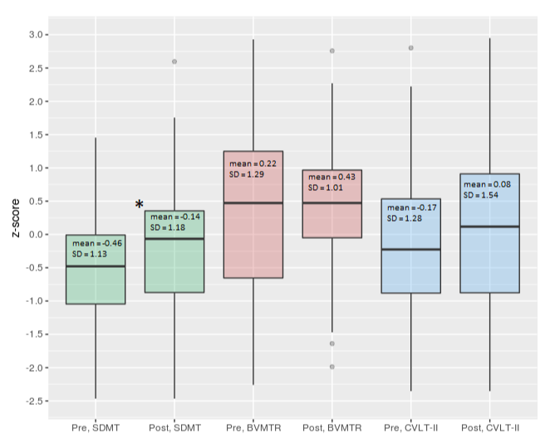
Significant Post-Rehabilitation Improvement on SDMT
Improvement on SDMT much greater (6X) than what would be expected for practice effect in people with MS¹
¹Benedict, et al., MSJ, 2008
Notes:
Mean improvement was 4.5 points on SDMT for RRMS, much higher than expected based on practice effect (about 2.5 pts after 6 monthly repetitions)
Citation:
Benedict, R H B, J A Duquin, S Jurgensen, R A Rudick, J Feitcher, F E Munschauer, M A Panzara, and B Weinstock-Guttman. 2008. “Repeated Assessment of Neuropsychological Deficits in Multiple Sclerosis Using the Symbol Digit Modalities Test and the MS Neuropsychological Screening Questionnaire.” Multiple Sclerosis (Houndmills, Basingstoke, England) 14 (7). England: 940–46. doi:10.1177/1352458508090923.

Slide 13
Heterogeneity in Patient Responses to Restorative Rehabilitation
*

Slide 14
Association Between Response to Restorative Rehabilitation and Baseline Factors
 | Demographics | MRI |  | Clinical / Neuropsychological
 | Disease Phenotype (RRMS vs PMS) | Gray Matter Volume | Deep Gray Matter Volume | Orderliness (Conscientiousness)
Effect | t=2.294 | r=0.311 | r=0.283 | r=0.292
p | 0.026 | 0.030 | 0.049 | 0.040
RRMS, Relapsing-Remitting Multiple Sclerosis; PMS, Progressive Multiple Sclerosis
Notes:
Don’t report non-sig correlations. Just show the sig ones.

Slide 15
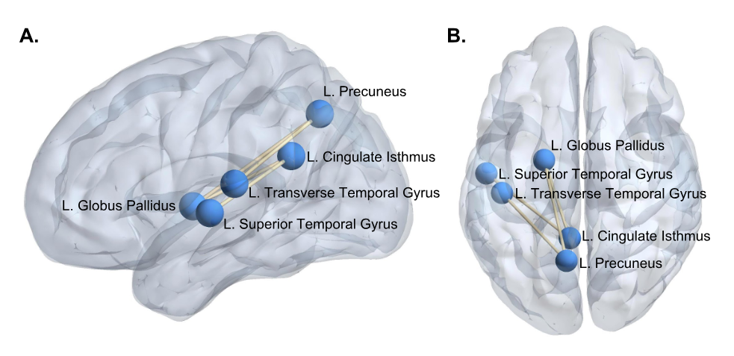
Association Between Response to Restorative Rehabilitation and Baseline Structural Network Connectivity/Disconnectivity
Notes:
This is the network whose disruption distinguishes those who improved vs not..

Slide 16
Association Between Response to Restorative Rehabilitation and Baseline Structural Network Connectivity/Disconnectity (cont.)
 | Predictor | β | R² | ΔR²
Model 1 | Age | -0.116 | 0.061 | -
 | Sex | 0.115 | - | -
 | GMV | 0.211 | - | -
Model 2 | Age | -0.197 | 0.142* | 0.081*
 | Sex | 0.217 | - | -
 | GMV | -0.067 | - | -
 | Efficacy-Network Disruption | -0.380* | - | -
*p<0.05
All βs are standardized. All R² values are adjusted for the number of predictors in the models.
Notes:
Regression for illustrative purposes, see double the explained variance.

Slide 17
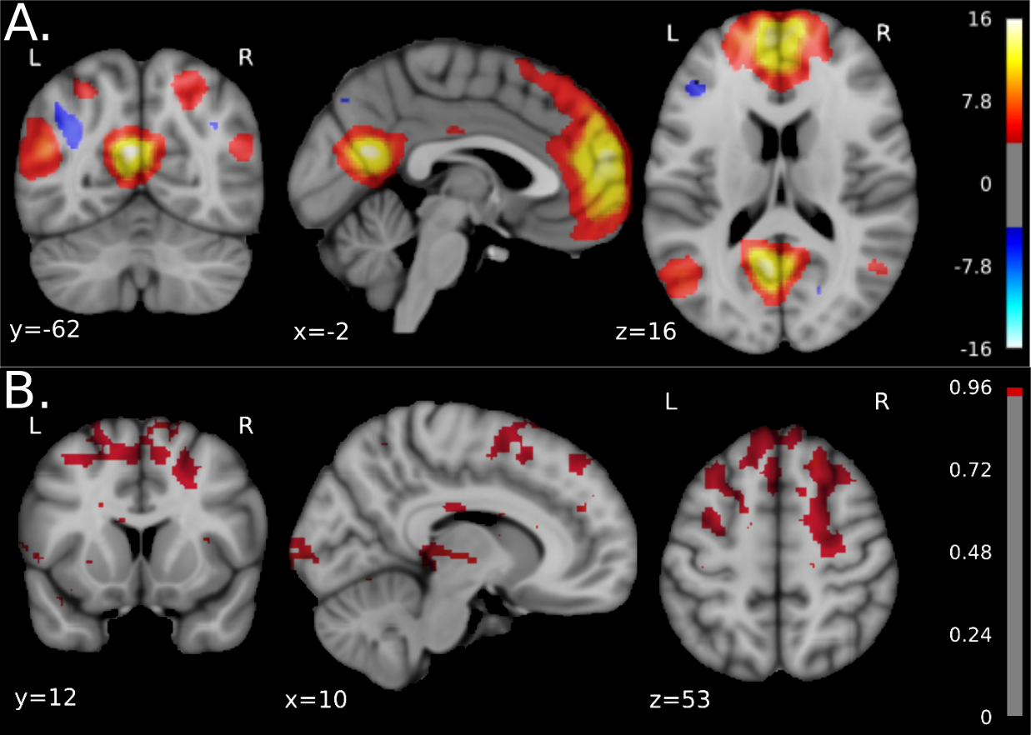
Association Between Response to Restorative Rehabilitation and Baseline Functional Network Connectivity
Notes:
MD: explain these images a bit. Describe functional results figure - need to explain what it is

Slide 18
Summary
Objective: Determine who is most likely to respond to a restorative cognitive rehabilitation in a real-world setting.
Findings: Disease phenotype of RRMS, higher GMV, higher Orderliness, and increased structural/functional connectivity of the default-mode network are associated with increased responsiveness to restorative cognitive rehabilitation
Future Work: Ought to consider whether these factors can be prospectively applied as predictors in an independent cohort.
Notes:
RB: have sub-head. Why? Find out who benefit from real life application and here’s what we found.
- RRMS. Higher GMV. DMN.

Slide 19

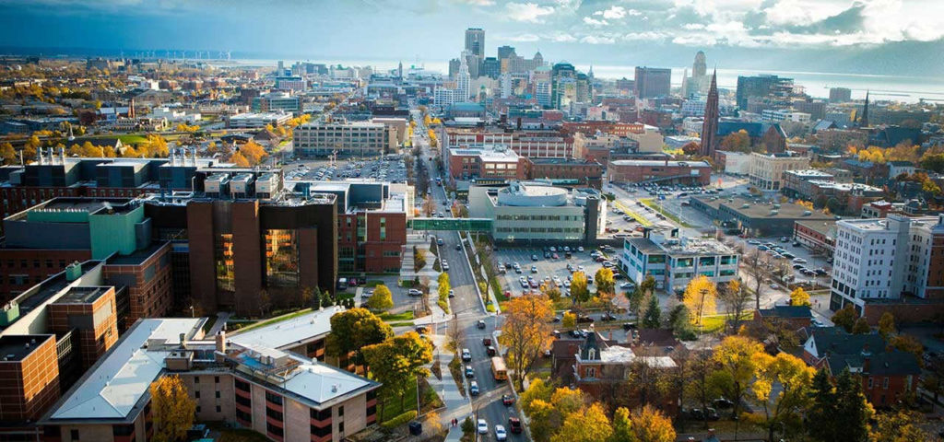

Thanks to
Mentors:
Ralph Benedict, PhD
Michael Dwyer, PhD
Robert Zivadinov, MD, PhD
Students and Collaborators:
Stefano Ziccardi
Alexander Bartnik
Devon Oship
Rebecca Campbell
Jose Escobar
Bianca Weinstock-Guttman, MD
Faizan Yasin, MD
Deepa Ramasamy, MD
Dejan Jakimovski, MD
Curtis Wojcik
Jeta Pol
Institutions:
Jacobs School of Medicine and Biomedical Sciences
Buffalo Neuroimaging Analysis Center
Jacobs Comprehensive Multiple Sclerosis Treatment and Research Center

