Slide 1



Clinical Predictions: Getting the Most Out of T2FLAIR
Tom Fuchs
ARSEP MS MRI Workshop
03 Feb 2023

Slide 2
Background
In multiple sclerosis. . .
T2FLAIR is the most commonly available MRI sequence in clinics and legacy datasets
This strength in availability makes T2FLAIR a good candidate for quantitative tools meant for clinical translation

Slide 3
Questions Addressed
How well can we approximate scientific-quality data using T2FLAIR alone?
How well does brain pathology measured using T2FLAIR predict clinical outcomes?

Slide 4
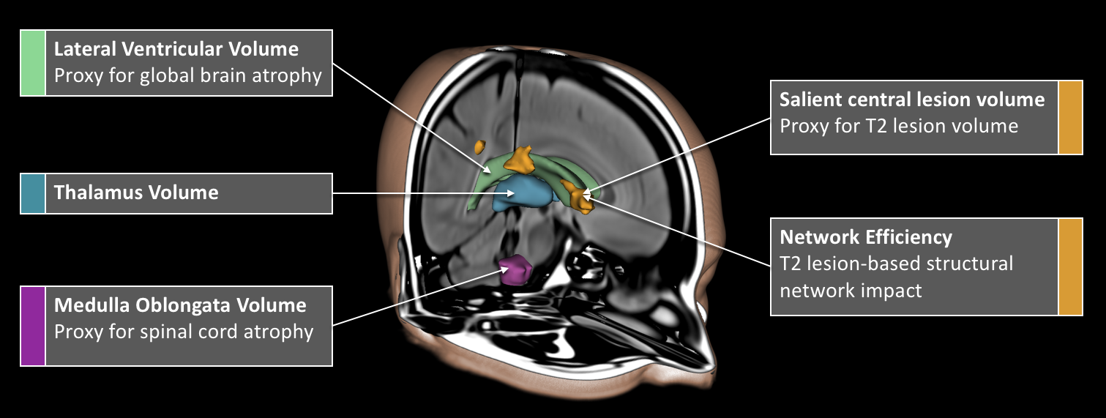
Methods

Slide 5
Sample Demographics
Age (years) | 47.2±11.1
Disease Duration (years) | 13.7±9.8
Female (n, %) | 128, 74.4%
Disease Course (n, %)
Relapsing-Remitting | 100, 58.1%
Progressive | 50, 29.1%
CIS | 22, 12.8%
EDSS (Median, IQR) | 2.5, 1.5-5.5
NHPT (s) | 26.5±14.8
T25FW (s) | 9.5±13.1
SDMT (raw score) | 50.0±14.8

Slide 6
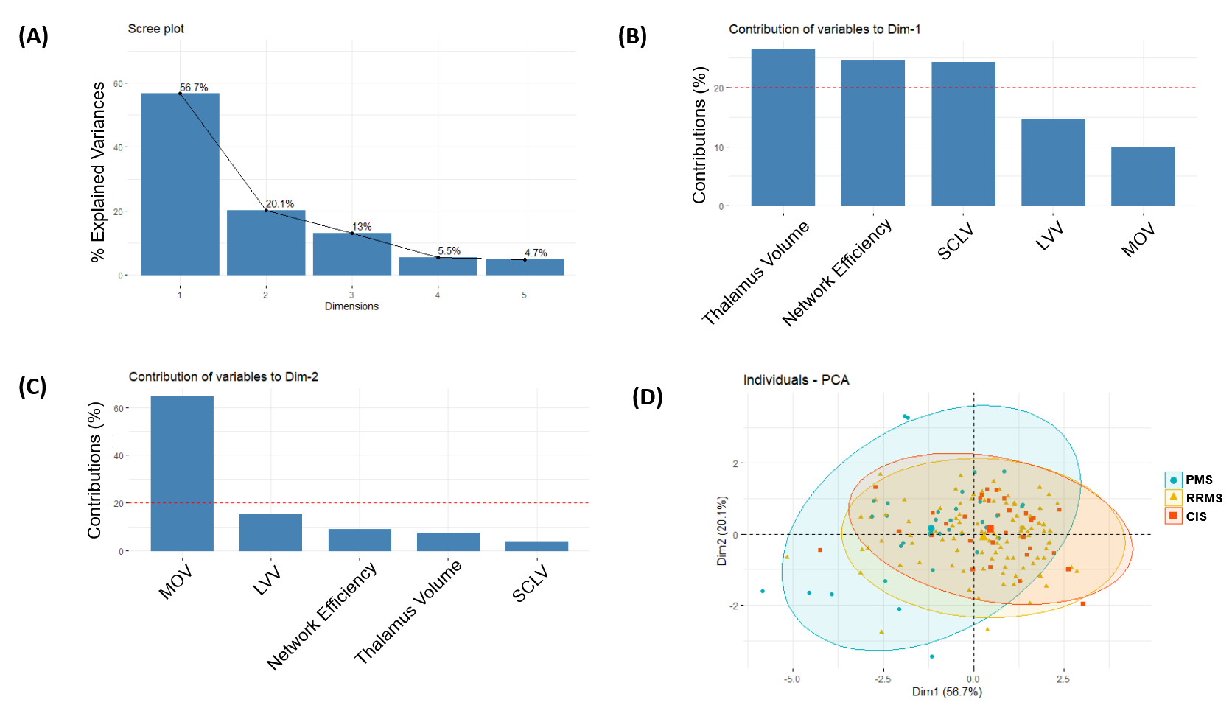
Principle Components

Slide 7
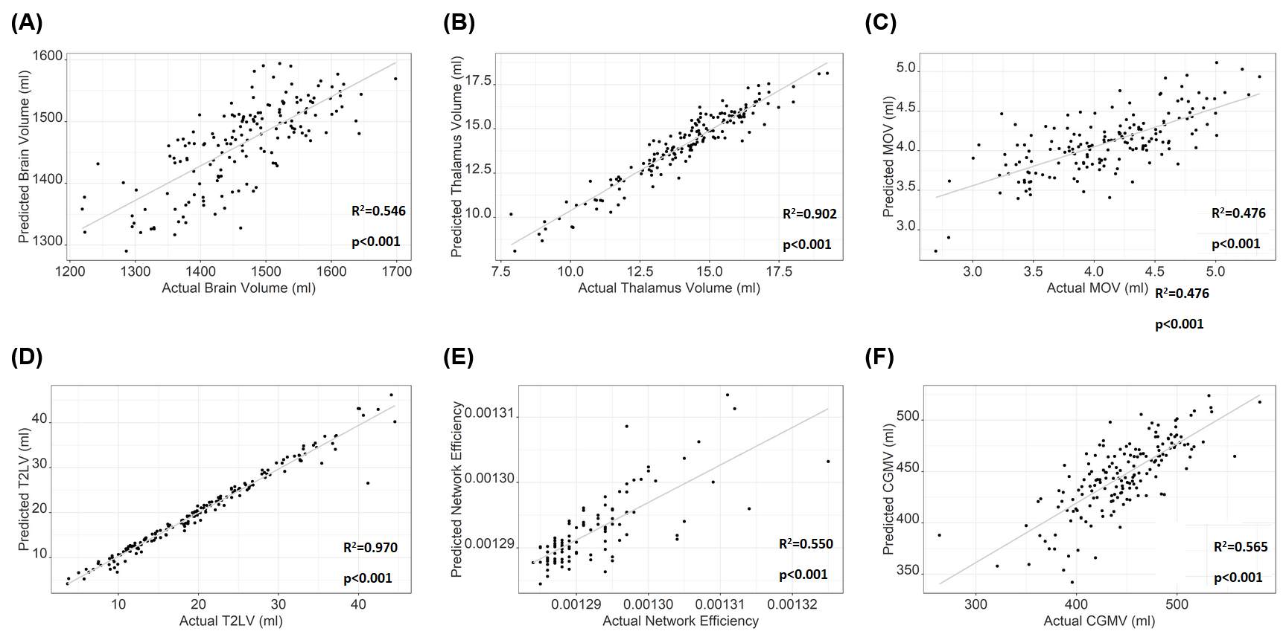
Predicting Scientific-Quality Data

Slide 8
Predicting Disability 5 Years Later
 |  | All
 |  | Β | p
EDSS | LVV | 0.110 | 0.174
All: n=172, R²=0.279, p<0.001 RRMS: n=100, R²=0.164, p<0.001 PMS: n=50, R²=0.063, p=0.177 | Thalamus Volume | -0.018 | 0.875
 | MOV | -0.288 | 0.001
 | SCLV | 0.214 | 0.045
 | Network Efficiency | 0.134 | 0.216
SDMT | LVV | -0.107 | 0.215
All: n=123, R²=0.382, p<0.001 RRMS: n=72, R²=0.227, p<0.001 PMS: n=40, R²=0.501, p<0.001 | Thalamus Volume | 0.397 | 0.002
 | MOV | 0.083 | 0.403
 | SCLV | -0.042 | 0.709
 | Network Efficiency | -0.170 | 0.149

Slide 9
Predicting 5-year EDSS Disability Progression
 |  | RRMS (n=99)
 |  | % Disease Progression, 32.0
 |  | β | p
T2-FLAIR Model | LVV | -0.001 | 0.993
RRMS: %Correctly Classified=69.8 R²=0.145, p=0.034 | Thalamus Volume | -0.048 | 0.760
 | MOV | -0.080 | 0.517
 | SCLV | -0.181 | 0.230
 | Network Efficiency | -0.122 | 0.411
Standard Research-Quality MRI Model | BPV | 0.202 | 0.341
RRMS: %Correctly Classified=72.4 R²=0.196, p=0.022 | Thalamus Volume | 0.002 | 0.992
 | MOV | 0.061 | 0.567
 | T2LV | 0.235 | 0.066
 | T1LV | 0.104 | 0.402
 | NCV | 0.273 | 0.084

Slide 10
Conclusions
The T2FLAIR measures. . .
(A) Are well-correlated with research-quality metrics
(B) Predict clinical disability cross-sectionally
(C) Perform similarly to research-quality imaging in longitudinal predictions
Therefore, these metrics. . .
(A) Are a useful tool for investigation of legacy datasets
(B) Are good candidates for development of clinical prediction models

Slide 11
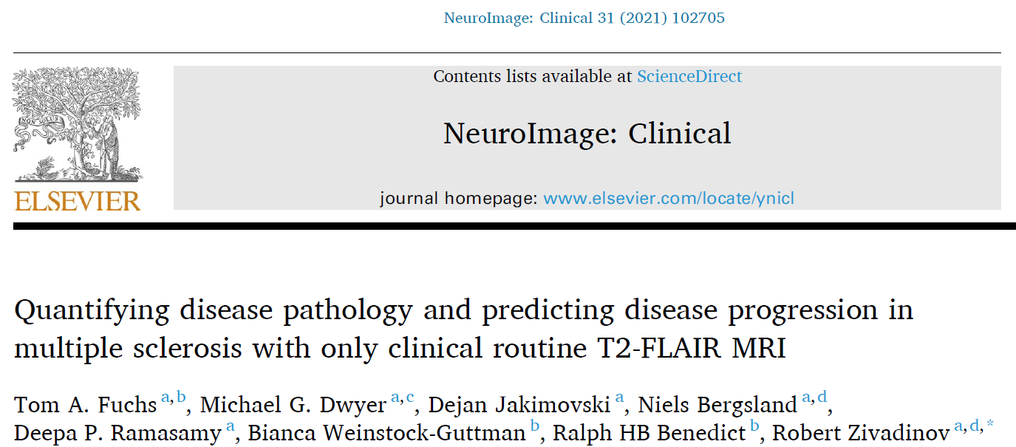
Questions?
Thanks To:
Robert Zivadinov, MD, PhD
Michael Dwyer, PhD
Niels Bergland, PhD
Ralph Benedict, PhD
Bianca Weinstock-Guttman, MD
Dejan Jakimovski, MD PhD
Institutions:
Jacobs School of Medicine and Biomedical Sciences
Buffalo Neuroimaging Analysis Center
Jacobs Multiple Sclerosis Treatment and Research Center

