Slide 1


Cognitive Progression Independent of Relapse activity in multiple sclerosis
TA Fuchs, R Zivadinov, MG Dwyer, MM Schoonheim, EMM Strijbis, B Weinstock-Guttman, RHB Benedict

Slide 2
Disclosures
TA Fuchs received research support from the European Committee for Treatment and Research in Multiple Sclerosis, serves on the editorial board of Frontiers in Neurology, and received consulting fees for Click Therapeutics.
R Zivadinov received personal compensation from Bristol Myers Squibb, EMD Serono, Sanofi, Protembis, Janssen, 415 Capital, and Novartis for speaking and consultant fees. He received financial support for research activities from Sanofi, Novartis, Bristol Myers Squibb, Octave, Mapi Pharma, CorEvitas, Protembis and V-WAVE Medical.
MG Dwyer received grant support from Novartis, Bristol Myers Squibb, Mapi Pharma, Merck Serono, Keystone Heart Ltd., Protembis GmbH, and V-Wave Ltd., and consulting fees Bristol Myers Squibb, Merck Serono, and Keystone Heart Ltd.
MM Schoonheim serves on the editorial board of Neurology and Frontiers in Neurology, receives research support from the Dutch MS Research Foundation, Eurostars-EUREKA, ARSEP, Amsterdam Neuroscience, MAGNIMS and ZonMW (Vidi grant, project number 09150172010056) and has served as a consultant for or received research support from Atara Biotherapeutics, Biogen, Celgene/Bristol Meyers Squibb, EIP, Sanofi, MedDay and Merck.
EMM Strijbis has nothing to disclose
B Weinstock-Guttman received honoraria as a speaker and/or as a consultant for Biogen Idec, Teva Pharmaceuticals, EMD Serono, Genzyme, Sanofi, Genentech, Novartis, Celgene/BMS, Janssen, Labcorp, TG therapeutics, and Horizon. Dr Weinstock-Guttman received research funds from Biogen Idec, EMD Serono, Genzyme, Genentech, Sanofi, Novartis.
RHB Benedict: Received consultation or speaking fees from Bristol Myer Squibb, Biogen, Merck, EMD Serono, Roche, Verasci, Immune Therapeutics, Novartis, and Sanofi-Genzyme. He has received research support from Biogen, Bristol Meyers Squibb, Genzyme, Genentech, Novartis, National Institutes of Health, National Multiple Sclerosis Society, Verasci. He consults for Immunic Therapeutics, Latin American Committee for Treatment and Research in Multiple Sclerosis, Merck, Novartis, Roche, Sanofi. He is on speaker bureau for Biogen, Bristol Meyers Squibb, EMD Serono. He received royalties from Psychological Assessment Resources.

Slide 3
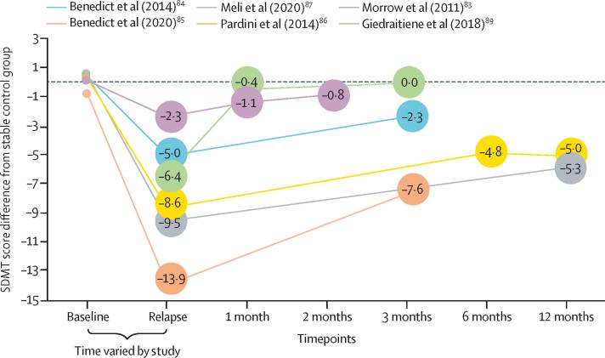
Cognitive Decline During Relapse
Notes:
Many groups have replicated results showing cognitive decline during relapse with recovery much like that seen for physical disabilirt. Has been validated in a recent large-scale prospective study.

Slide 4


Progression Independent of Relapse Activity
Notes:
Used to think relapse was driver of disability in RRMS. But are now seeing that as much as 2/3 of CDW is PIRA. All based on EDSS.
Must keep in mind that may be more common in the modern era thanks to stronger control over relapse, therefore masking these effects.
But still shows us the importance of disease monitoring methods that go beyond control of relapse.

Slide 5
Aim
Characterize the extent to which cognitive decline occurs independent of relapse in relapsing-remitting multiple sclerosis

Slide 6

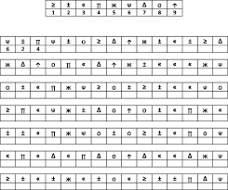

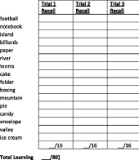
Cognitive Testing
Notes:
And although these tests only take 12 minutes, the three allow us to assess three different cognitive domains, CPS, VSPM, and VM

Slide 7
Cognitive Testing
~8 years
Notes:
Median of 3 (IQR 2-4) BICAMS assessments. Mean 8.1 years (SD 3). Mean 3.2 years between assessments.

Slide 8
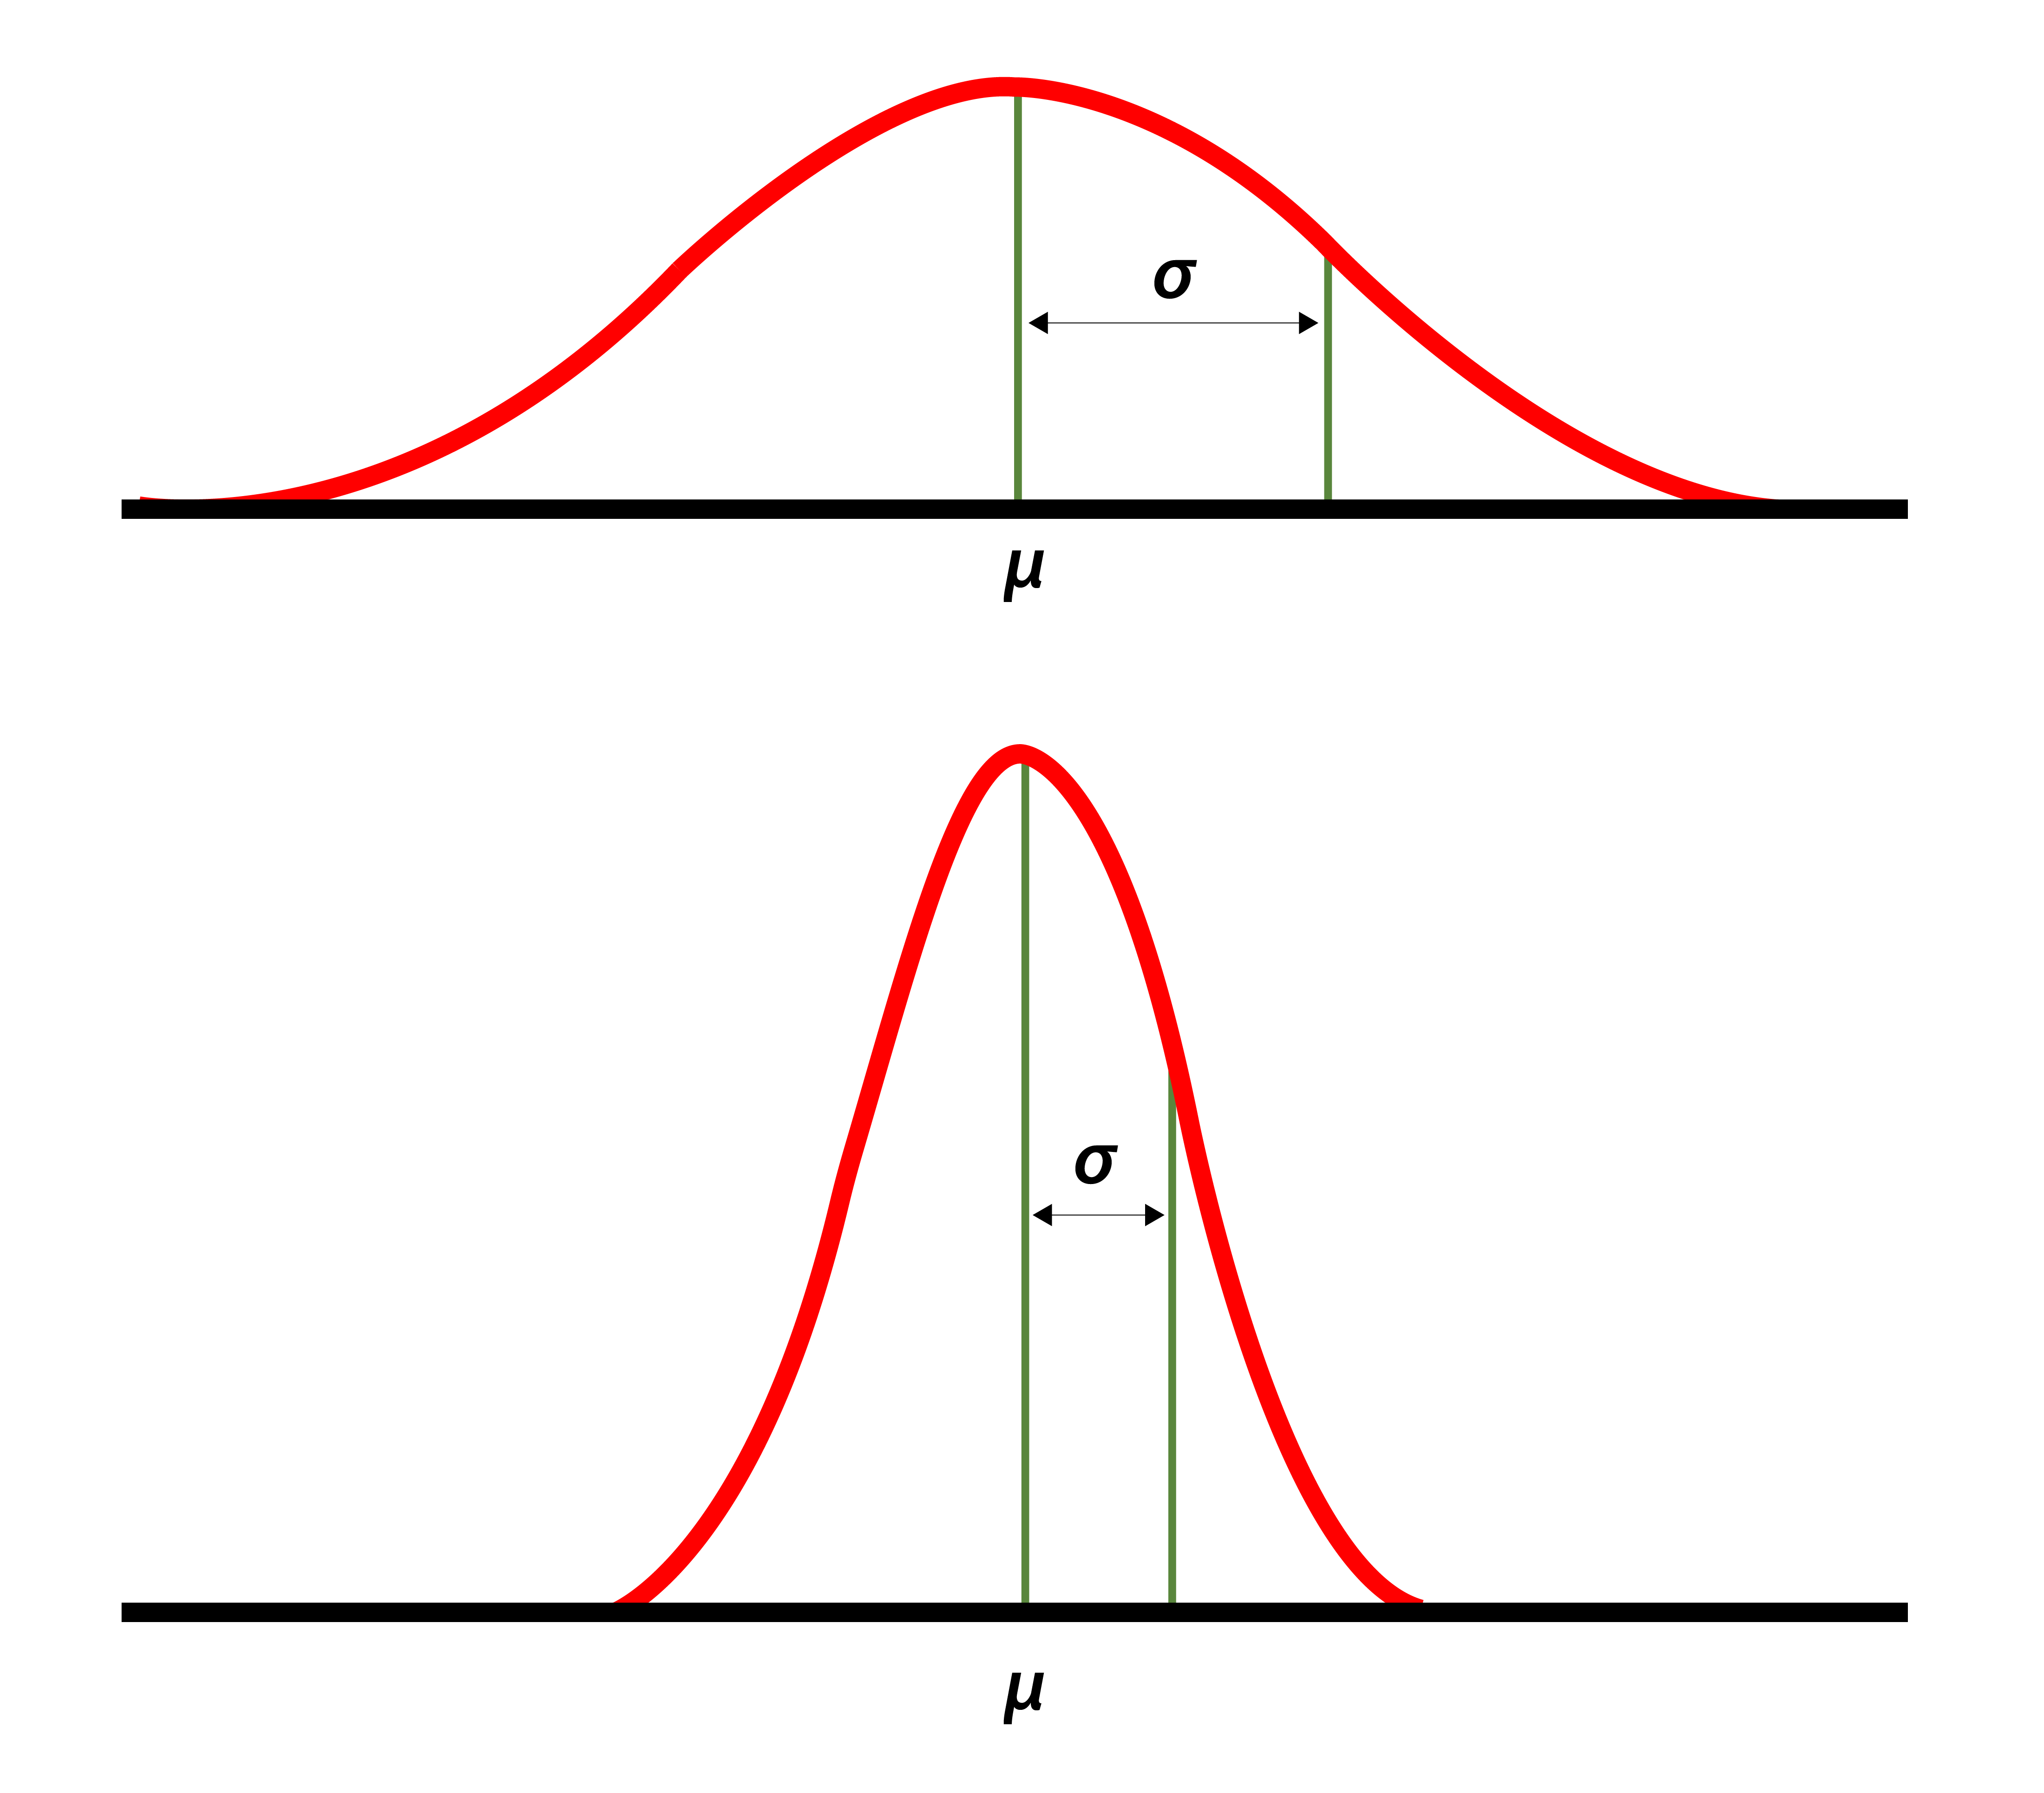
Defining Cognitive Decline
Notes:
Decline as 1 SD based on 54 age-matched HCs. Done for each test separately. More conservative than RCI statistically mmeaningful and clinically meaningful decline. Here, 10 pts on SDMT vs present standard of 8pts set

Slide 9
Defining Cognitive PIRA
Notes:
Cognitive PIRA: Decline with NO relapse between assessments and with NO relapse within 9 months of second assessment
Otherwise, considered Cognitive RAW

Slide 10
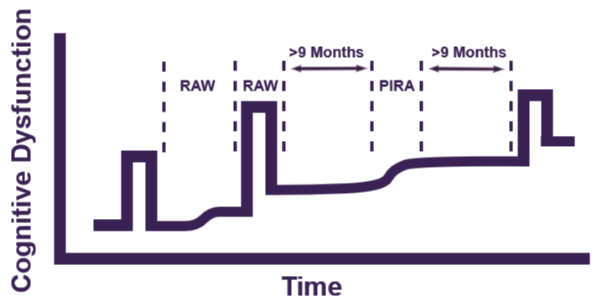
Defining Cognitive PIRA
PIRA=progression independent of relapse activity; RAW=relapse associated worsening
Notes:
Cognitive PIRA: Decline with NO relapse between assessments and with NO relapse within 9 months of second assessment
Otherwise, considered Cognitive RAW. 9 months used because wanted to be more conservative, given that we do not have confirmed cognitive progression available.
Although EDSS PIRA has been less conservative (30 days after relapse and 90 days prior), we chose to be extra conservative in our definition given out inability to provide “confirmed” worsening.

Slide 11
Defining Cognitive PIRA
PIRA=progression independent of relapse activity; RAW=relapse associated worsening
Notes:
Cognitive PIRA: Decline with NO relapse between assessments and with NO relapse within 9 months of second assessment
Otherwise, considered Cognitive RAW

Slide 12
Defining Cognitive PIRA
PIRA=progression independent of relapse activity; RAW=relapse associated worsening
Notes:
Cognitive PIRA: Decline with NO relapse between assessments and with NO relapse within 9 months of second assessment
Otherwise, considered Cognitive RAW

Slide 13
Study Sample
RRMS (No, %) | 336, 100%
Female (No, %) | 271, 80.7%
Age (mean, SD) | 43.1, 9.5
Disease Duration (mean, SD) | 10.8, 8.4
Disease Modifying Therapy (No, %) | 184, 54.8%
EDSS (median, IQR) | 2.5, 1.5-3.5
SDMT (mean, SD) | 51.3, 12.8
CVLT-II (mean, SD) | 49.8, 11
BVMT-R (mean, SD) | 21.5, 7.2
RRMS=relapsing-remitting multiple sclerosis; EDSS=Expanded Disability Status Scale; SDMT=Symbol Digit Modalities Test; BVMT-R=Brief Visuospatial Memory Test Revised; CVLT-II=California Verbal Learning Test-II
Notes:
Mostly on low-efficacy or no disease modifying therapy. Only 3% on natalizumab at baseline

Slide 14
Cognitive Decline
SDMT=Symbol Digit Modalities Test; CVLT-II=California Verbal Learning Test-II; BVMT-R=Brief Visuospatial Memory Test Revised

Slide 15
PIRA: Cognition versus EDSS
PIRA=progression independent of relapse activity; RAW=relapse associated worsening; EDSS=Expanded Disability Status Scale

Slide 16
Cognitive PIRA Independent of EDSS Worsening
PIRA=progression independent of relapse activity; RAW=relapse associated worsening

Slide 17

Conclusions
Cognitive dysfunction progresses independent of clinically-recorded relapse activity
  It is more common than RAW
  More observed by testing multiple domains
  It can occur independent of physical disability
  Frequency is likely over-estimated due to biases and under-reported relapse
  Control may be a useful future target for future disease modifying therapies
  Prospective research is needed
Notes:
Caveats: based on clinically defined and clinically captured relapse. Prospective research is needed to confirm.
Perhaps time to teach MS disability with diagrams that match reality, rather than fixate on relapses

Slide 18
Next Steps
Validate findings
Longer follow-up
Alternate definitions of PIRA
Compare sensitivity with EDSS
MRI associations
Prognostic value
Prospective design
Notes:
Alternates: distance from relapse, RCI, and confirmed cognitive decline

Slide 19


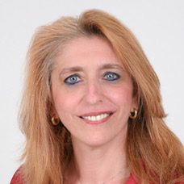


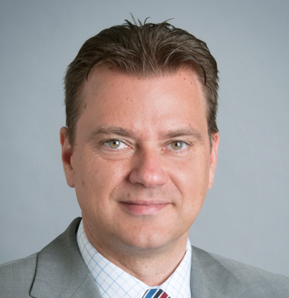

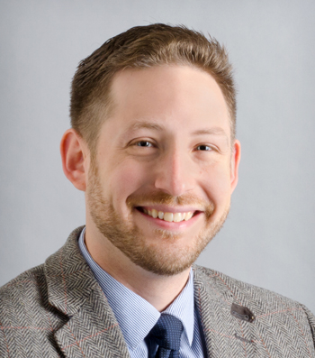
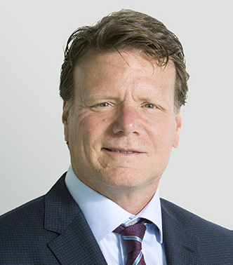

Thank you
Questions? t.fuchs@amsterdamumc.nl or see me at Poster Session 1, P036
Notes:
Thank collaborators, MS Milan for inviting me to present, ECTRIMS supporting my work. I invite you to please contact me with questions.

