Slide 1
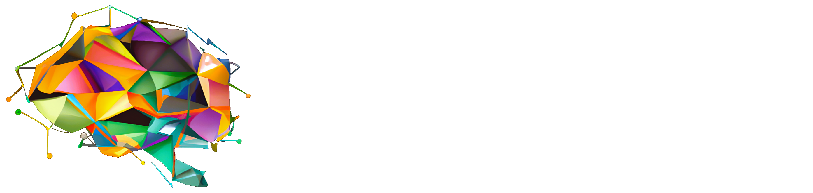
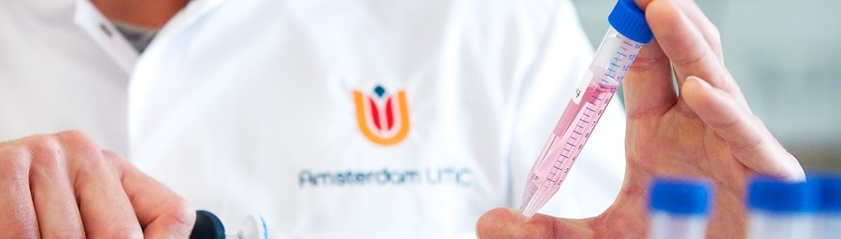
Cognitive progression independent of relapse in multiple sclerosis: multi-center characterization
Tom A. Fuchs, Stefano Ziccardi, Rick Hollestelle, Massimiliano Calabrese, Damiano Marastoni, Carolin Balloff, Ramona Hagler, Philipp Albrecht, Bianca Weinstock-Guttman, Robert Zivadinov, Tomas Uher, Dana Horakova, Joep Kilestein, Ralph Benedict, Eva M. Strijbis, Menno M. Schoonheim

Slide 2
Funding & disclosures
This work is funded by ECTRIMS, supporting the salary of Dr. Tom A Fuchs
TA Fuchs received research support from the European Committee for Treatment and Research in Multiple Sclerosis, serves on the editorial board of Frontiers in Neurology, and received consulting fees for Click Therapeutics.
R Zivadinov received personal compensation from Bristol Myers Squibb, EMD Serono, Sanofi, Protembis, Janssen, 415 Capital, and Novartis for speaking and consultant fees. He received financial support for research activities from Sanofi, Novartis, Bristol Myers Squibb, Octave, Mapi Pharma, CorEvitas, Protembis and V-WAVE Medical.
D Horakova received compensation for travel and/or speaker honoraria and/or consultant fees from Biogen, Novartis, Bayer, Sanofi, Roche, and Teva, as well as support for research activities from Biogen.
Stefano Ziccardi serves on the editorial board of Frontiers in Aging Neuroscience and Diagnostics.
MM Schoonheim serves on the editorial board of Neurology and Frontiers in Neurology, receives research support from the Dutch MS Research Foundation, Eurostars-EUREKA, ARSEP, Amsterdam Neuroscience, MAGNIMS and ZonMW (Vidi grant, project number 09150172010056) and has served as a consultant for or received research support from Atara Biotherapeutics, Biogen, Celgene/Bristol Meyers Squibb, EIP, Sanofi, MedDay and Merck.
EM Strijbis serves on the editorial board of Frontiers in Neurology and receives research support from Stichting MS Research and ZonMS. Received speaker fees from Merck and Novartis.
J Killestein: received consulting fees for F. Hoffmann-La Roche, Biogen, Teva, Merck, Novartis, Sandoz and Sanofi/Genzyme (payments to institution); reports speaker relationships with F. Hoffmann-La Roche, Biogen, Teva, Merck, Novartis and Sanofi/Genzyme (payments to institution); adjudication committee of MS clinical trials of Immunic (payments to institution).
B Weinstock-Guttman received honoraria as a speaker and/or as a consultant for Biogen Idec, Teva Pharmaceuticals, EMD Serono, Genzyme, Sanofi, Genentech, Novartis, Celgene/BMS, Janssen, Labcorp, TG therapeutics, and Horizon. Dr Weinstock-Guttman received research funds from Biogen Idec, EMD Serono, Genzyme, Genentech, Sanofi, Novartis.
RHB Benedict: Received consultation or speaking fees from Bristol Myer Squibb, Biogen, Merck, EMD Serono, Roche, Verasci, Immune Therapeutics, Novartis, and Sanofi-Genzyme. He has received research support from Biogen, Bristol Meyers Squibb, Genzyme, Genentech, Novartis, National Institutes of Health, National Multiple Sclerosis Society, Verasci. He consults for Immunic Therapeutics, Latin American Committee for Treatment and Research in Multiple Sclerosis, Merck, Novartis, Roche, Sanofi. He is on speaker bureau for Biogen, Bristol Meyers Squibb, EMD Serono. He received royalties from Psychological Assessment Resources.

Slide 3
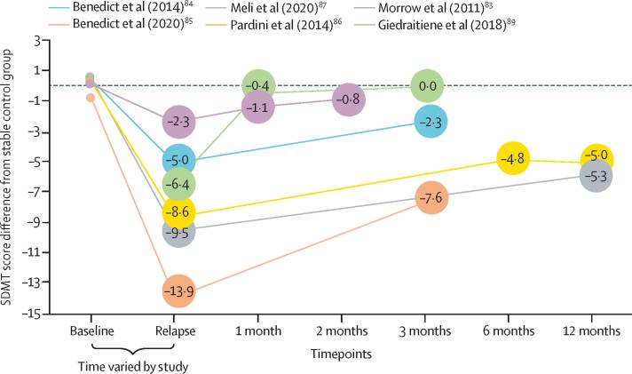
Cognitive relapse
Several studies have demonstrated that cognitive decline can occur in isolated relapses
Benedict et al., Lancet Neurology, 2020

Slide 4

Progression independent of relapse (PIRA)
Disability worsening in RRMS often progresses independent of relapses (PIRA). Cognitive PIRA and the effects of therapy are less well understood.
Lublin et al, Brain, 2022

Slide 5
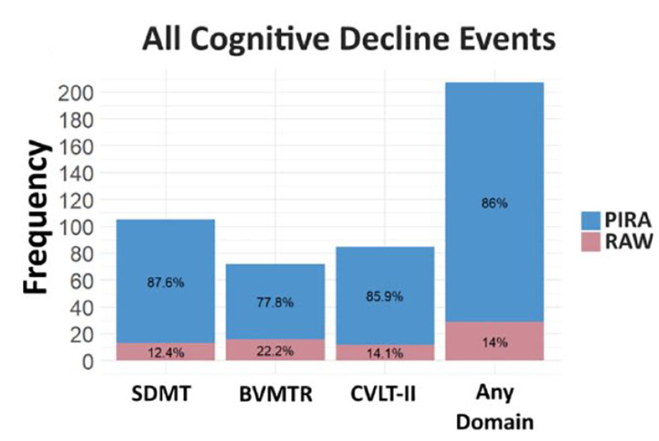
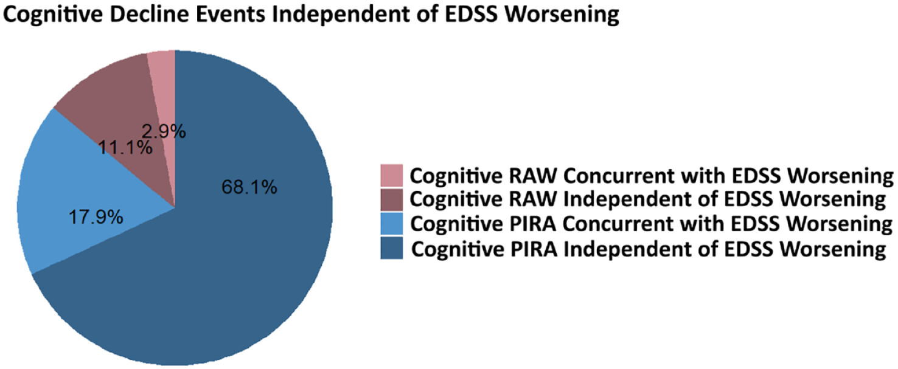
Cognitive PIRA
Cognitive decline is a window into smoldering plaques/neurodegeneration. Most cognitive decline is PIRA and independent of EDSS worsening
Fuchs et al, MSJ, 2024

Slide 6
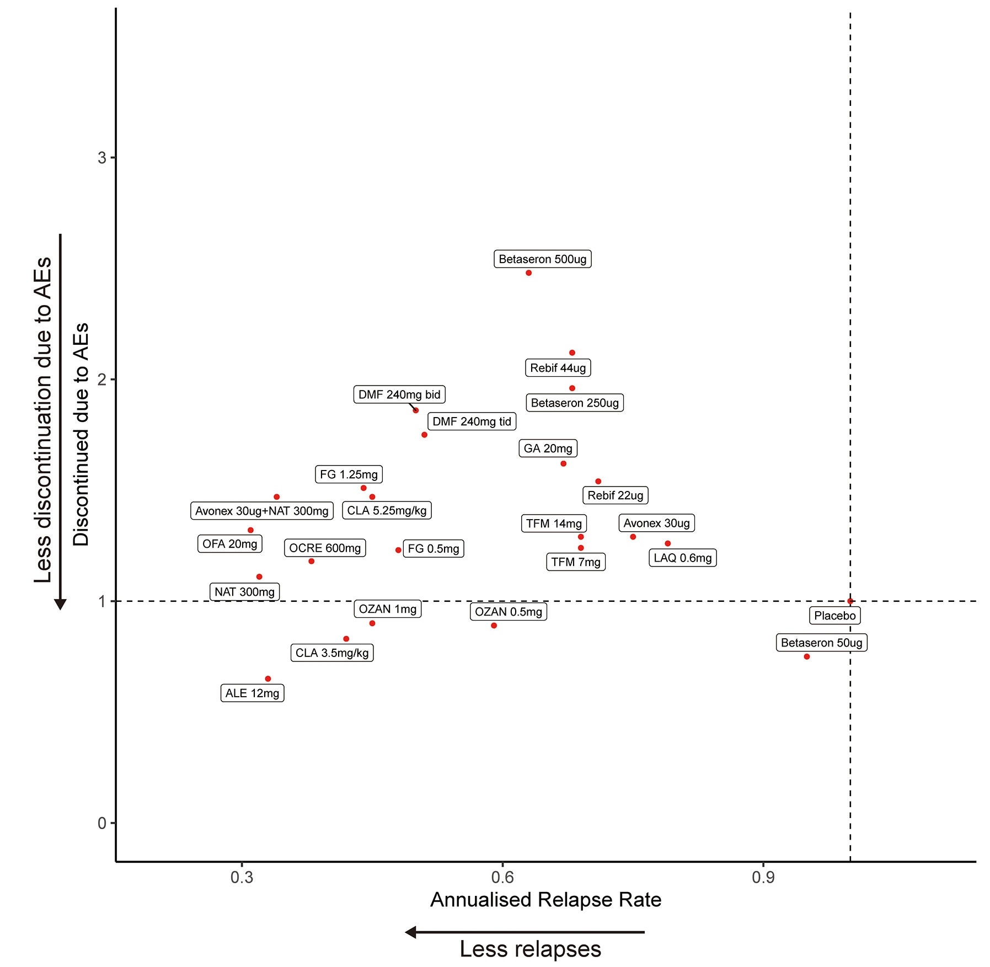
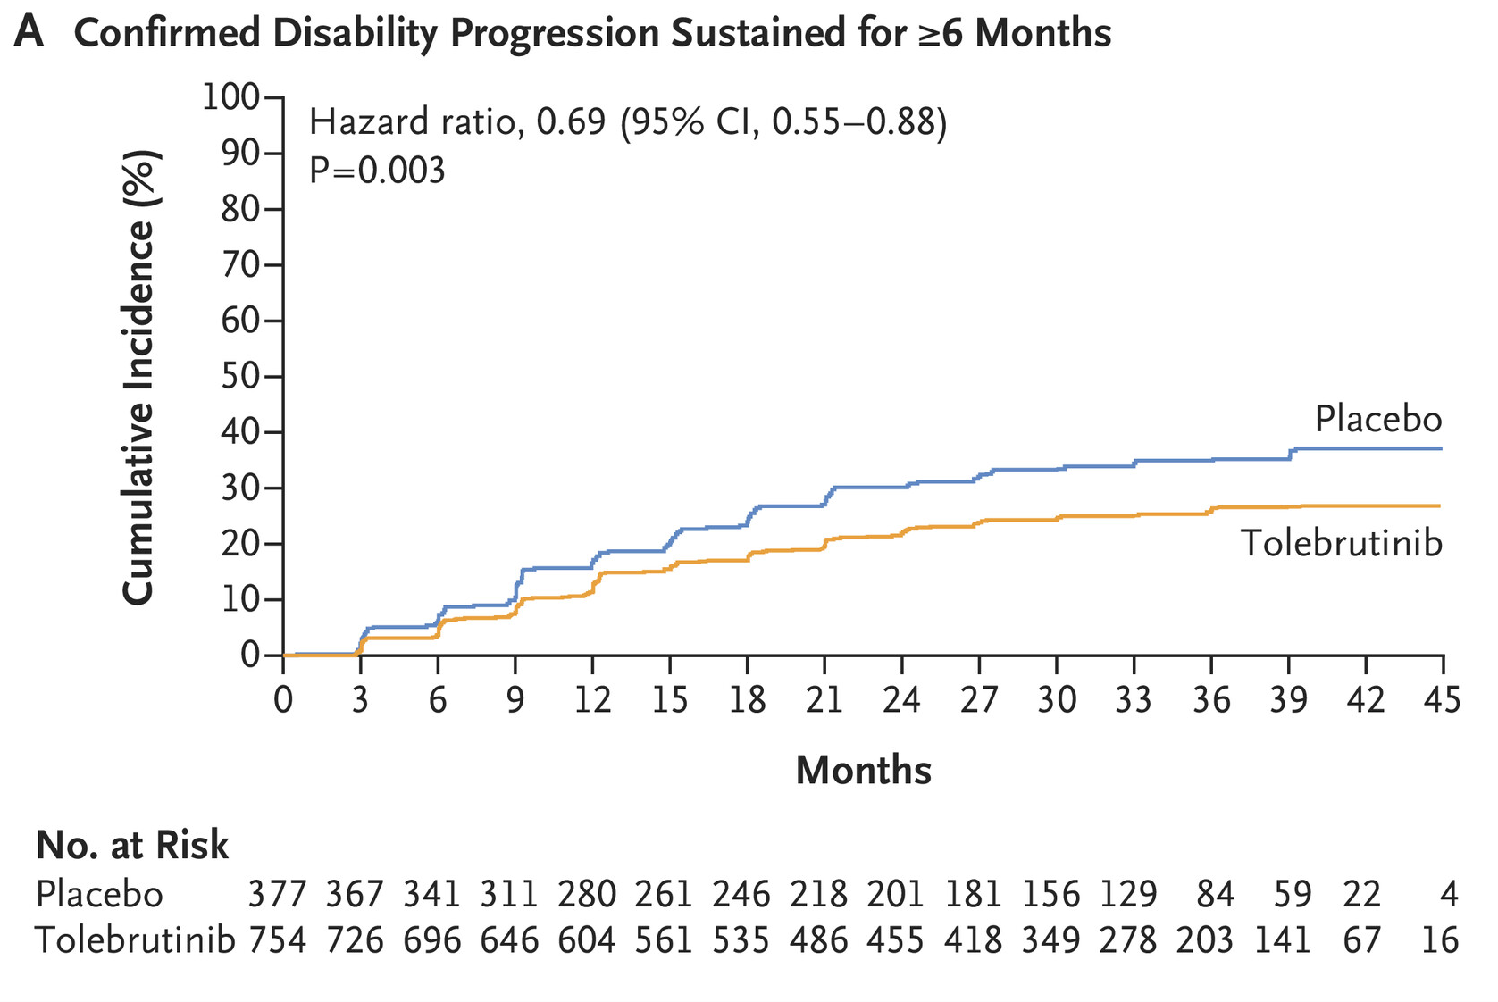
Relevance to treatment
Smoldering disease matters: New treatment options are showing potential for increased control of relapse-free smoldering MS progression.
Liu et al, Autoimmunity Reviews, 2021; Fox et al, NEJM, 2025
Notes:
Here emphacize that historically – treatments aimed at relapse control. Now, newer age of treatments are also showing potential for greater control in relapse-free smoldering progressionMS.

Slide 7
Aims
Characterize the occurrence of cognitive PIRA in a multi-center retrospective dataset and examine the impact of disease modifying therapy (DMT) on this phenomenon

Slide 8
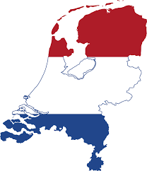

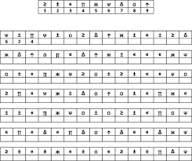

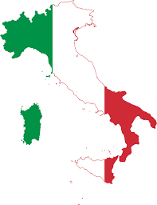

Methods
Cognitive trajectories were assessed with retrospective RRMS clinical data from Amsterdam, Prague, Dusseldorf, and Verona using the Symbol Digit Modalities Test over a mean of 3 years
~3 years

Slide 9
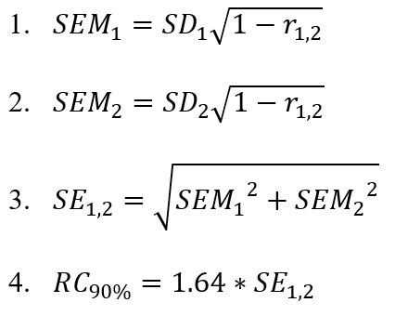
Methods
Cognitive trajectories were assessed with retrospective RRMS clinical data from Amsterdam, Prague, Dusseldorf, and Verona using the Symbol Digit Modalities Test over a mean of 3 years
~3 years

Slide 10
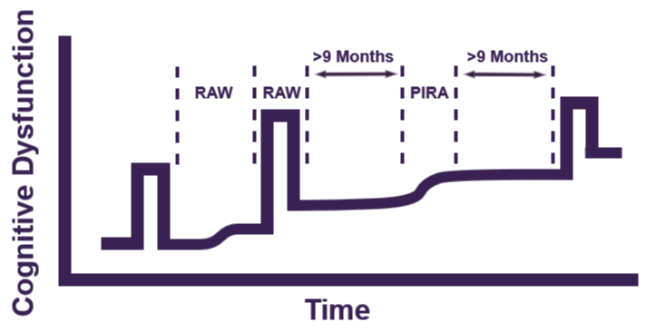
Methods
Cognitive trajectories were assessed with retrospective RRMS clinical data from Amsterdam, Prague, Dusseldorf, and Verona using the Symbol Digit Modalities Test over a mean of 3 years
~3 years

Slide 11
Methods
Cognitive trajectories were assessed with retrospective RRMS clinical data from Amsterdam, Prague, Dusseldorf, and Verona using the Symbol Digit Modalities Test over a mean of 3 years
High-efficacy DMT: Alemtuzumab, Daclizumab, Dalfampridine, Natalizumab, Ocrelizumab, Ofatumumab, Rituximab, Siponimod, Mitoxantrone, Aniselimod or Laquinimod
Low-efficacy DMT: Glatiramer Acetate, Interferon, Dimethyl Fumerate, Azathioprine, Teriflunomide, Fingolimod or Cladribine
~3 years
He et al, The Lancet Neurology, 2020

Slide 12
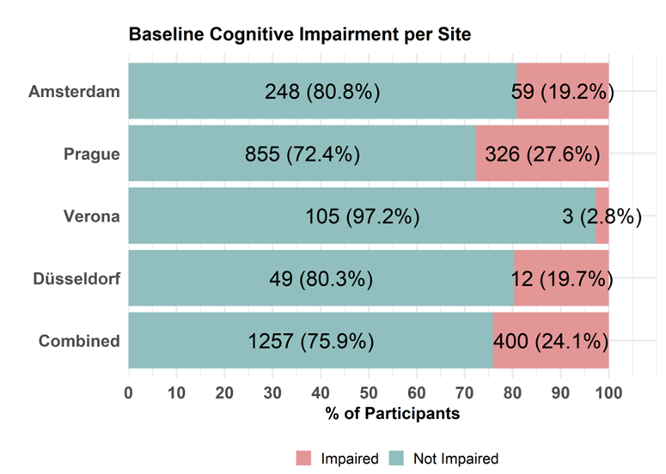
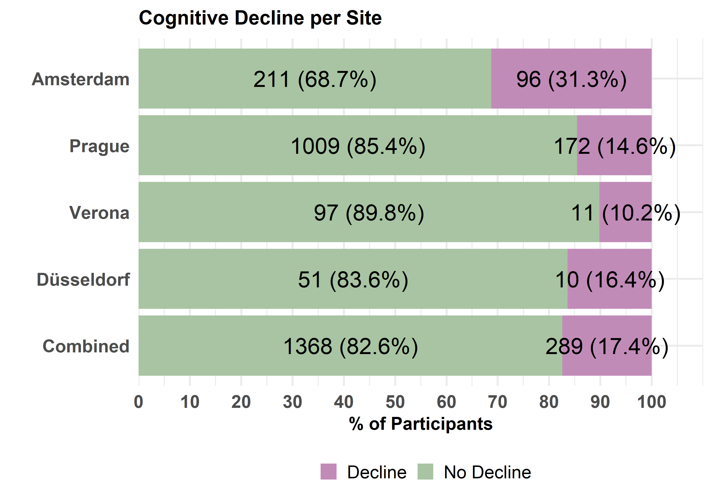
Results
Cognitive impairment and cognitive decline varied by site

Slide 13
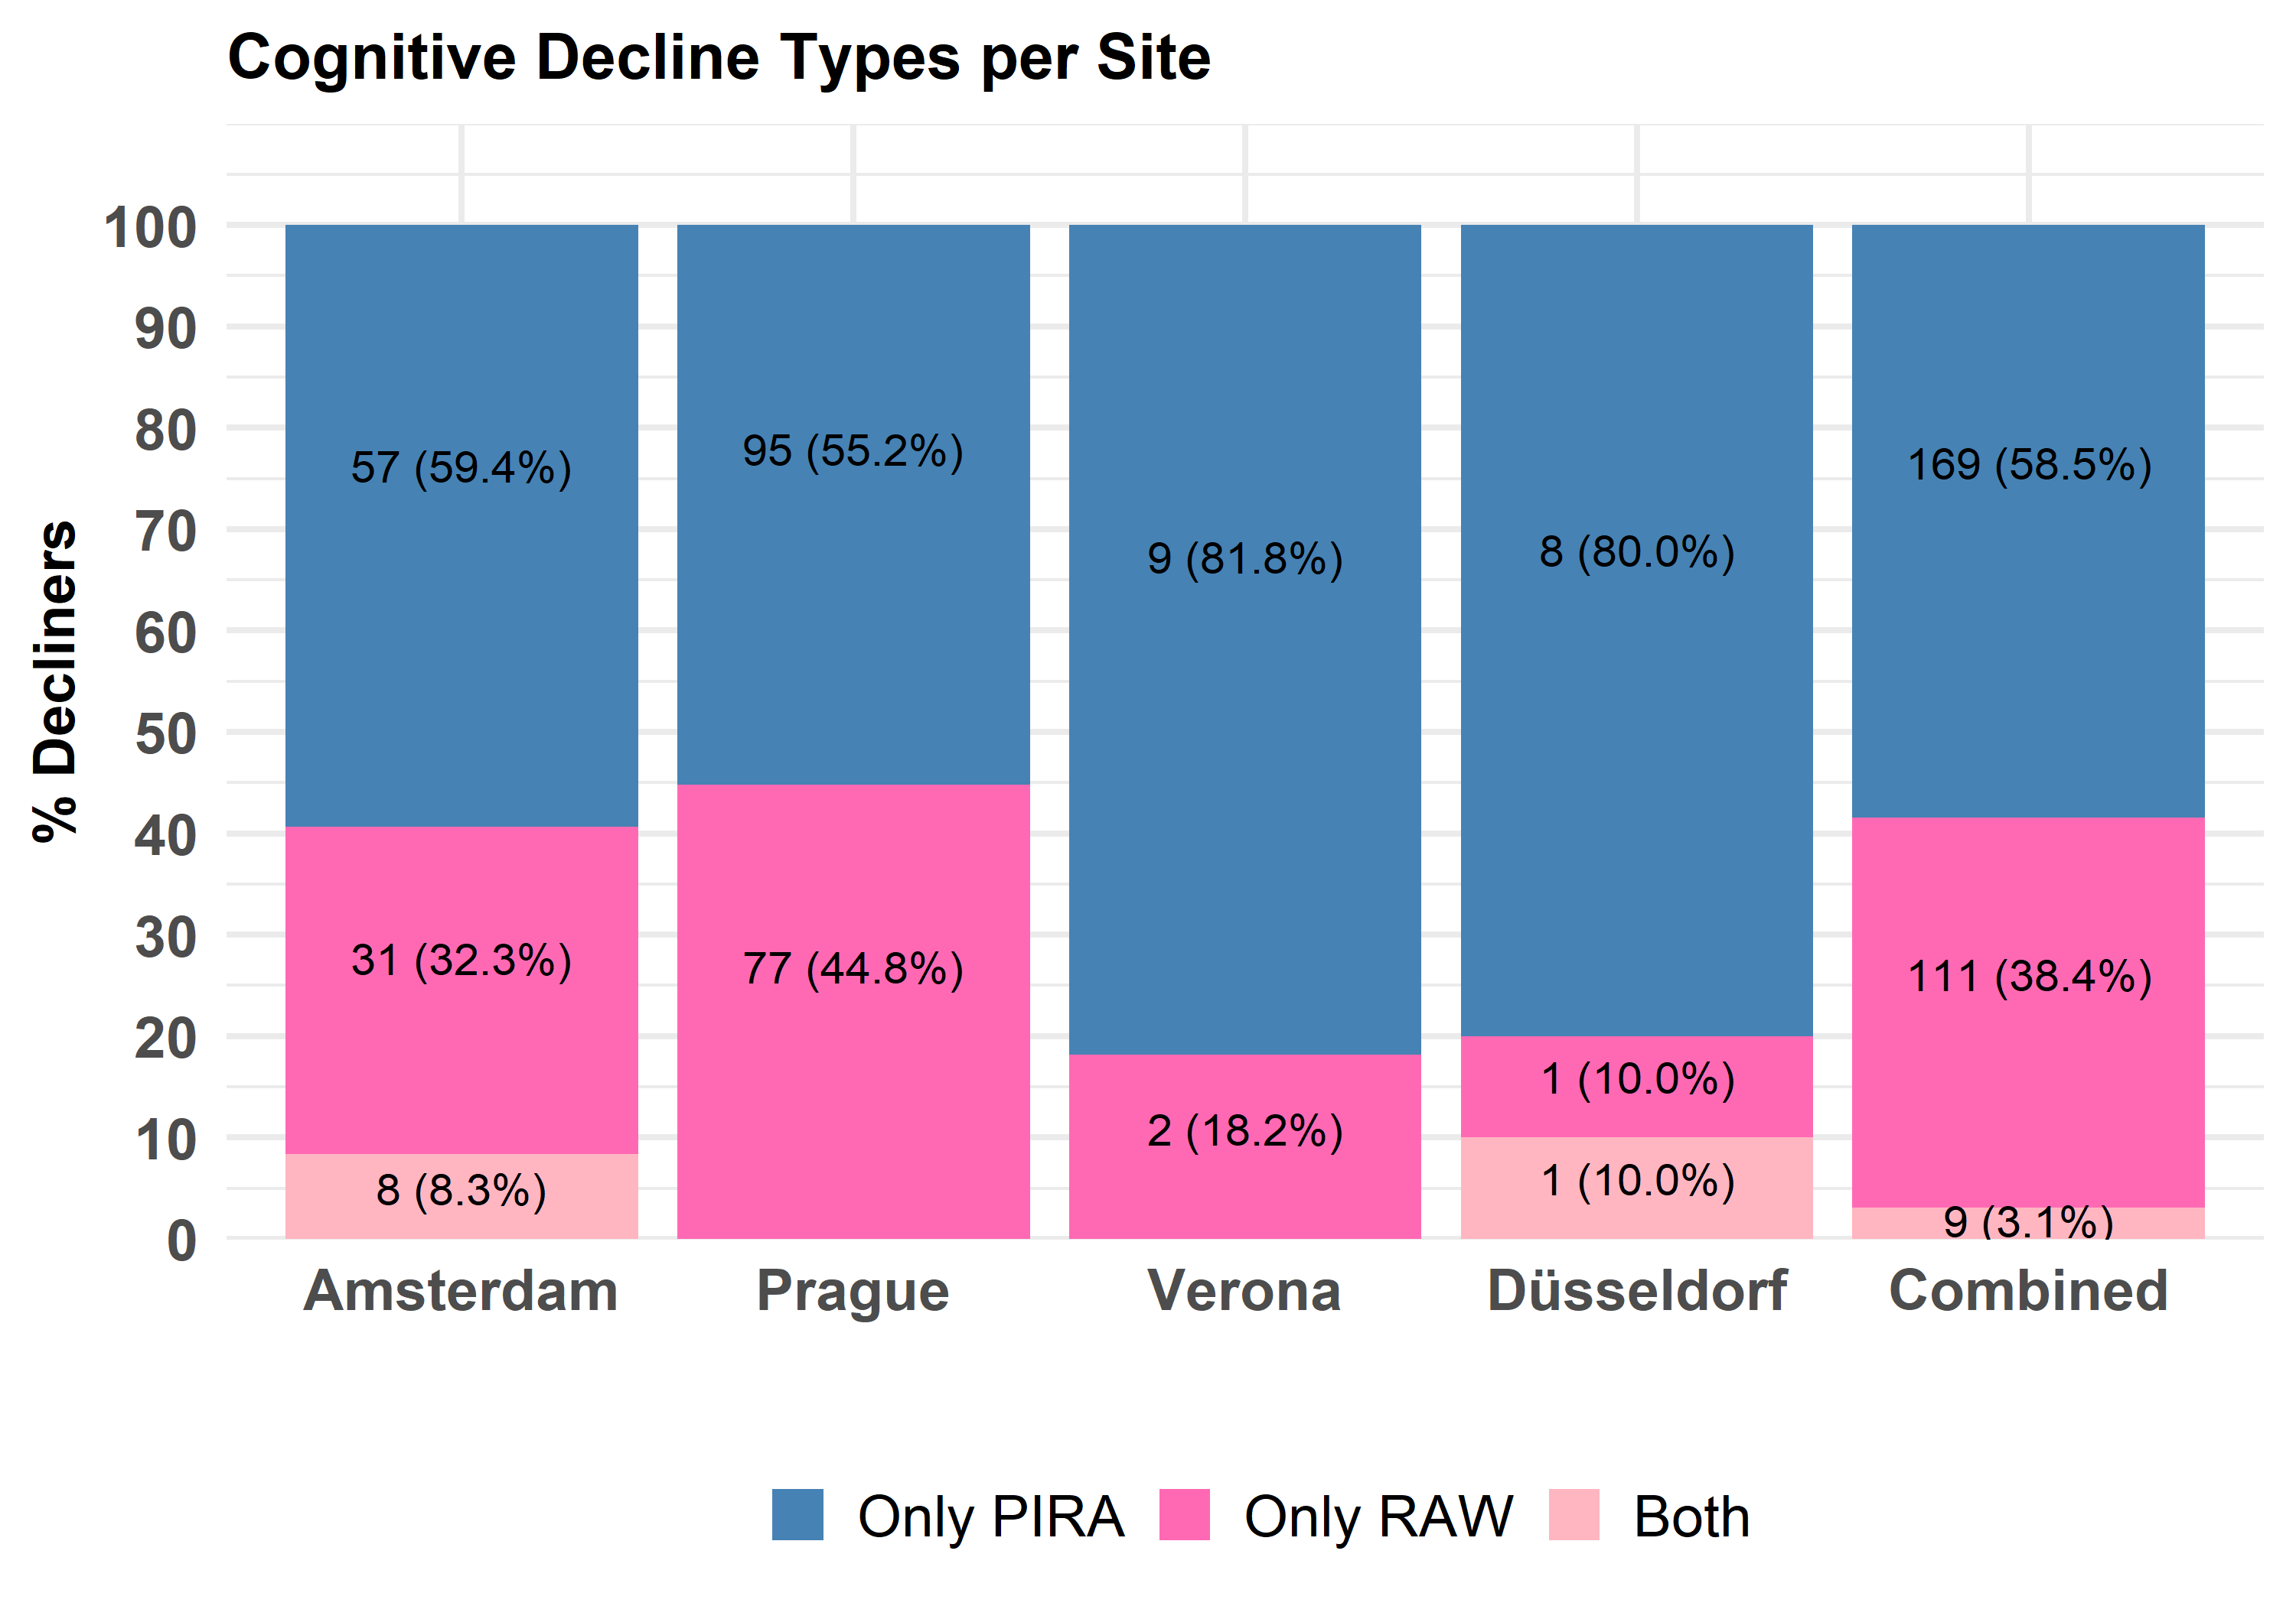
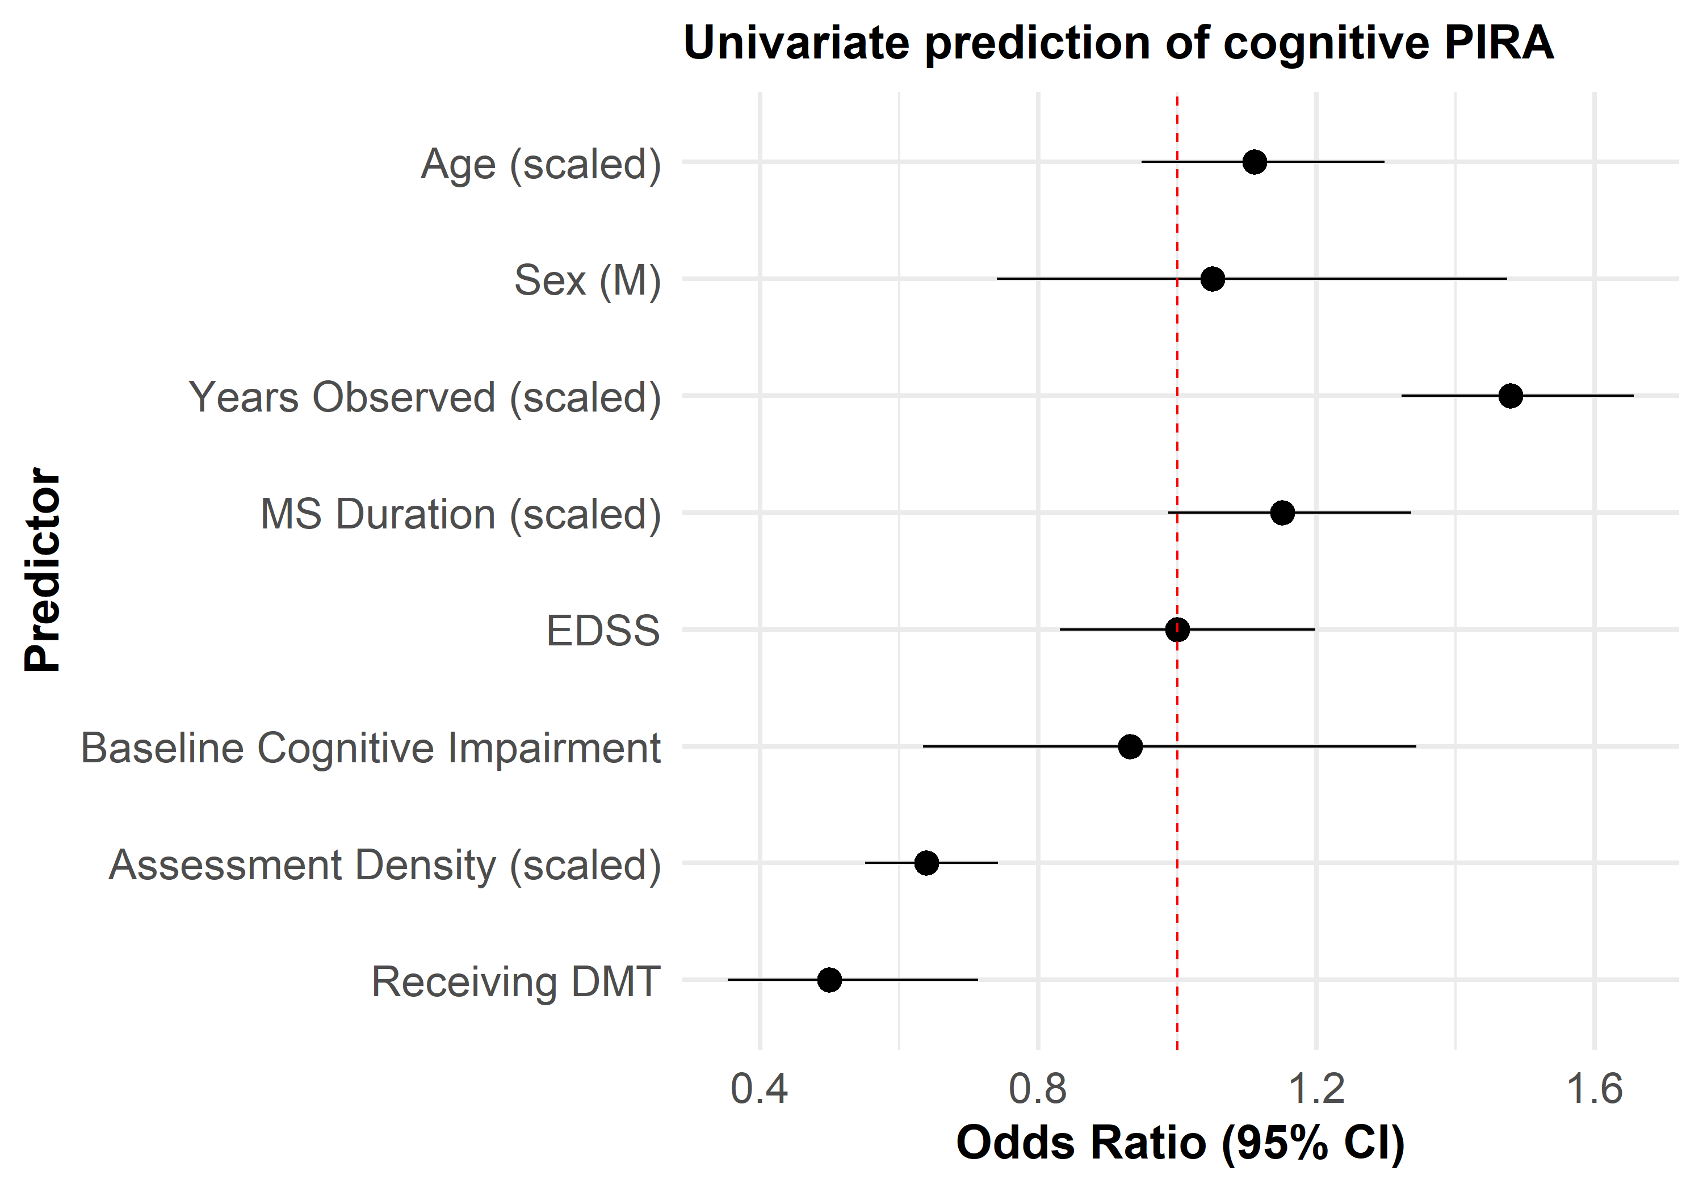
Results
Cognitive PIRA accounted for most cognitive decline. Differences across sites were partly explained by discrepancies in assessment density and DMT use.

Slide 14
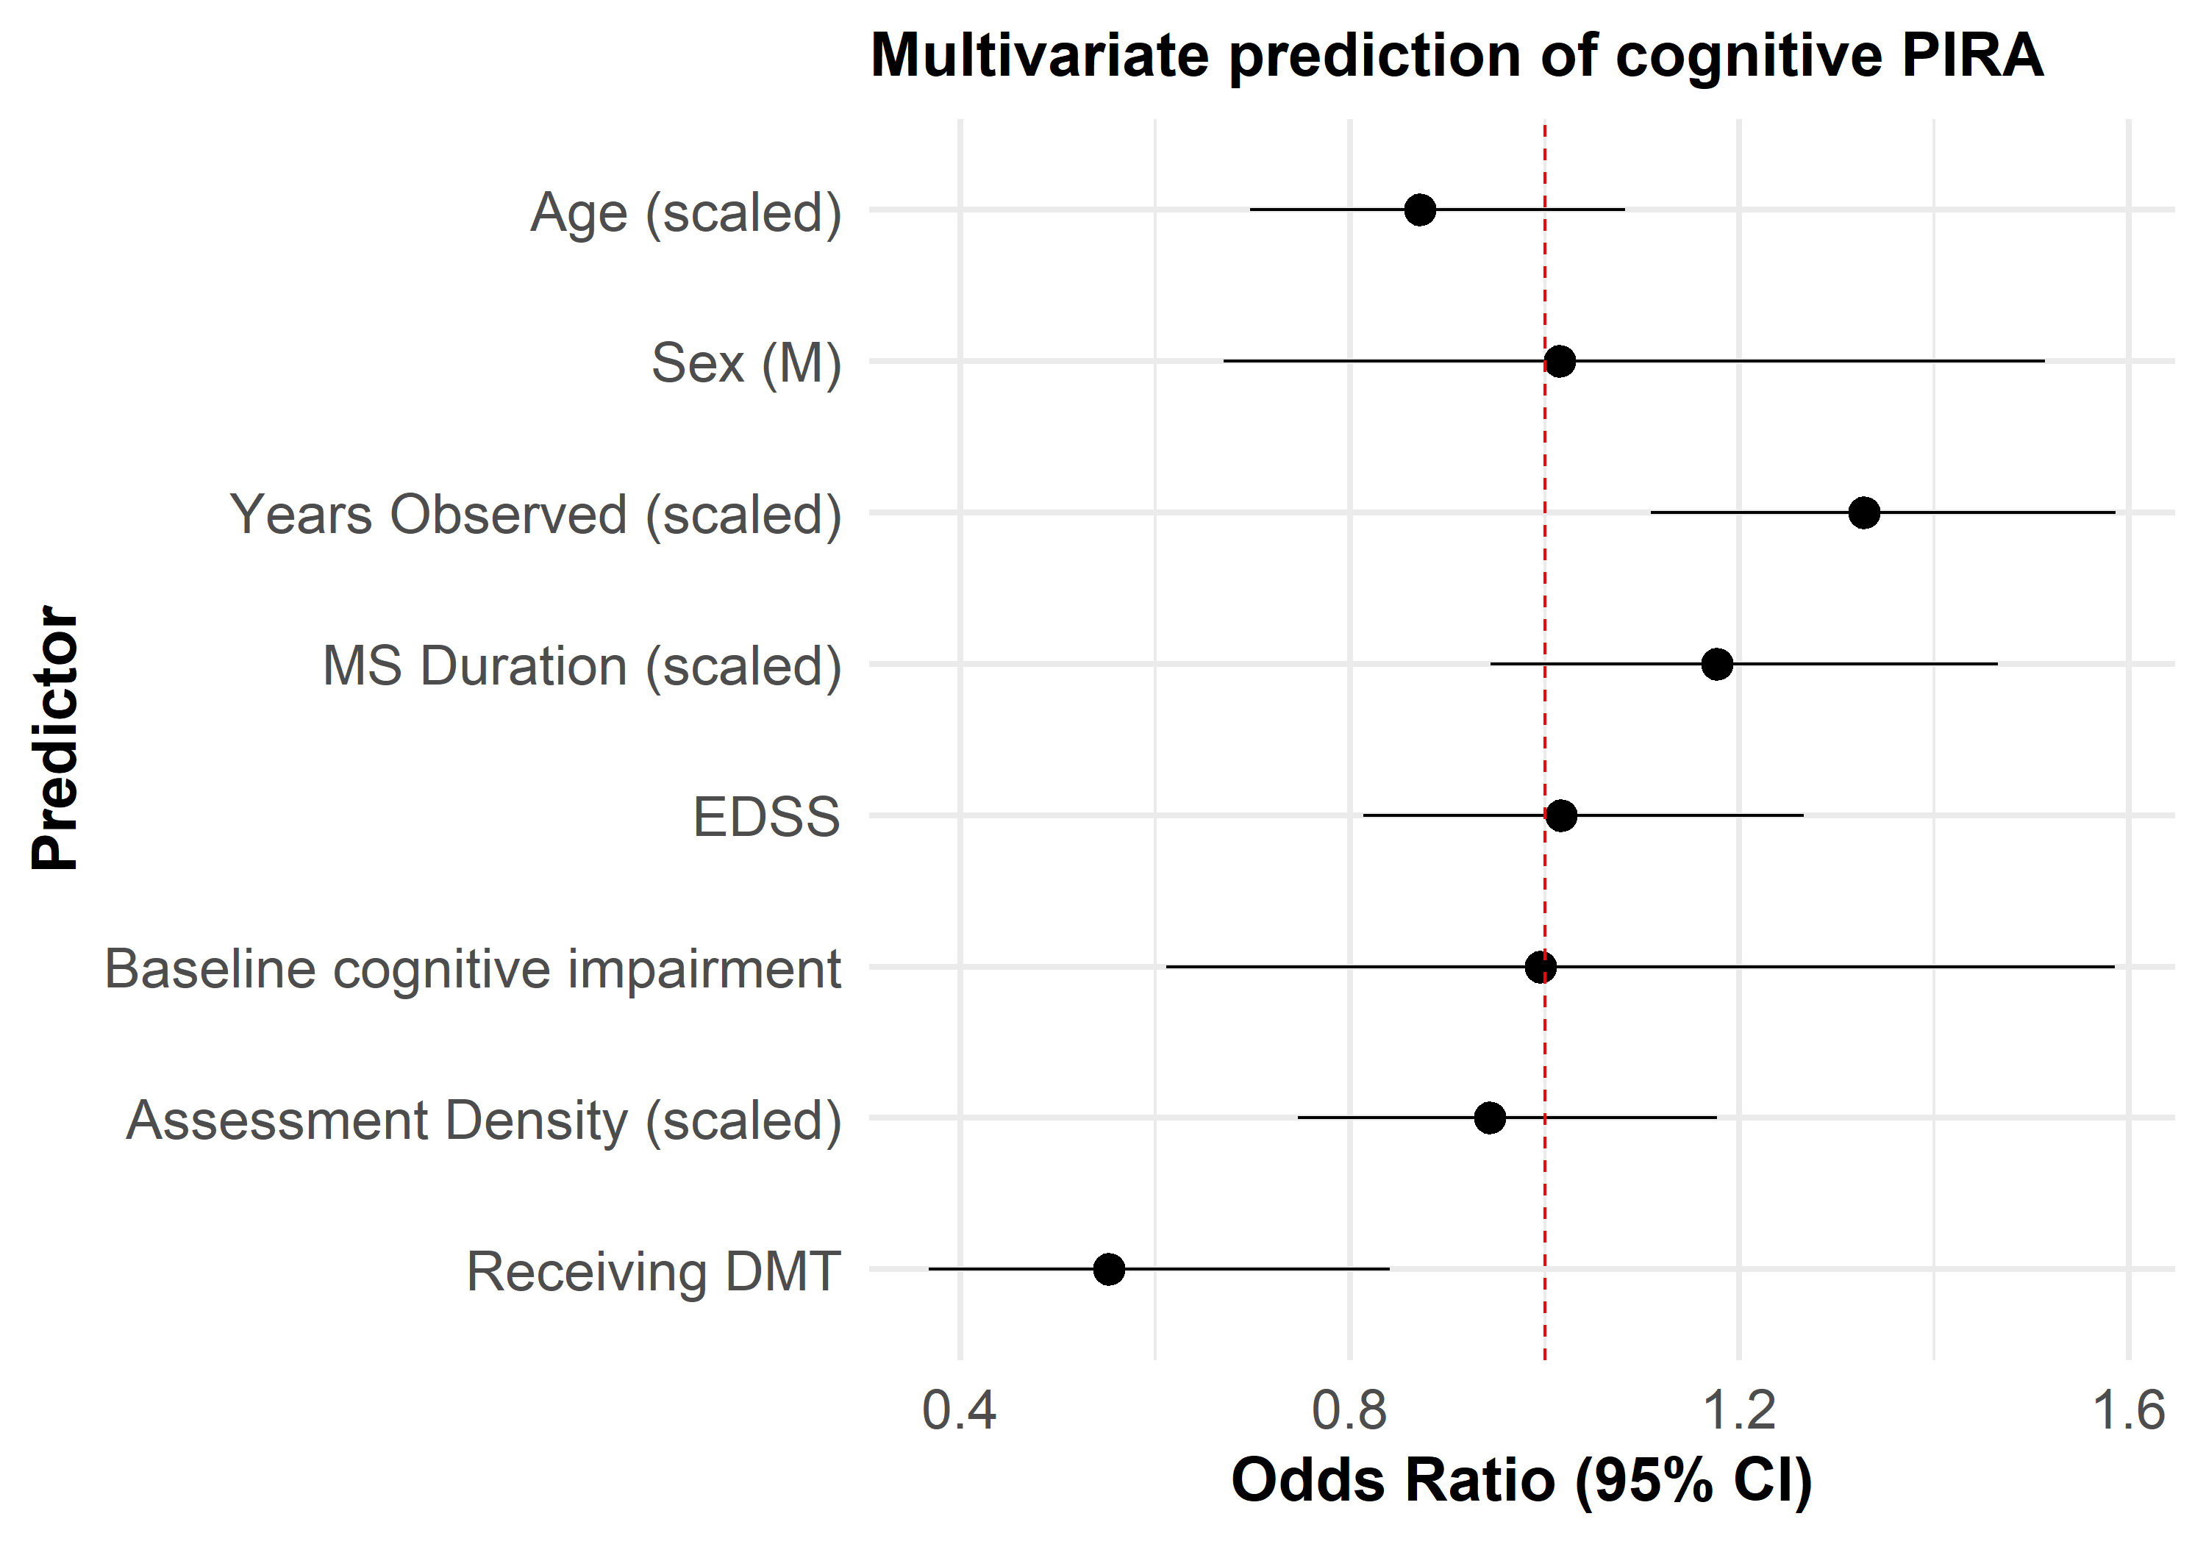
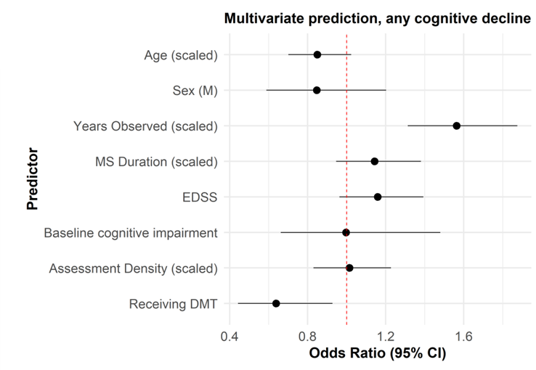
Results
DMT use was associated with lower likelihood of cognitive PIRA overall. This effect was similar considering any cognitive decline (PIRA or RAW)

Slide 15
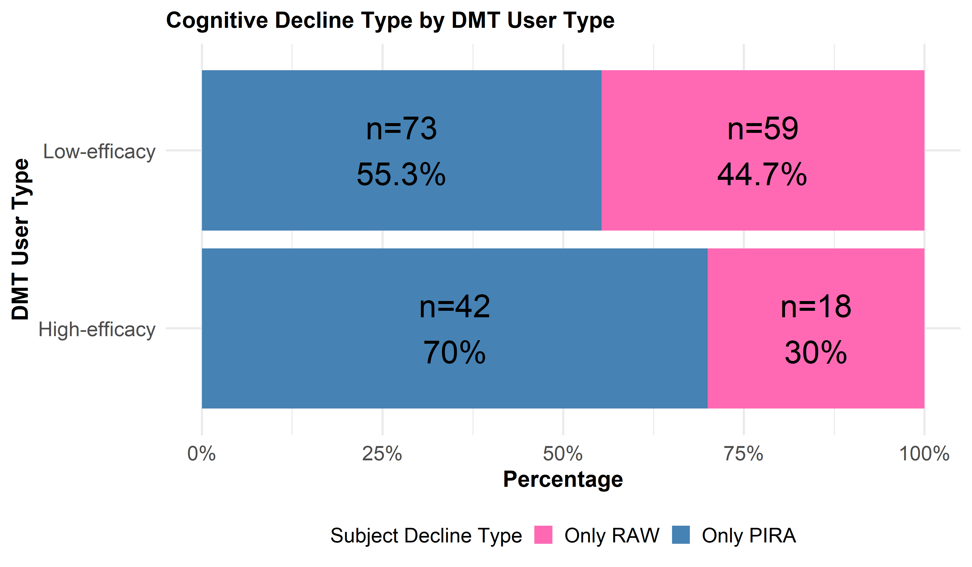
Results
However, High-efficacy DMT was associated with increased proportions of cognitive decline considered PIRA.

Slide 16
Interpretation of Results
Consistent with previous investigations, cognitive PIRA accounts for most cognitive decline across sites
  Though fewer events are captured without tests of memory
It is less likely to occur in patients receiving DMT
And high-efficacy therapy may control relapses, thereby increasing proportions of cognitive decline considered PIRA

Slide 17
Discussion

Slide 18
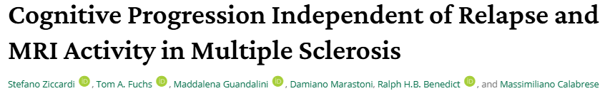
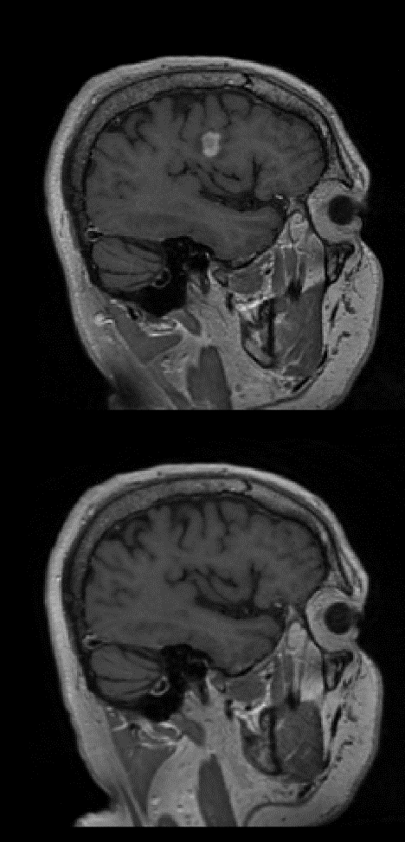
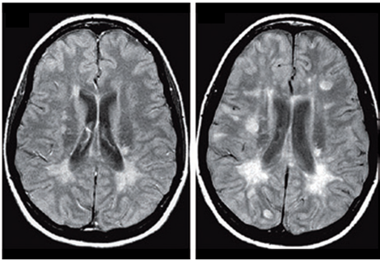
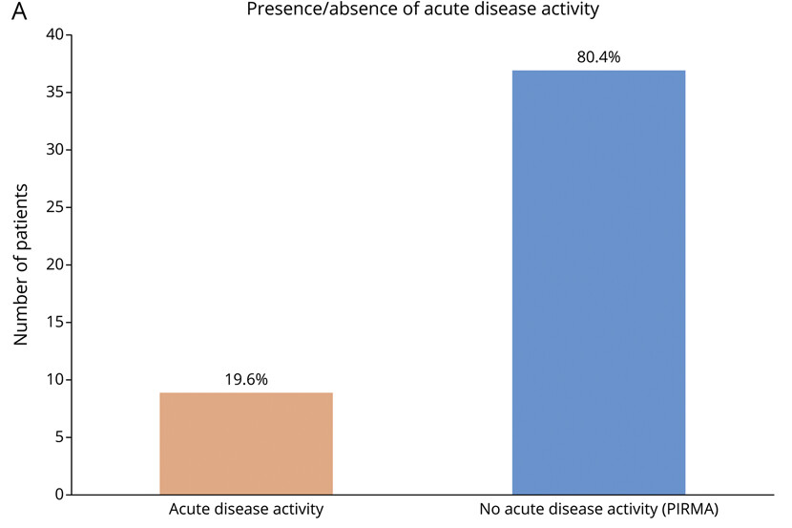
Discussion
Most cognitive decline is PIRA and is also independent of gad-enhancing lesions and new lesions
Ziccardi et al., Neurology Open Access, 2025
Notes:
It is also indepepdent of new lesions and gad-enhancing lesions

Slide 19
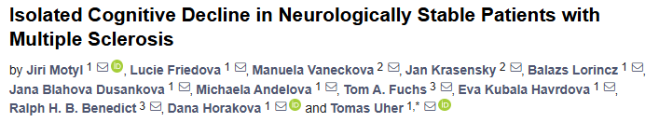
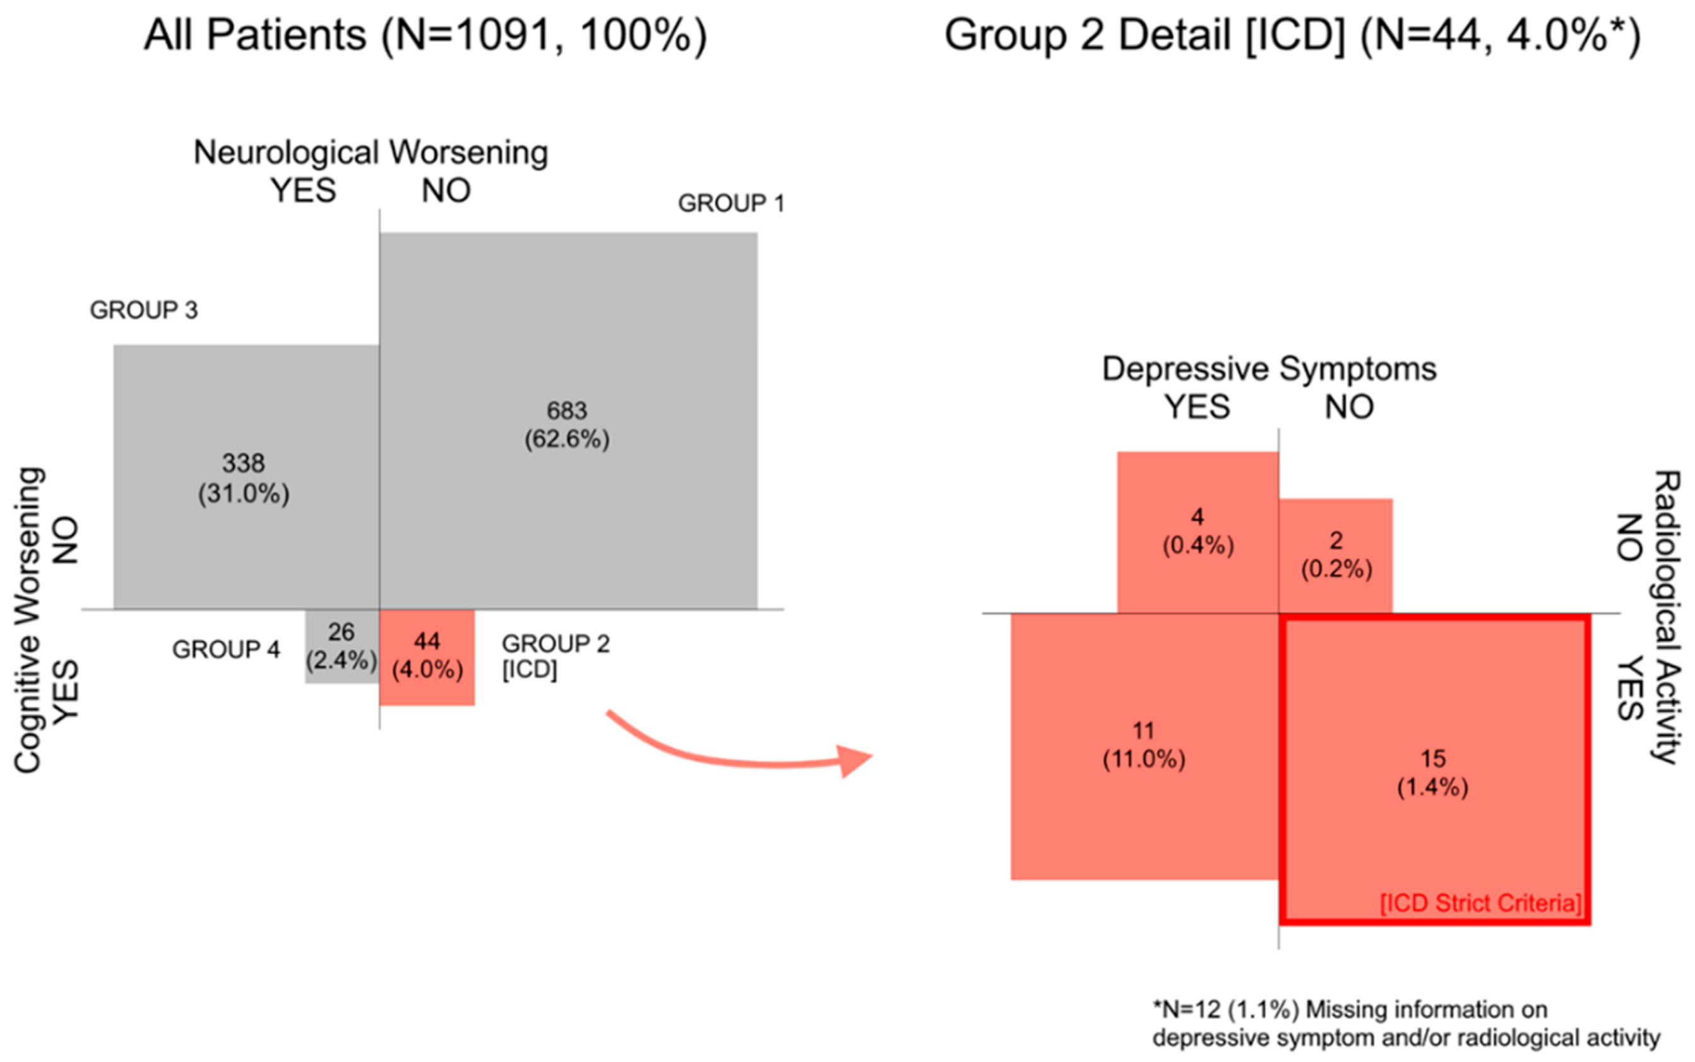
Discussion
Smoldering lesion growth is a strong candidate for pathologic underpinnings of cognitive PIRA
Motyl et al., Diagnostics, 2021
Notes:
Though much less is independent of GROWING lesions. Thus indicating smoldering lesion growth may be the best place to look in association with cognitive PIRA

Slide 20
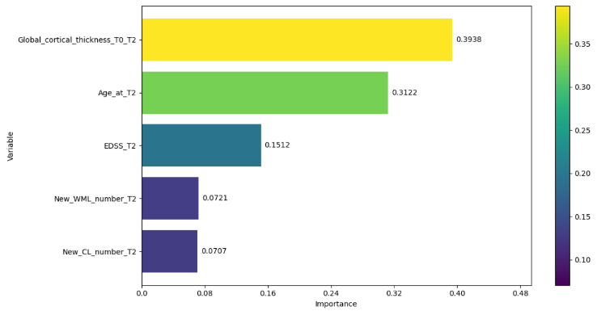
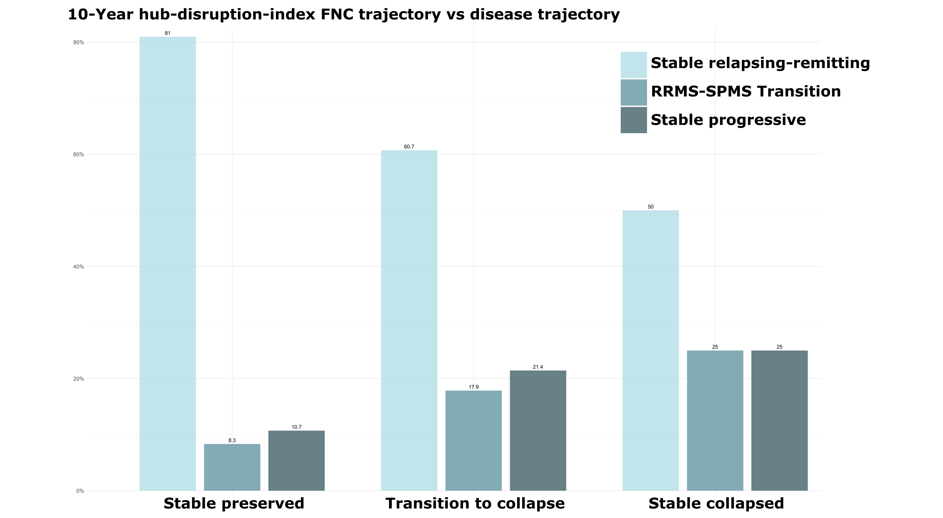
Discussion
Neocortical atrophy and functional network collapse also likely to contribute to cognitive PIRA
P548, Poster Session 2
P670, Poster Session 2
Ziccardi et al, ECTRIMS, 2025; Fuchs et al, ECTRIMS, 2025

Slide 21
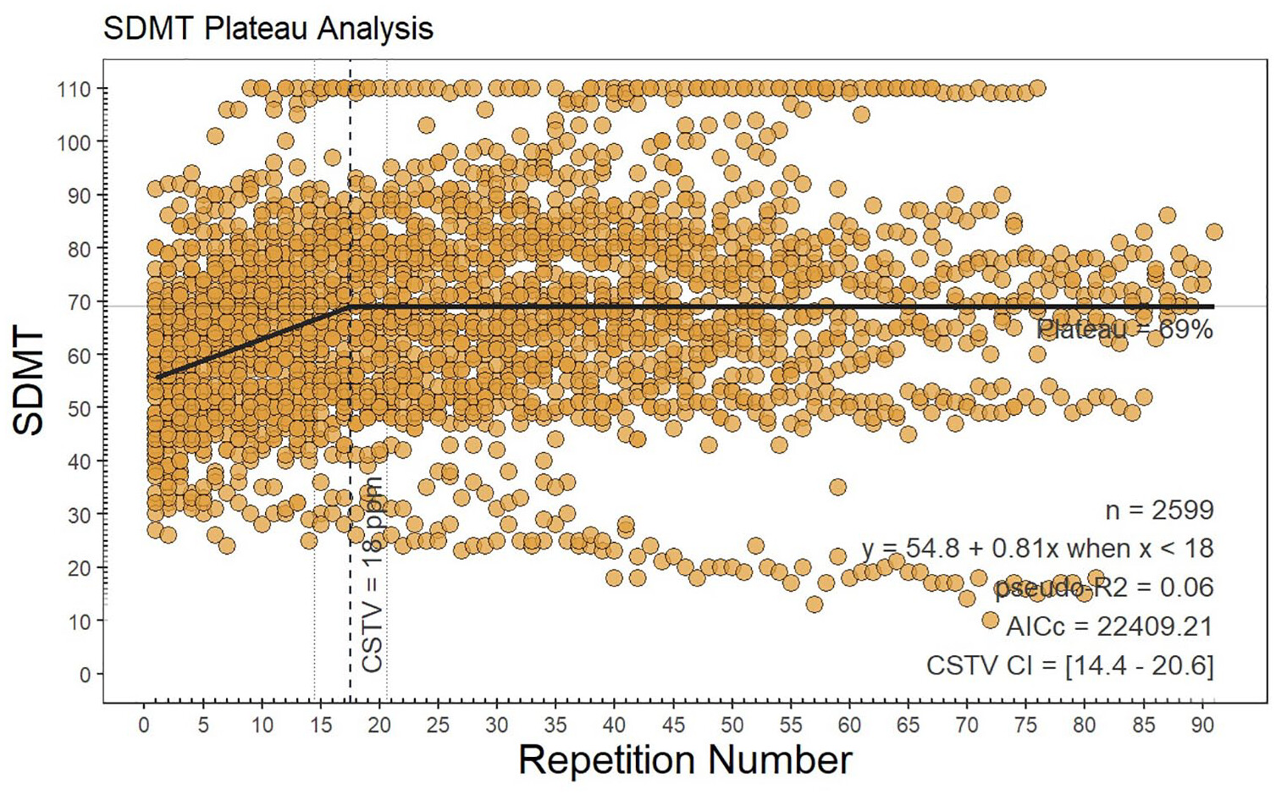
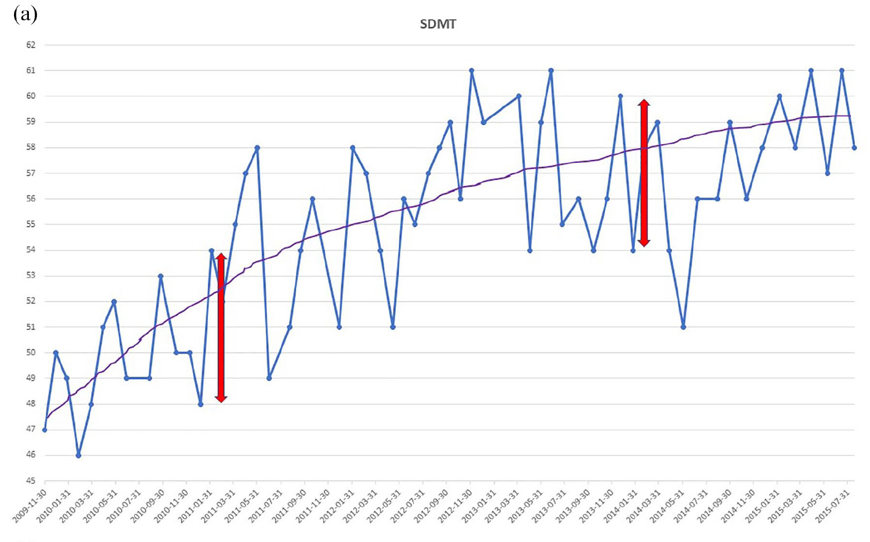
Discussion
Practice effects and test-retest noise are pivotal to consider in longitudinal cognitive analyses
Novakova et al., MSJ, 2025

Slide 22
Conclusions and future directions
Cognitive PIRA is a window into silent MS disease progression, missed with clinical assessment and potentially related to smoldering plaques/neurodegeneration – making it an ideal candidate for treatment and clinical trial endpoints
Its occurrence is reduced in people receiving DMT, though high-efficacy therapy may control relapses, thereby increasing proportions of cognitive decline considered PIRA
  Indication bias may also explain increased PIRA in HE-treated people
Prospective research is needed to explore biological mechanisms, effects of intervention, and to better distinguish cognitive PIRA from cognitive relapse.

Slide 23

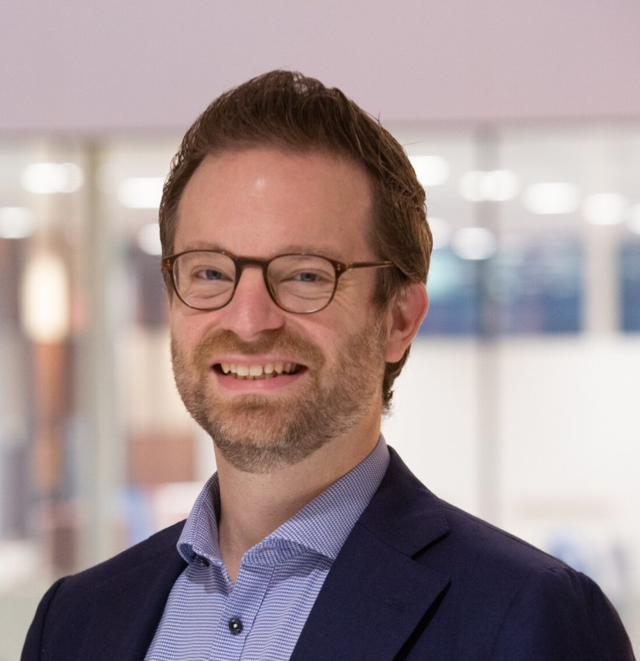
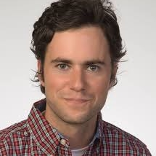
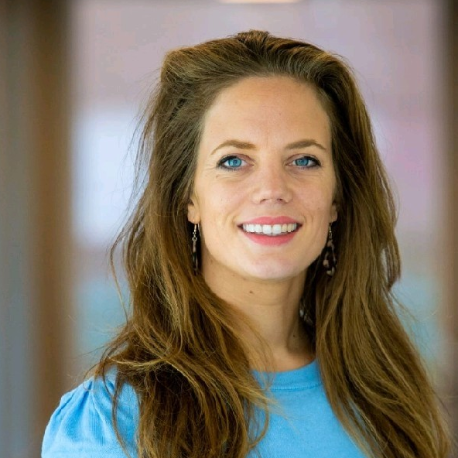
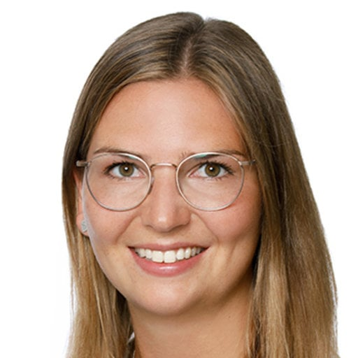



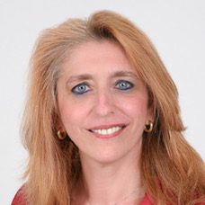
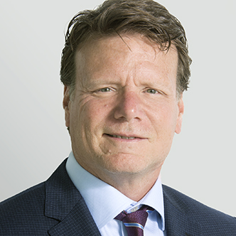
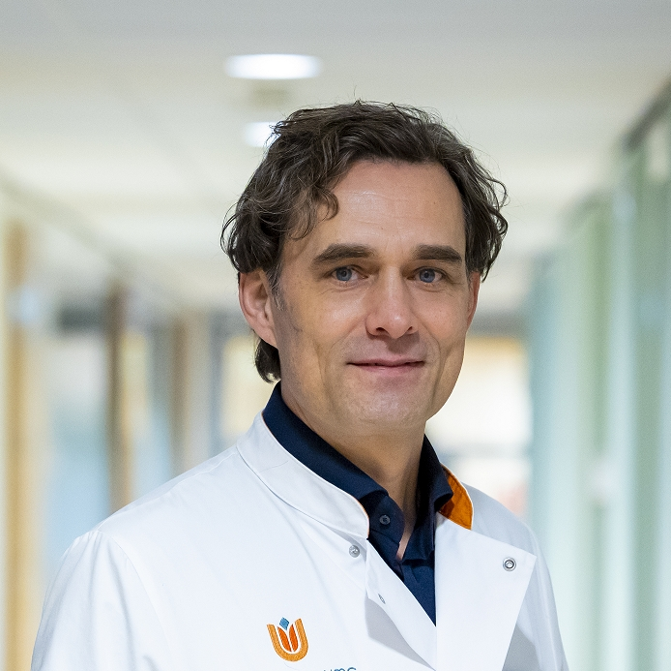
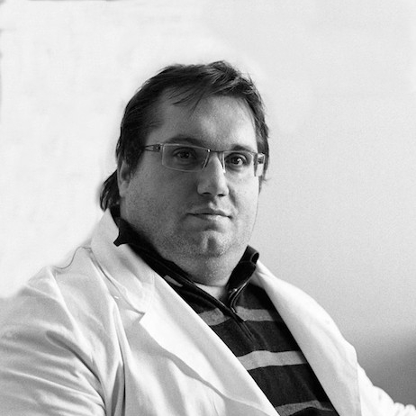
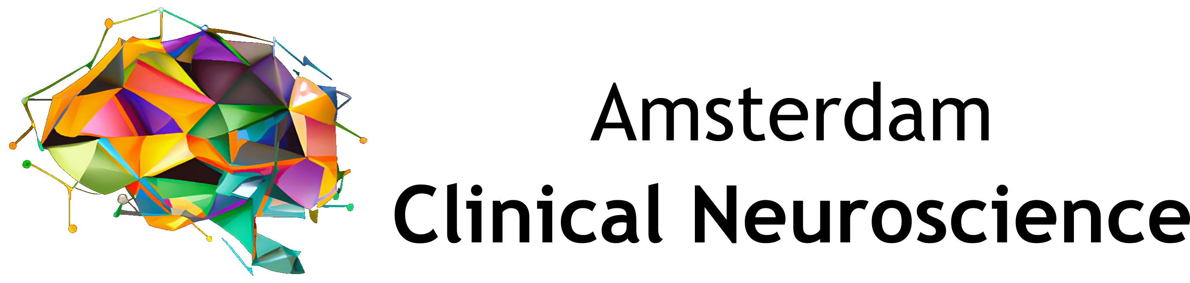


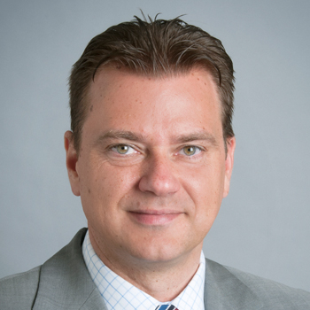

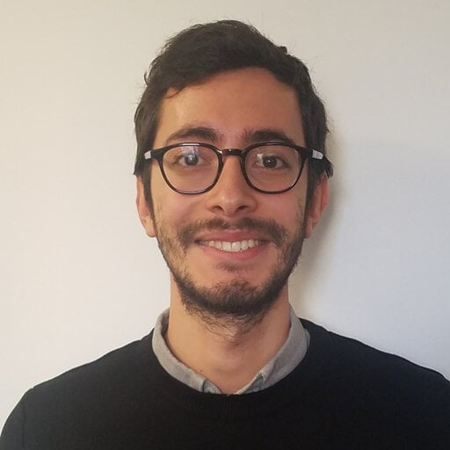
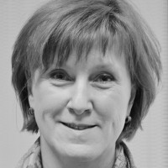


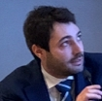
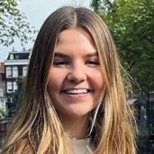
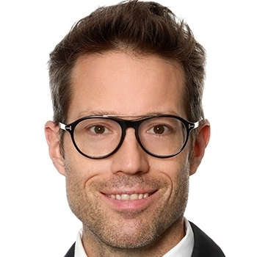

Thank you!
Slides & citations
Thoughts?
t.fuchs@amsterdamumc.nl
Poster Session 2, P548 & P670

