Slide 1

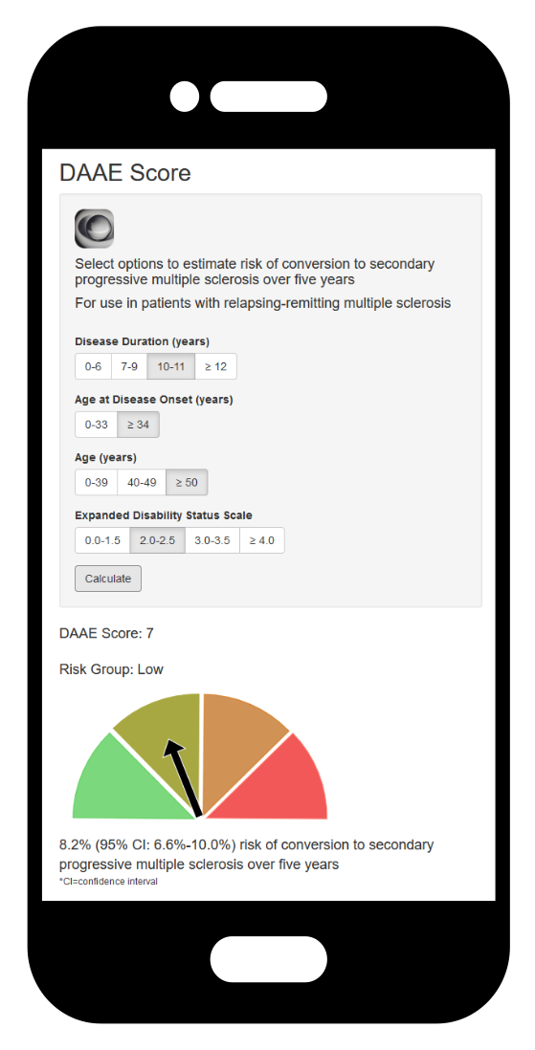

Is it possible to predict the progression
21 March 2025
Tom A. Fuchs, MD PhD

Slide 2
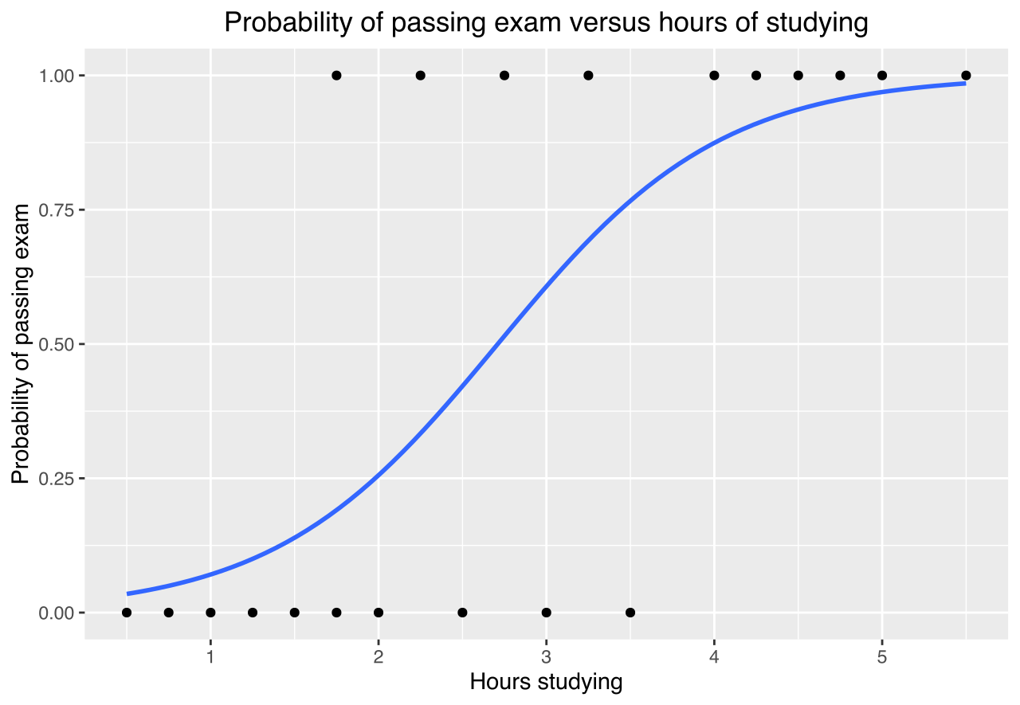
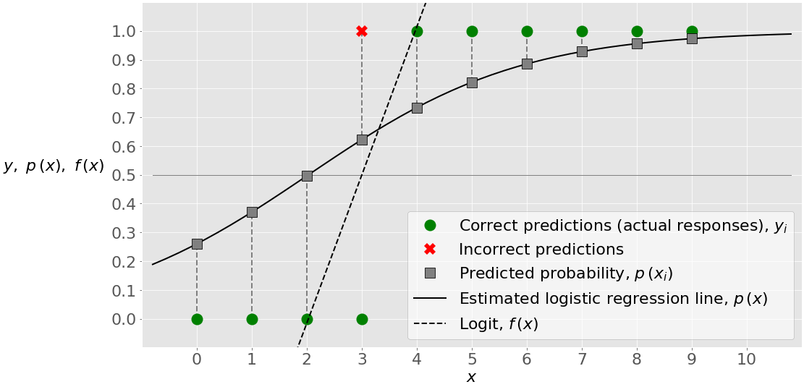
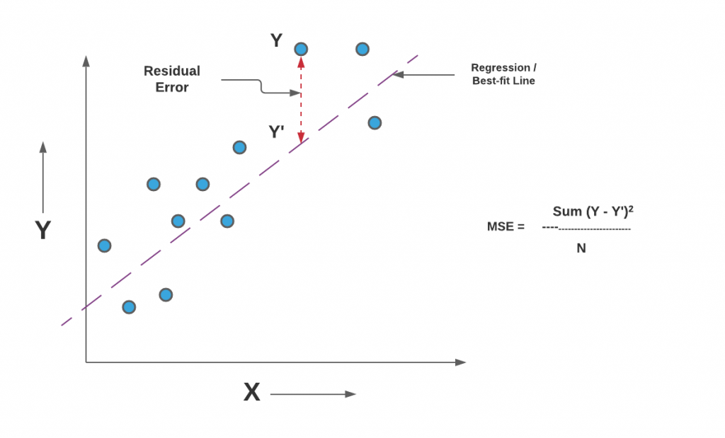
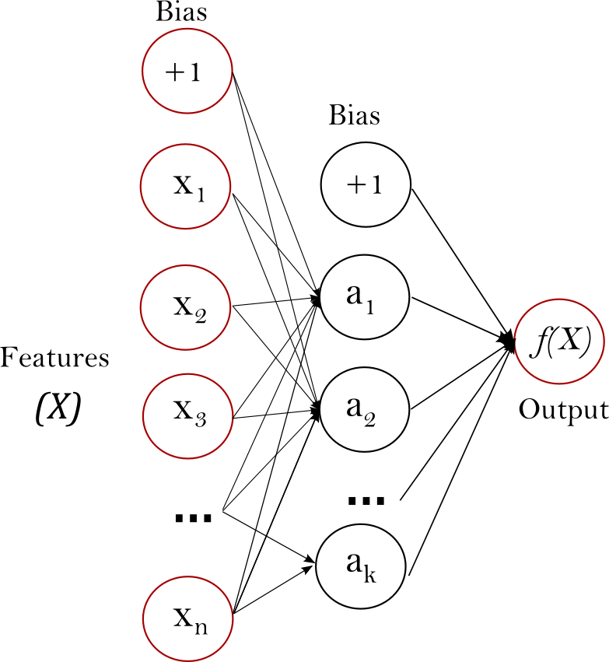
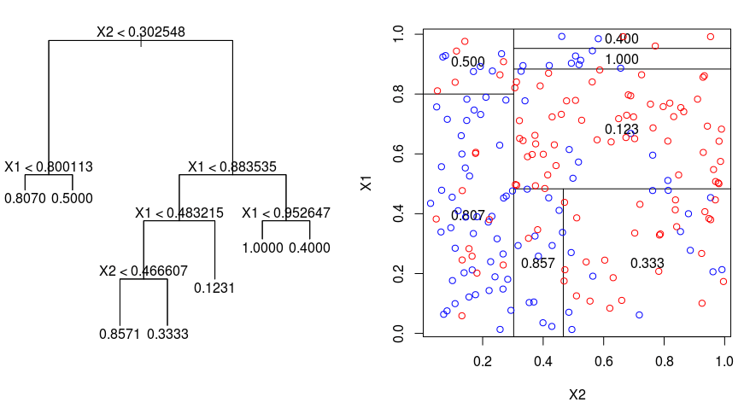
Are you using supervised machine learning?
Notes:
Historical perspective – for less experienced audience. Pearson Regression since 1896 and logistic regression since 1958.

Slide 3
“Predict” versus “Predict”
To scientists, “predict” may mean. . .
Classify present status
(e.g. Diagnostic - is there a tumor now?)
BUT commonly, “predict” means. . .
Forecast of the future
(e.g. Will there be a tumor next year?)
Easier, can expect higher certainty
Harder, must expect greater uncertainty
Notes:
Key terms

Slide 4
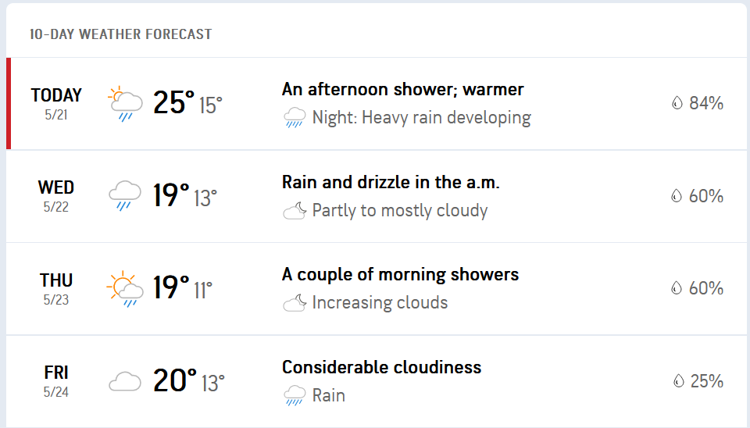
Predictions in daily life
Notes:
We are all well acquainted with probabilistic predictions.

Slide 5
Predictions in daily life
Notes:
We are all well acquainted with probabilistic predictions. Humidity, air pressure changes, temperature differentials. Yet uncertainty remains.

Slide 6
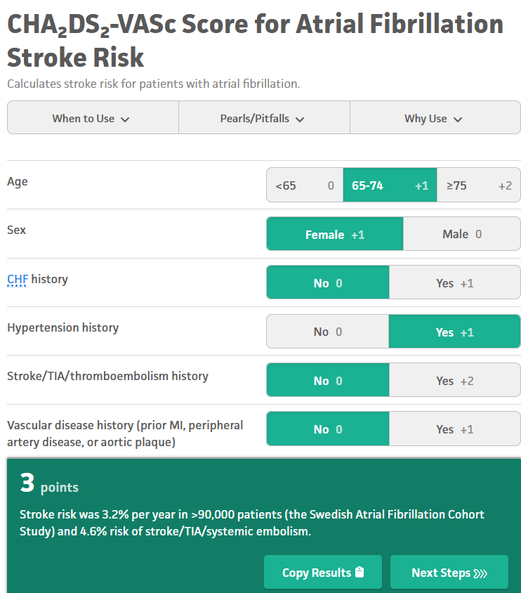
Forecasts in neurology

Slide 7
Disability progression in MS
Objective: Late-stage progression independent of relapse
Lorscheider criteria (EDSS>4.0 & CDW PIRA)
Clinical: Transition to SPMS
Accumulate disability more rapidly
No longer benefit from most disease modifying therapies or rehabilitation
100+ studies identified
Roos et al., Neurology 2021; Fuchs et al., MSARD 2019; Sorensen et al., COIN, 2020

Slide 8
Predictive model development
Notes:
Could use ensemble

Slide 9
Predictive model development
Notes:
But for clinical translation – models ought fit existing methods

Slide 10
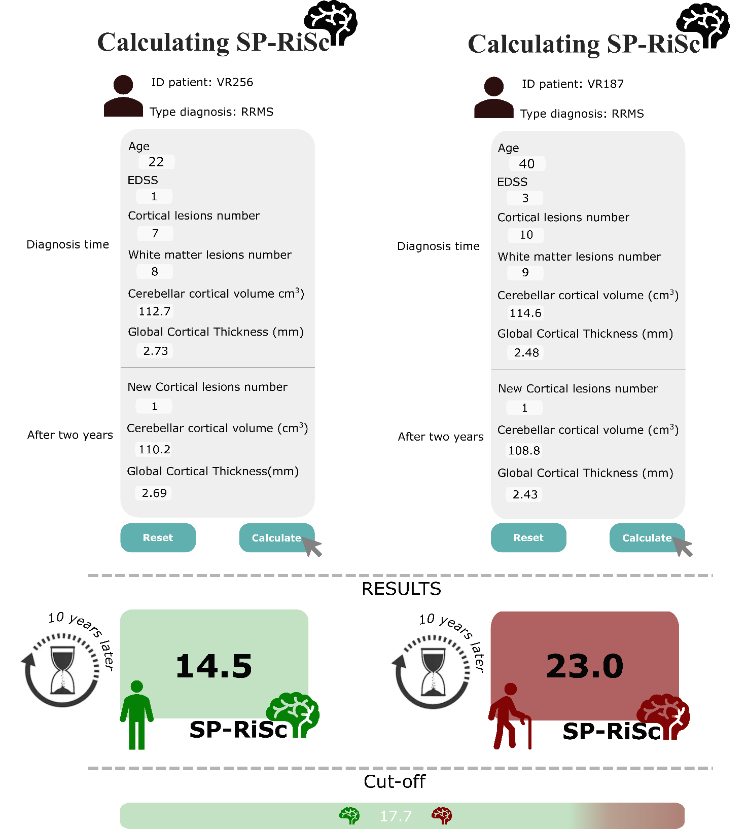
Predictive model development
Pisani. . . Calabrese, EJoN, 2021
Notes:
But for clinical translation – models ought fit existing methods

Slide 11
Predictive model development
(1) Systematic Literature Review: ~100 studies identified
(2) Feature Ordinalization: GAM (generalized additive modeling)
(3) Feature Selection: LASSO (least-absolute-shrinkage-and-selection-operator)
(4) Feature Weighting: Explained variance and coefficient weighting
(5) Testing and Validation: Machine-learning-based approach
Notes:
So here is what we do

Slide 12
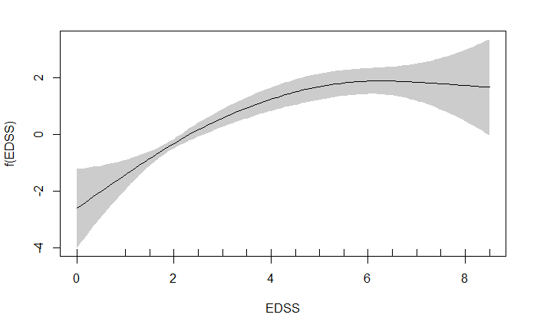
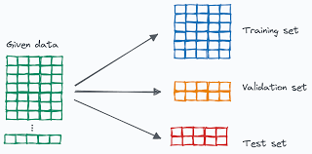
Predictive model development
Notes:
Non-linear relationships and machine-learning based methods

Slide 13
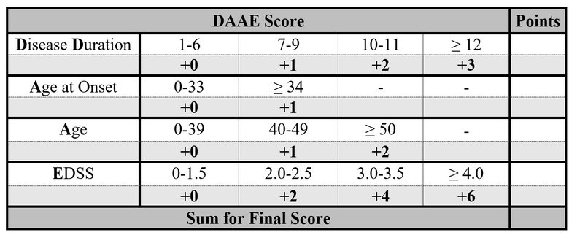
Predictive model development

Slide 14
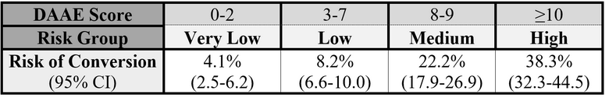
Predictive model development

Slide 15
Model validation

Slide 16
Model validation

Slide 17
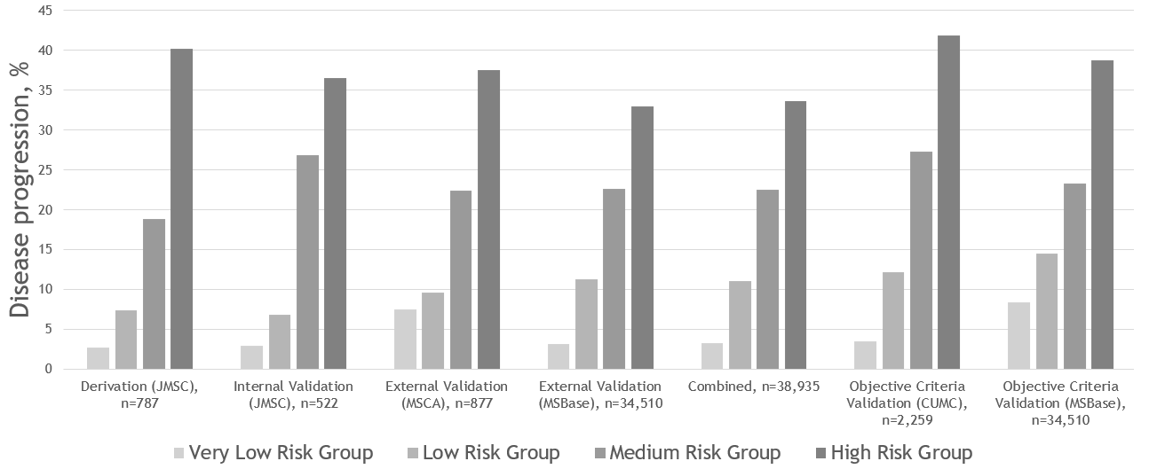
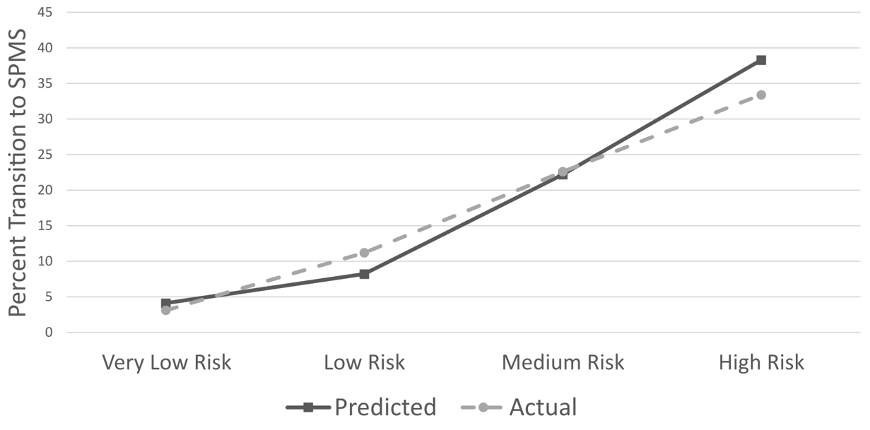
Model validation

Slide 18
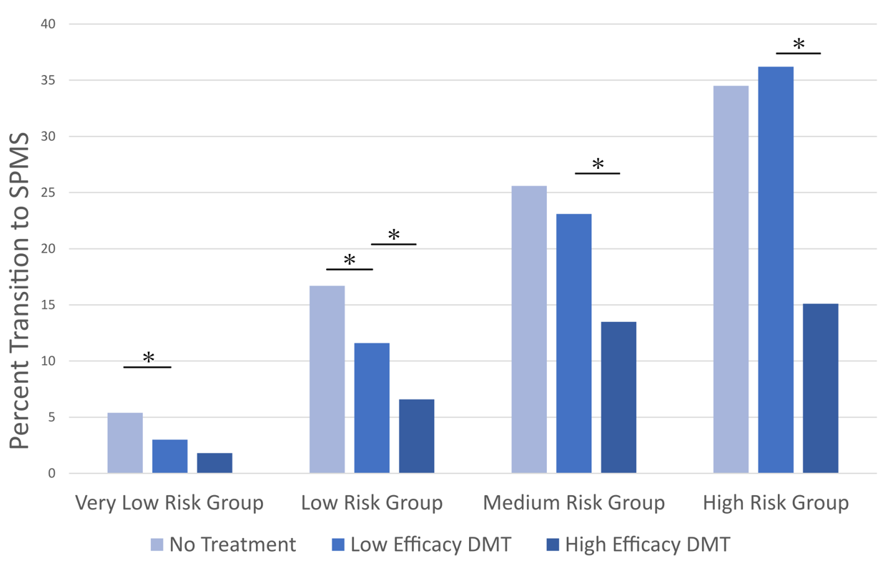
Model validation

Slide 19

Model validation

Slide 20
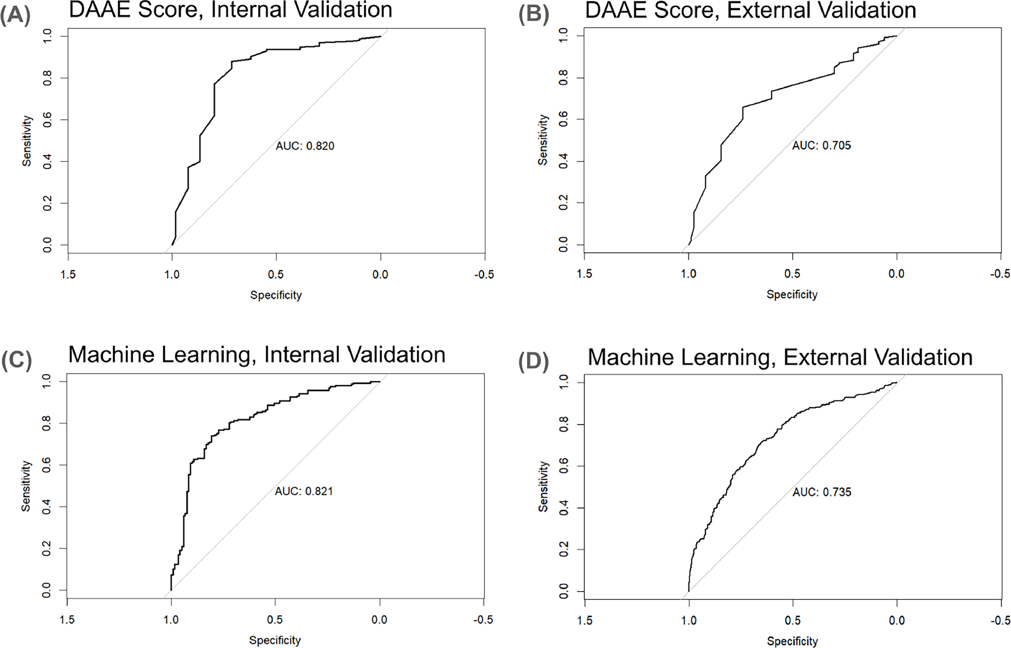
Model validation

Slide 21
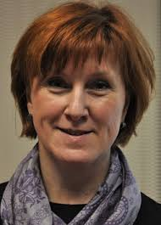
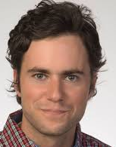
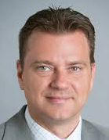
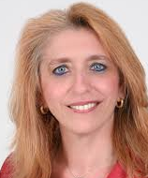
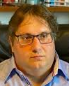

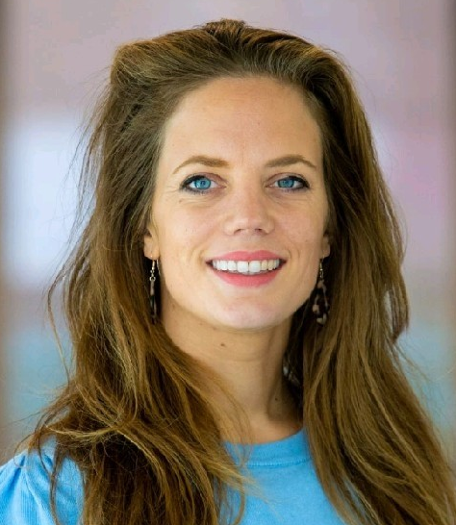
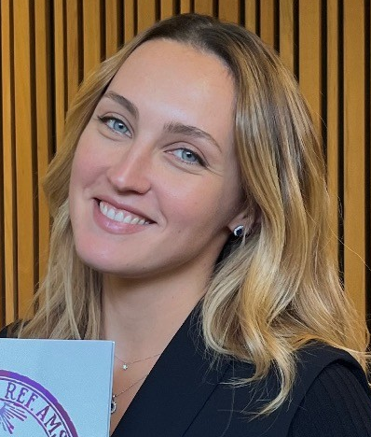
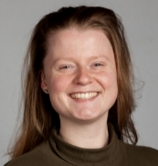

Thanks to

Slide 22
Participating centers
CISSS Chaudière-Appalache, Levis, Canada
Università di Bologna, Bologna, Italia
Neuroimmunology Centre, Department of Neurology, Royal Melbourne Hospital, Melbourne, Australia
Universita di Foggia, Medical and Surgical Sciences, Foggia, Italy
S. Maria delle Croci Hospital, AUSL Romagna, Ravenna, Italy
Nationaal MS Centrum, Melsbroek, Belgium
Razi University Hospital, Tunis, Tunisia
University of Debrecen, Debrecen, Hungary
Multiple Sclerosis Research Center, Neuroscience Institute, Tehran University of Medical Sciences, Tehran, Iran
Charles University in Prague and General University Hospital, Prague, Czech Republic
Izmir University of Economics, Medical Point Hospital, Izmir, Turkey
Isfahan University of Medical Sciences, Isfahan, Iran
CHUM and Universite de Montreal, Montreal, Canada
Amiri Hospital, Sharq, Kuwait
University G. d'Annunzio of Chieti-Pescara, Chieti, Italy
Neuroimmunology Centre, Department of Neurology, Royal Melbourne Hospital, Melbourne, Australia
Department of Neurosciences, Box Hill Hospital, Box Hill, Australia
Department of Neurology, Box Hill Hospital, Melbourne, Australia
Hospital Clinic de Barcelona, Barcelona, Spain
Academic MS Center Zuyd, Department of Neurology, Zuyderland Medical Center, Sittard-Geleen, Netherlands
Department of Neurology, The Alfred Hospital, Melbourne, Australia
American University of Beirut Medical Center, Beirut, Lebanon
Monash University, Clayton, Australia
Cliniques Universitaires Saint-Luc, Brussels, Belgium
S. Maria delle Croci Hospital, AUSL Romagna, Ravenna, Italy
Centro Hospitalar Universitario de Sao Joao, Porto, Portugal
University Hospital and University of Basel, Basel, Switzerland
Azienda Opsedaliera per l'Emergenza Cannizzaro, Catania, Italy
AST Macerata, Macerata, Italy
Perron Institute for Neurological and Translational Science, Sir Charles Gairdner Hospital, QEIIMC, University of Western Australia, Nedlands, Australia
Perron Institute for Neurological and Translational Science, The University of Western Australia, Perth, Australia
Perron Institute for Neurological and Translational Science, The University of Western Australia, Perth, Australia
Royal Brisbane Hospital, Brisbane, Australia
Bakirkoy Education and Research Hospital for Psychiatric and Neurological Diseases, Istanbul, Turkey
Yeditepe University, Istanbul, Turkey
Royal Hobart Hospital, Hobart, Australia
Azienda Ospedaliera di Rilievo Nazionale San Giuseppe Moscati Avellino, Avellino, Italy
Universitary Hospital Ghent, Ghent, Belgium
Dr. Etemadifar MS Institute, Isfahan University Of Medical Sciences, Isfahan, Iran
Aarhus University Hospital, Arhus C, Denmark
Nemocnice Jihlava, Jihlava, Czech Republic
South Eastern HSC Trust, Belfast, United Kingdom
University of Cordoba, Spain
Hospital Universitario Donostia and IIS Biodonostia, San Sebastián, Spain
Koc University, School of Medicine, Istanbul, Turkey
Virgen de la Arrixaca Clinical University Hospital. IMIB-Arrixaca, Murcia, Spain;
Groene Hart Ziekenhuis, Gouda, Netherlands
Galdakao-Usansolo University Hospital, Osakidetza-Basque Health Service, Galdakao, Spain
Neurology Unit Galliera Hospital Genova Italy
Sultan Qaboos University, Al-Khodh, Oman
Westmead Hospital, Sydney, Australia
Royal Brisbane Hospital, Brisbane, Australia
Department of Neuroscience Clinic of Neurology, University of Medicine and Pharmacy Victor Babes Timisoara
Erciyes University, Neurology, Kayseri, Turkey
King Fahad Specialist Hospital-Dammam, Saudi Arabia
Geneva University Hospitals and Faculty of Medicine, Geneva, Switzerland
Concord Repatriation General Hospital, Sydney, Australia
University of Sydney, Sydney, Australia
Department of Neurology, Antwerp University Hospital, Edegem (Antwerp), Belgium.
Centro de Esclerosis Múltiple (CEMHUN), Department of Neurology, Hospital Universitario Nacional de Colombia Bogota, Colombia
St Vincents Hospital, Fitzroy, Melbourne, Australia
Hospital General Universitario de Alicante, Alicante, Spain
University Hospital Center Zagreb, Zagreb, Croatia
Bombay Hospital Institute of Medical Sciences, Mumbai, India
Postgraduate Institute of Medical Education and Research, Chandigarh, India
AHEPA University Hospital, Thessaloniki, Greece
Yeditepe University, Istanbul, Turkey
AZ Alma Ziekenhuis, Sijsele - Damme, Belgium
Semmelweis University, Budapest, Hungary

Slide 23
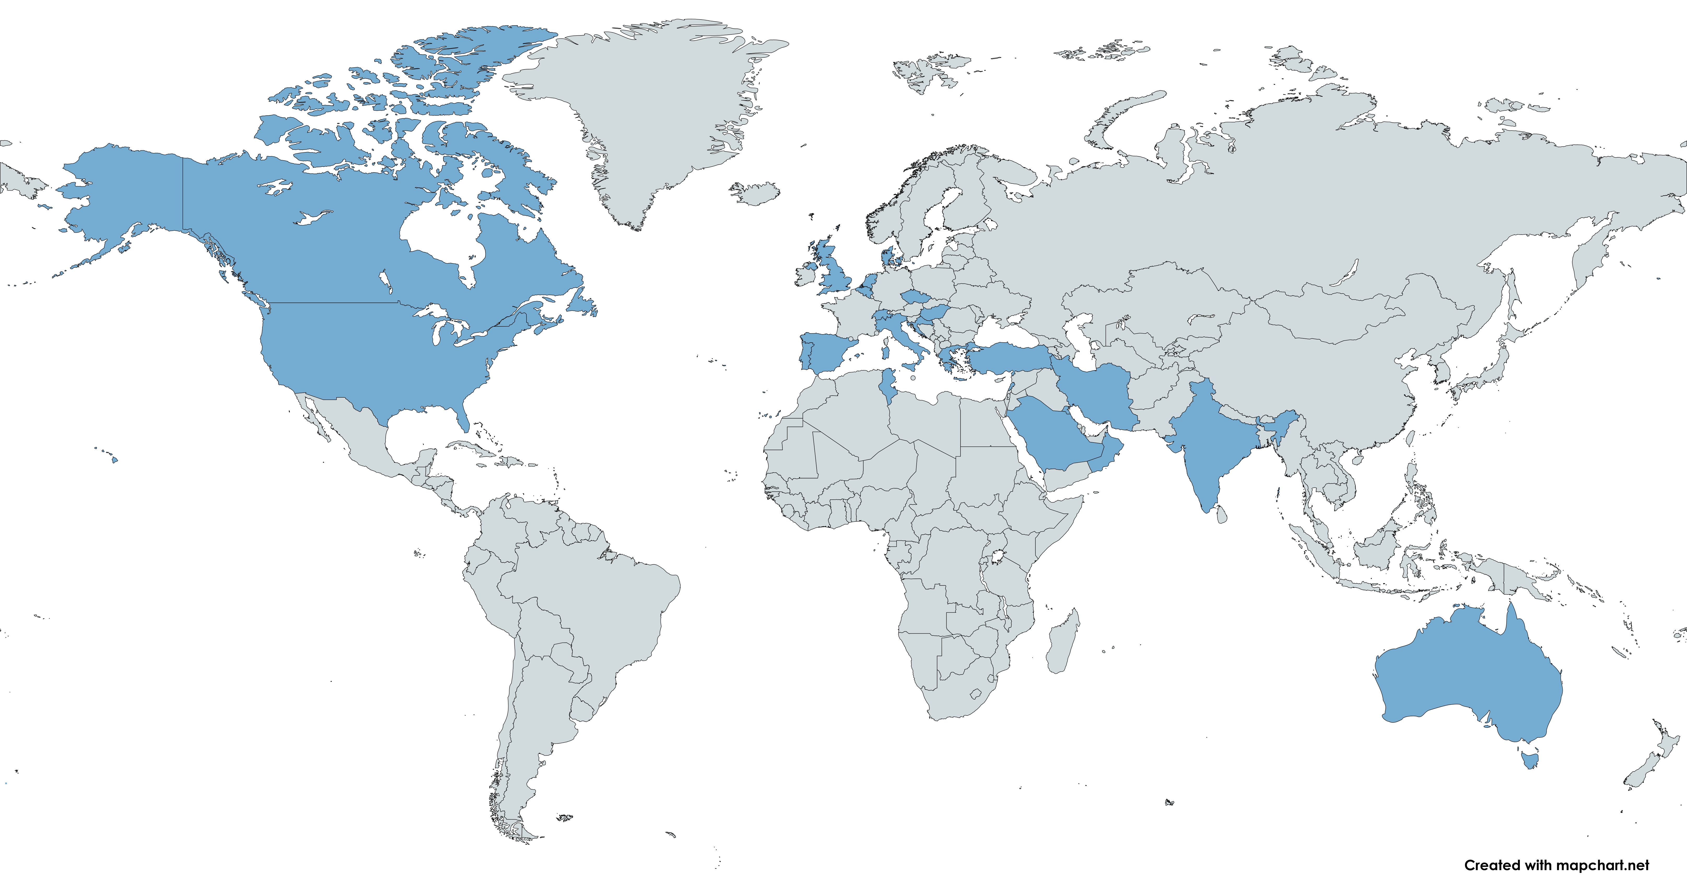
Participating centers
CISSS Chaudière-Appalache, Levis, Canada
Università di Bologna, Bologna, Italia
Neuroimmunology Centre, Department of Neurology, Royal Melbourne Hospital, Melbourne, Australia
Universita di Foggia, Medical and Surgical Sciences, Foggia, Italy
S. Maria delle Croci Hospital, AUSL Romagna, Ravenna, Italy
Nationaal MS Centrum, Melsbroek, Belgium
Razi University Hospital, Tunis, Tunisia
University of Debrecen, Debrecen, Hungary
Multiple Sclerosis Research Center, Neuroscience Institute, Tehran University of Medical Sciences, Tehran, Iran
Charles University in Prague and General University Hospital, Prague, Czech Republic
Izmir University of Economics, Medical Point Hospital, Izmir, Turkey
Isfahan University of Medical Sciences, Isfahan, Iran
CHUM and Universite de Montreal, Montreal, Canada
Amiri Hospital, Sharq, Kuwait
University G. d'Annunzio of Chieti-Pescara, Chieti, Italy
Neuroimmunology Centre, Department of Neurology, Royal Melbourne Hospital, Melbourne, Australia
Department of Neurosciences, Box Hill Hospital, Box Hill, Australia
Department of Neurology, Box Hill Hospital, Melbourne, Australia
Hospital Clinic de Barcelona, Barcelona, Spain
Academic MS Center Zuyd, Department of Neurology, Zuyderland Medical Center, Sittard-Geleen, Netherlands
Department of Neurology, The Alfred Hospital, Melbourne, Australia
American University of Beirut Medical Center, Beirut, Lebanon
Monash University, Clayton, Australia
Cliniques Universitaires Saint-Luc, Brussels, Belgium
S. Maria delle Croci Hospital, AUSL Romagna, Ravenna, Italy
Centro Hospitalar Universitario de Sao Joao, Porto, Portugal
University Hospital and University of Basel, Basel, Switzerland
Azienda Opsedaliera per l'Emergenza Cannizzaro, Catania, Italy
AST Macerata, Macerata, Italy
Perron Institute for Neurological and Translational Science, Sir Charles Gairdner Hospital, QEIIMC, University of Western Australia, Nedlands, Australia
Perron Institute for Neurological and Translational Science, The University of Western Australia, Perth, Australia
Canada
Italy
Australia
Belgium
Tunisia
Hungary
Iran
Czech Republic
Turkey
Kuwait
Spain
Netherlands
Lebanon
Portugal
Switzerland
Denmark
United Kingdom
United States
Oman
Croatia
India
Greece
Hungary
Saudi Arabia
Perron Institute for Neurological and Translational Science, The University of Western Australia, Perth, Australia
Royal Brisbane Hospital, Brisbane, Australia
Bakirkoy Education and Research Hospital for Psychiatric and Neurological Diseases, Istanbul, Turkey
Yeditepe University, Istanbul, Turkey
Royal Hobart Hospital, Hobart, Australia
Azienda Ospedaliera di Rilievo Nazionale San Giuseppe Moscati Avellino, Avellino, Italy
Universitary Hospital Ghent, Ghent, Belgium
Dr. Etemadifar MS Institute, Isfahan University Of Medical Sciences, Isfahan, Iran
Aarhus University Hospital, Arhus C, Denmark
Nemocnice Jihlava, Jihlava, Czech Republic
South Eastern HSC Trust, Belfast, United Kingdom
University of Cordoba, Spain
Hospital Universitario Donostia and IIS Biodonostia, San Sebastián, Spain
Koc University, School of Medicine, Istanbul, Turkey
Virgen de la Arrixaca Clinical University Hospital. IMIB-Arrixaca, Murcia, Spain;
Groene Hart Ziekenhuis, Gouda, Netherlands
Galdakao-Usansolo University Hospital, Osakidetza-Basque Health Service, Galdakao, Spain
Neurology Unit Galliera Hospital Genova Italy
Sultan Qaboos University, Al-Khodh, Oman
Westmead Hospital, Sydney, Australia
Royal Brisbane Hospital, Brisbane, Australia
Department of Neuroscience Clinic of Neurology, University of Medicine and Pharmacy Victor Babes Timisoara
Erciyes University, Neurology, Kayseri, Turkey
King Fahad Specialist Hospital-Dammam, Saudi Arabia
Geneva University Hospitals and Faculty of Medicine, Geneva, Switzerland
Concord Repatriation General Hospital, Sydney, Australia
University of Sydney, Sydney, Australia
Department of Neurology, Antwerp University Hospital, Edegem (Antwerp), Belgium.
Centro de Esclerosis Múltiple (CEMHUN), Department of Neurology, Hospital Universitario Nacional de Colombia Bogota, Colombia
St Vincents Hospital, Fitzroy, Melbourne, Australia
Hospital General Universitario de Alicante, Alicante, Spain
University Hospital Center Zagreb, Zagreb, Croatia
Bombay Hospital Institute of Medical Sciences, Mumbai, India
Postgraduate Institute of Medical Education and Research, Chandigarh, India
AHEPA University Hospital, Thessaloniki, Greece
Yeditepe University, Istanbul, Turkey
AZ Alma Ziekenhuis, Sijsele - Damme, Belgium
Semmelweis University, Budapest, Hungary
70 Centers
24 Countries

Slide 24
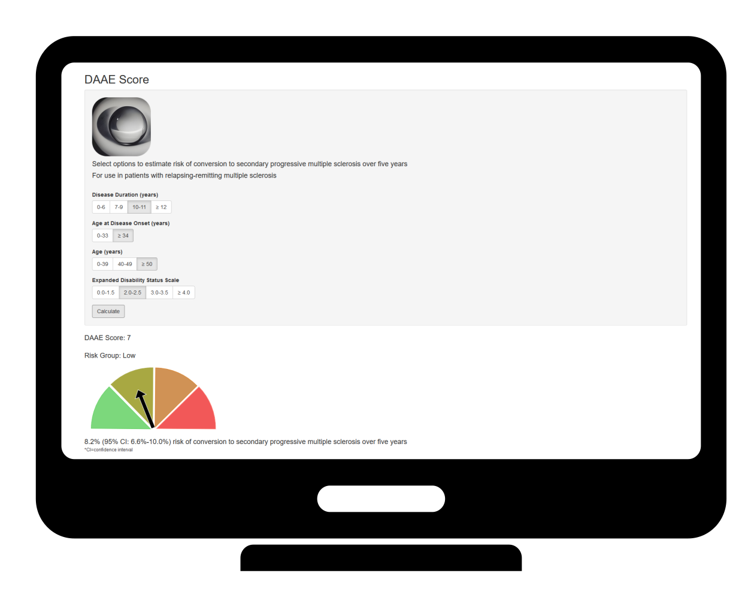
Online app

Slide 25
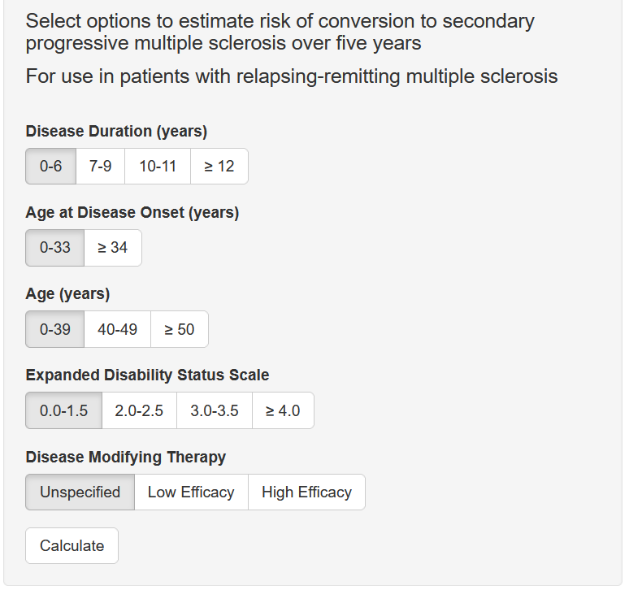
Online app

Slide 26
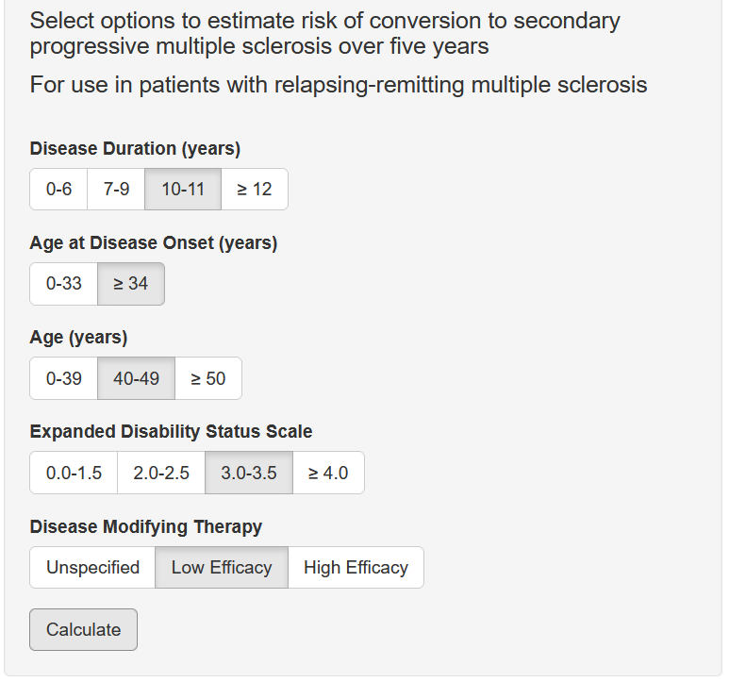
Online app

Slide 27
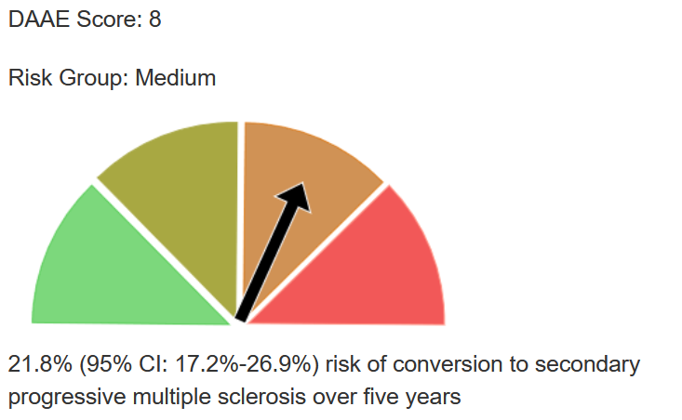
Online app

Slide 28

Online app

Slide 29

Complete the cycle - implementation

Slide 30
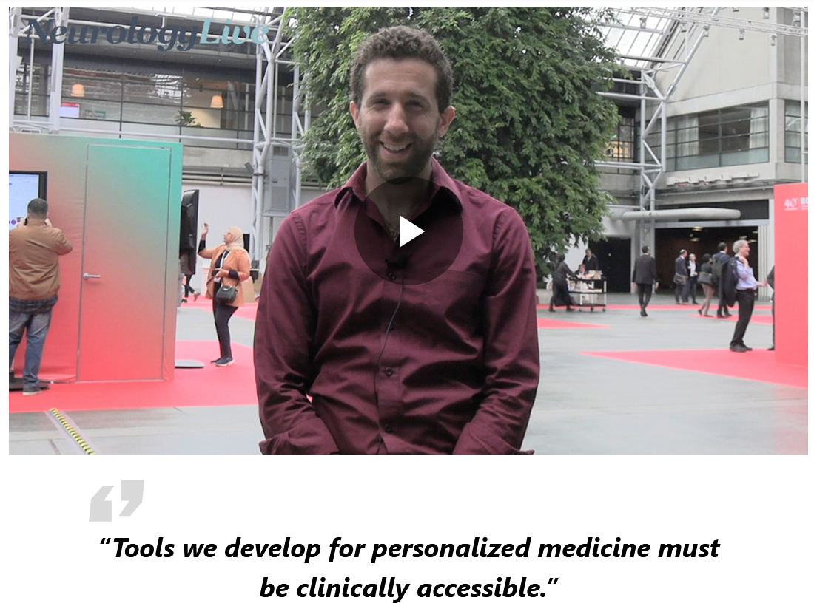
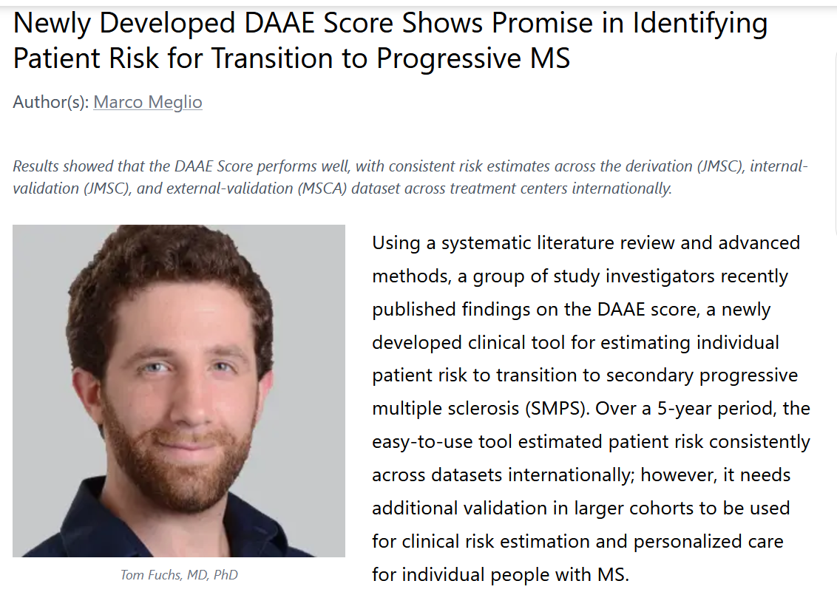
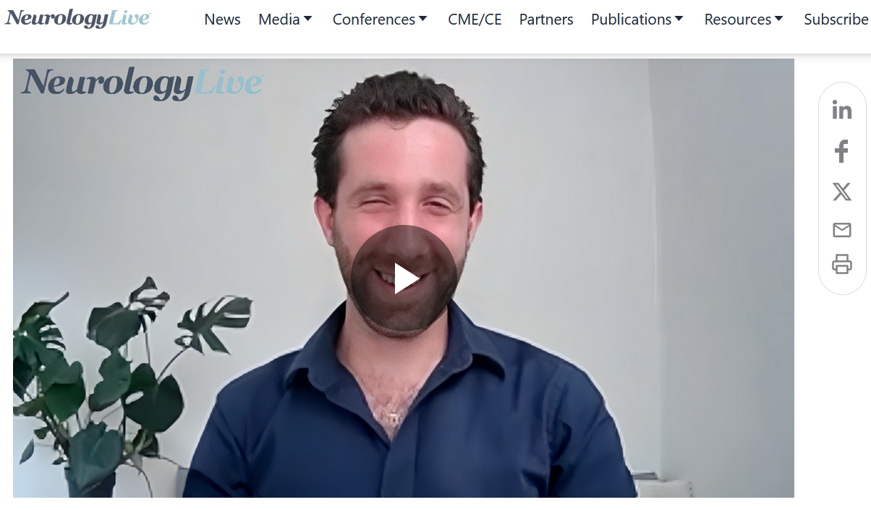
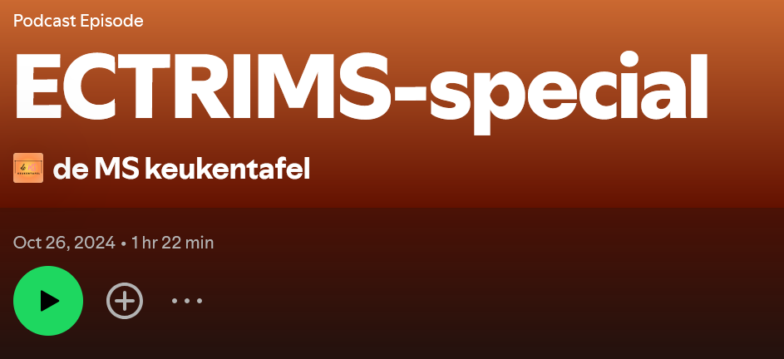
Early interest

Slide 31
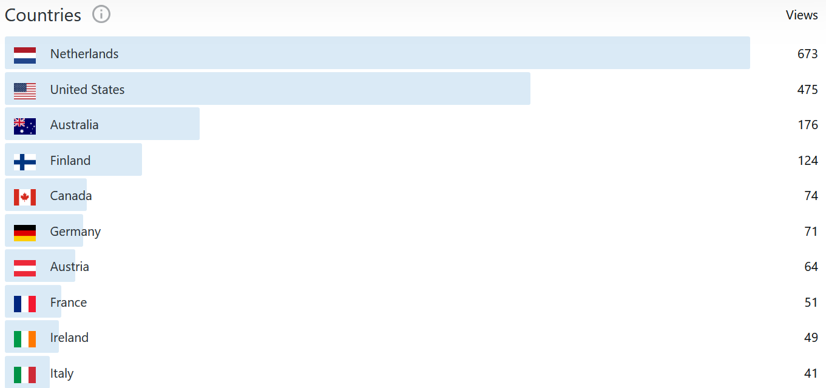
Early interest

Slide 32
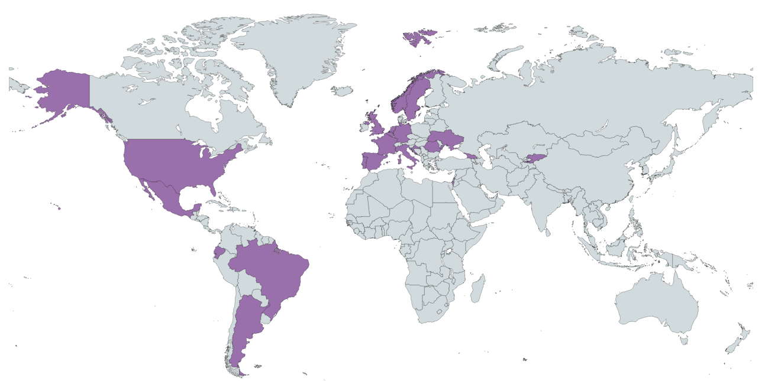
Early interest
Physician survey, System Usability Scale (SUS)
n | 25
Countries | 24
Years of practice | 16.4(14.4)
Rating on SUS | 90.3(6.6)

Slide 33
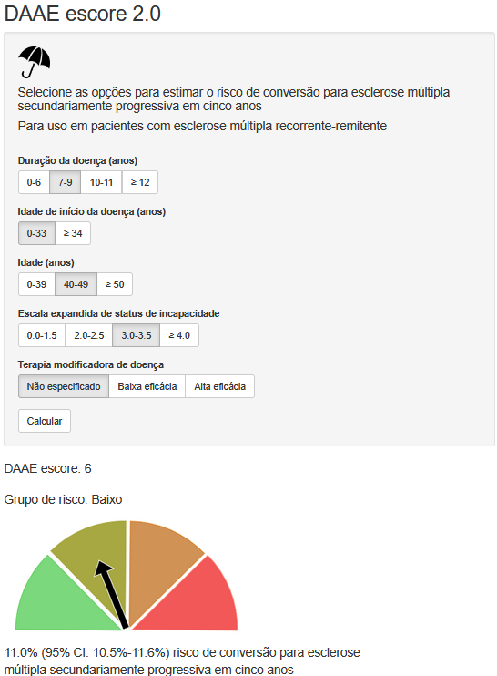
Early interest
Italian?
Physician survey, System Usability Scale (SUS)
n | 25
Countries | 24
Years of practice | 16.4(14.4)
Rating on SUS | 90.3(6.6)

Slide 34
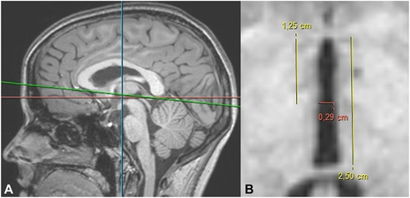
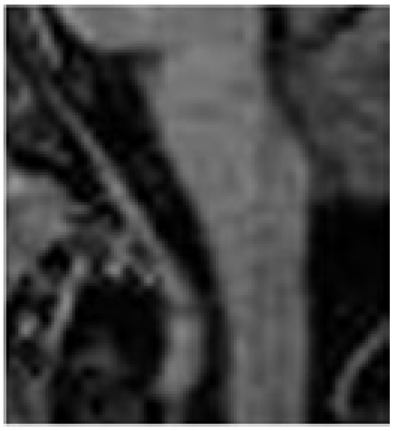
Incorporating MRI
Lutz et al, J. Neuroimaging, 2016; Pontillo et al, Eur Radiology, 2020; Haider et al, JNNP, 2021
Notes:
MSBase

Slide 35
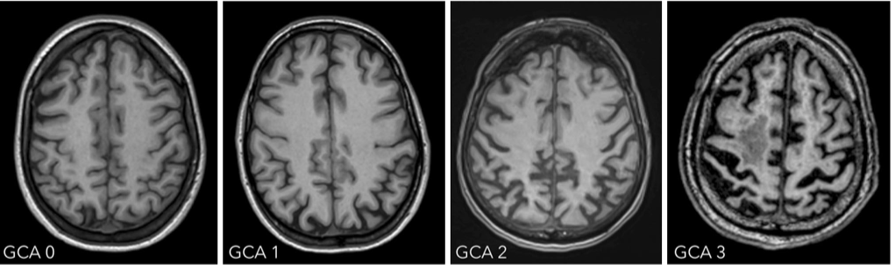
Incorporating MRI
Furtner et al, Nueroimaging in dementia, 2021
Notes:
MSBase

Slide 36
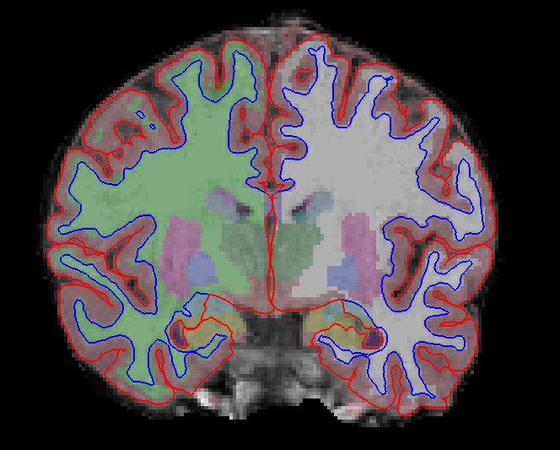
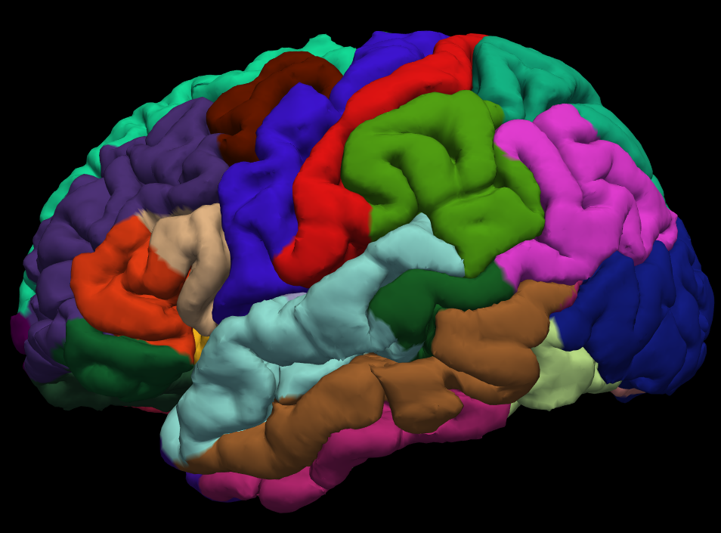
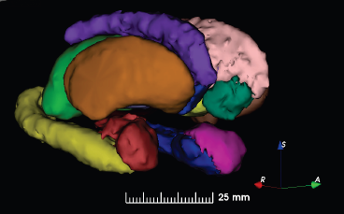
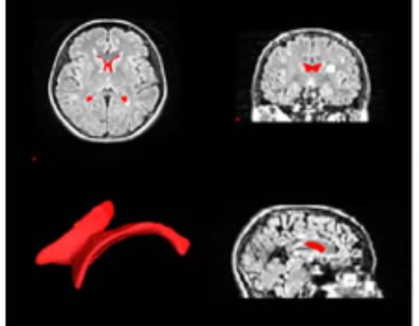
Incorporating MRI
Furtner et al, Nueroimaging in dementia, 2021
Notes:
MSBase

Slide 37
MSBase participating centers
University Hospital Center Zagreb, Zagreb, Croatia
Jacobs School of Medicine, Buffalo, New York, United States
Perron Institute for Neurological and Translational Science, The University of Western Australia, Perth, Australia
Brain and Mind Centre, Sydney, Australia
Neuroimmunology Centre, Department of Neurology, Royal Melbourne Hospital, Melbourne, Australia
Hunter New England Health, John Hunter Hospital, NSW Australia
Department of Neurosciences, Box Hill Hospital, Box Hill, Australia
Department of Neurology, The Alfred Hospital, Melbourne, Australia
n=2,345
10 centers

Slide 38
MAGNIMS participating centers
Amsterdam MS Centre; Amsterdam, The Netherlands
Charles University Medical Centre; Prague, Czech Republic
Medical University of Graz; Graz, Austria
University of Verona; Verona, Italy
University “Federico II”; Naples, Italy
Vita-Salute San Raffaele Universityl; Milan, Italy
Johannes Gutenberg University; Mainz, Germany
Karolinska Institutet; Stockholm, Sweden
Multiple Sclerosis Centre of Catalonia; Barcelona, Spain
n=2,000+
9 centers

Slide 39
Take-away points
Beware the difference between “classify” and “predict”
Clinical predictions should be accessible: remain skeptical of less accessible models and measures
Clinical impact potential is improved when considered at early research stages
Open science is fun!

Slide 40

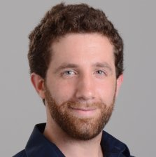
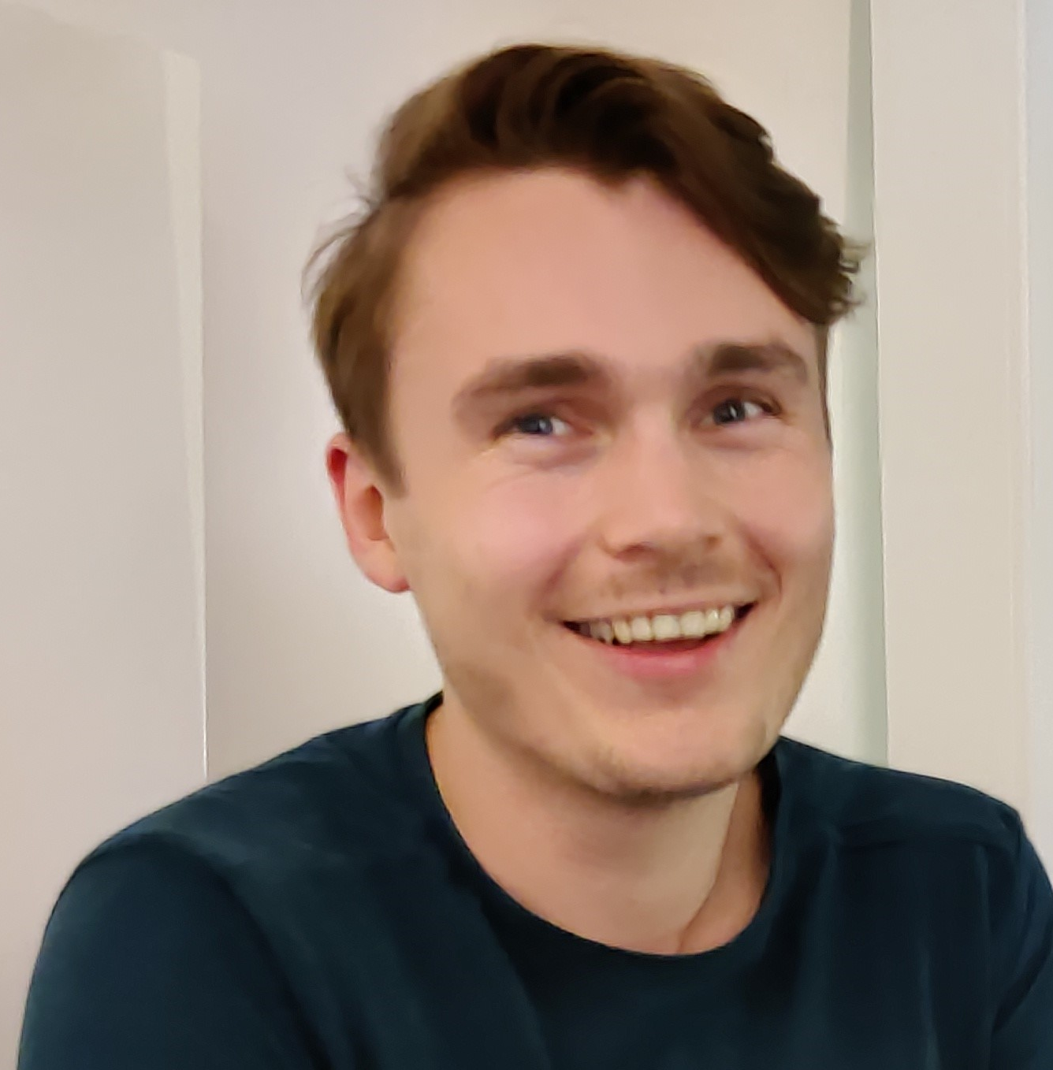
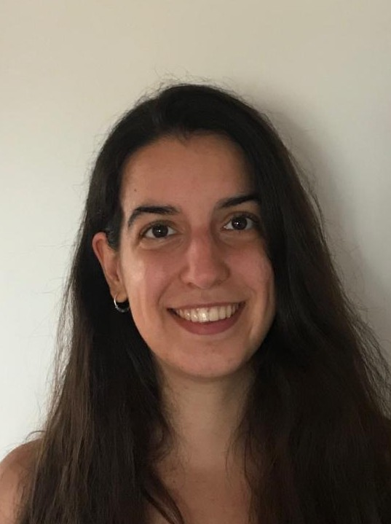
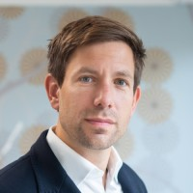

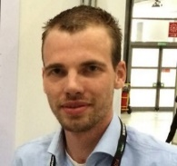
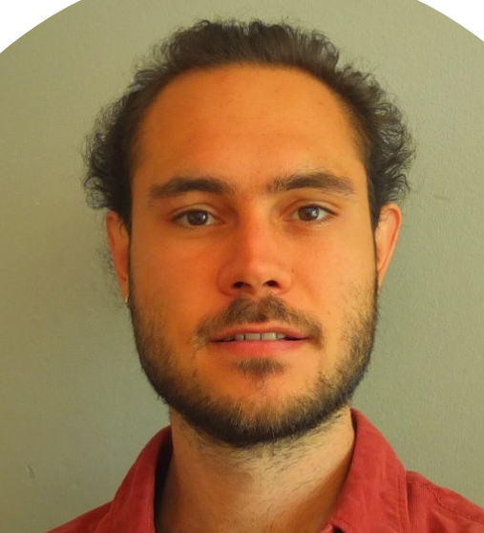
















Questions?
t.fuchs@amsterdamumc.nl
References: ¹Author et al. YEAR; ²Author et al. YEAR; ³Author et al. YEAR

