Slide 1

Preservation of Functional Connectivity Moderates the Impact of White Matter Tract Disruption on Cognition in Multiple Sclerosis
Tom Fuchs¹, Ralph Benedict², Sanjeevani Choudhery¹, Xian Li¹, Keith Carolus¹, Matthew Mallory¹, Alexander Bartnik¹, Devon Oship¹, Faizan Yasin¹, Deepa Ramasamy¹, Dejan Jakimovski¹, Bianca Weinstock-Guttman², Robert Zivadinov¹, Michael Dwyer¹
¹Buffalo Neuroimaging Analysis Center, Department of Neurology, Jacobs School of Medicine and Biomedical Sciences, University at Buffalo, State University of New York, Buffalo, NY, USA
²Jacobs Comprehensive Multiple Sclerosis Treatment and Research Center, Department of Neurology, Jacobs School of Medicine and Biomedical Sciences, University at Buffalo, State University of New York, Buffalo, NY, USA

Slide 2
Disclosures
Robert Zivadinov received personal compensation from Teva Pharmaceuticals, Biogen Idec, EMD Serono, Genzyme-Sanofi, Claret Medical, IMS Health and Novartis for speaking and consultant fees. He received financial support for research activities from Teva Pharmaceuticals, Genzyme-Sanofi, Novartis, Claret Medical, Intekrin and IMS Health
Ralph H. B. Benedict has received research support from Accorda, Novartis, Genzyme, Biogen Idec, and Questcor Pharmaceuticals, and is on the speakers’ bureau for EMD Serono (designing CME courses), and consults for Biogen Idec, Genentech, and Novartis. Dr. Benedict also receives royalties for Psychological Assessment Resources
Michael G Dwyer received personal compensation from Novartis and Claret Medical for speaking and consultant fees. He received financial support for research activities from Novartis
Tom Fuchs, Sanjeevani Choudhery, Xian Li, Keith Carolus, Matthew Mallory, Alexander Bartnik, Devon Oship, Faizan Yasin, Deepa Ramasamy, Dejan Jakmovski, and Bianca Weinstock-Guttman have nothing to disclose.
Notes:
10 seconds

Slide 3
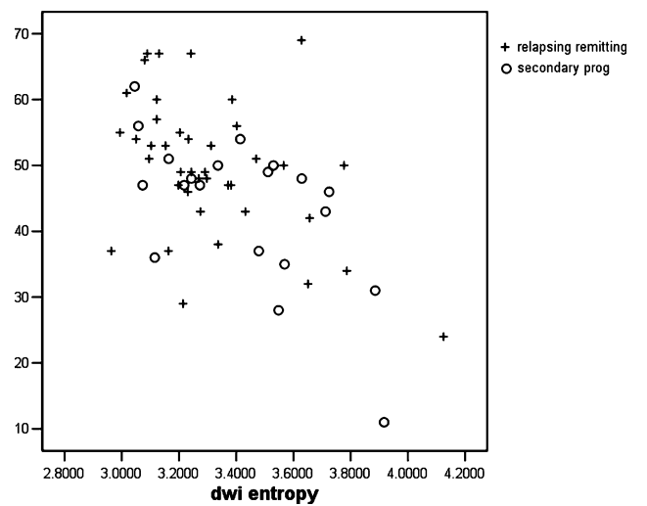
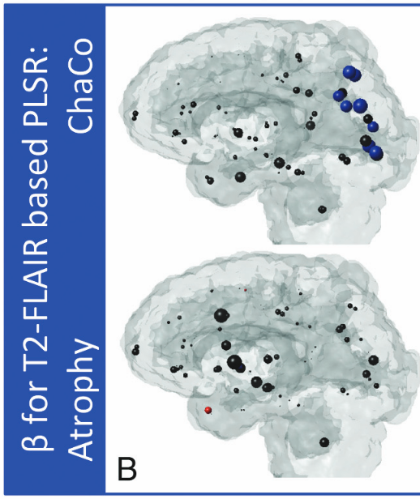
Background
DTI measures of structural connectivity, or disconnectivity, predict cognitive impairment in MS¹
SDMT
Network disruption can be examined via lesion burden, and location.
Lesions in eloquent locations have a greater impact on cognition.
  EG, disruption of tracts connected to occipital structures contribute more to impaired visual processing speed²
Sphere diameter = β, predicting SDMT performance
¹Benedict, et al., Multiple Sclerosis Journal, 2007; ²Kuceyeski, et al., American Journal of Neuroradiology, 2015
Notes:
30s. “Lesion location matters. See here that lesions disrupting white matter emerging from around the occipital cortex is associated with decline in V-IPS.
RB: for decasdes have understood that WM lesions in eloquent areas of the brain can have profound and specific effects on cognition. And cite famous paper. . . Then the second bullet is “in this presentation, we are focused on that same quation, but from a whole brain connectivity persepective. Make picture more spatially associated with the picture.

Slide 4
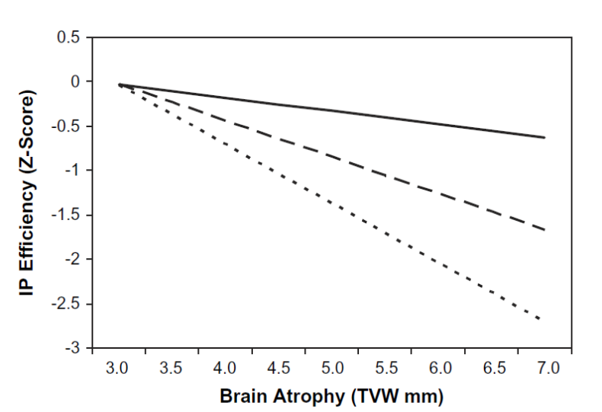
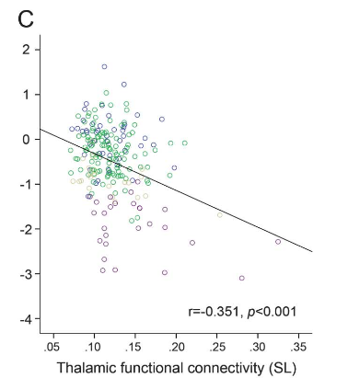
Moderators of the Structure/Cognition Correlation³:
Education
Leisure Activities
Verbal Intelligence
Parental Education
Cognitive Reserve
Cognitive Reserve, via MRI:
Functional connectivity also correlates with cognitive impairment in MS^{4,5}
Does functional connectivity moderate the structure → cognition relationship?
³Sumowski, Journal of the International Neuropsychological Society, 2009; ⁴Schoonheim, et al., Neurology, 2015; ⁵Hawellek, et al., Proceedings of the National Academy of Sciences, 2011

Slide 5
Methods: Subjects
137 MS and 49 HC subjects recruited from the Jacobs Multiple Sclerosis Center, as part of a large Cardiovascular, Environmental, and Genetics (CEG) study⁶
Mean age MS: 53.86,
Mean disease duration: 21.07
Median EDSS: 3.0
Inclusion criteria
Diagnosis of relapsing-remitting, progressive or primary-progressive MS
Neurologic/physical examination within 30 days from the standardized MRI
Exclusion criteria
Substance dependence/abuse
Psychiatric disorders
History of neurological disease other than MS.
⁶Kappus, et al., JNNP, 2015
Notes:
15s. Well matched with HCs

Slide 6
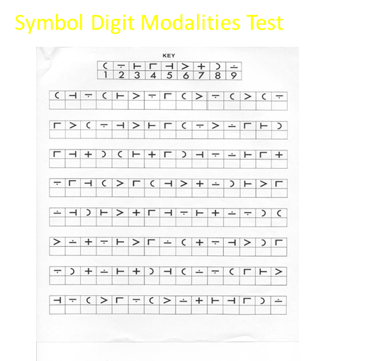
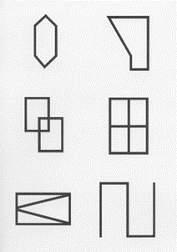
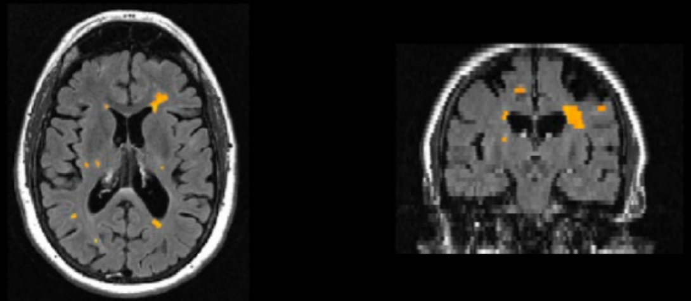
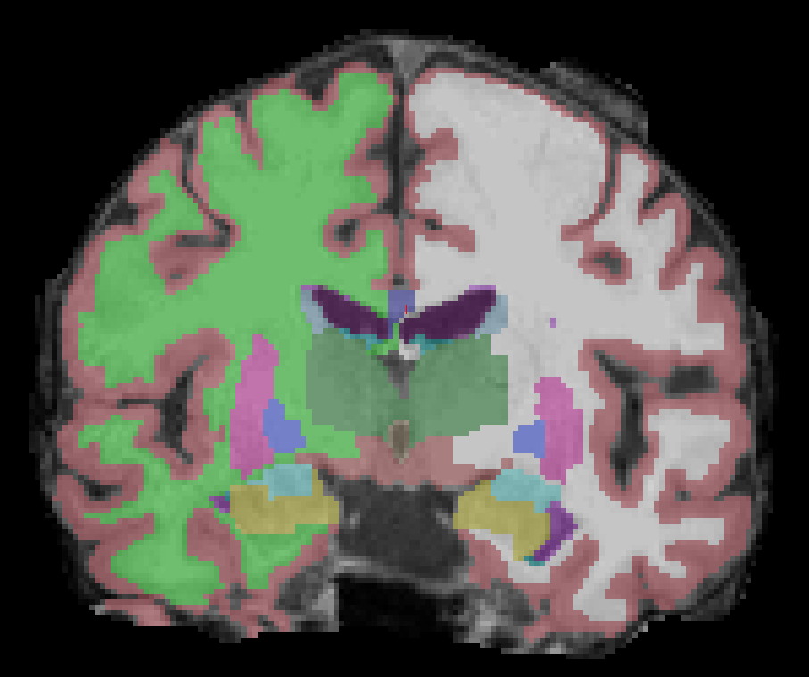
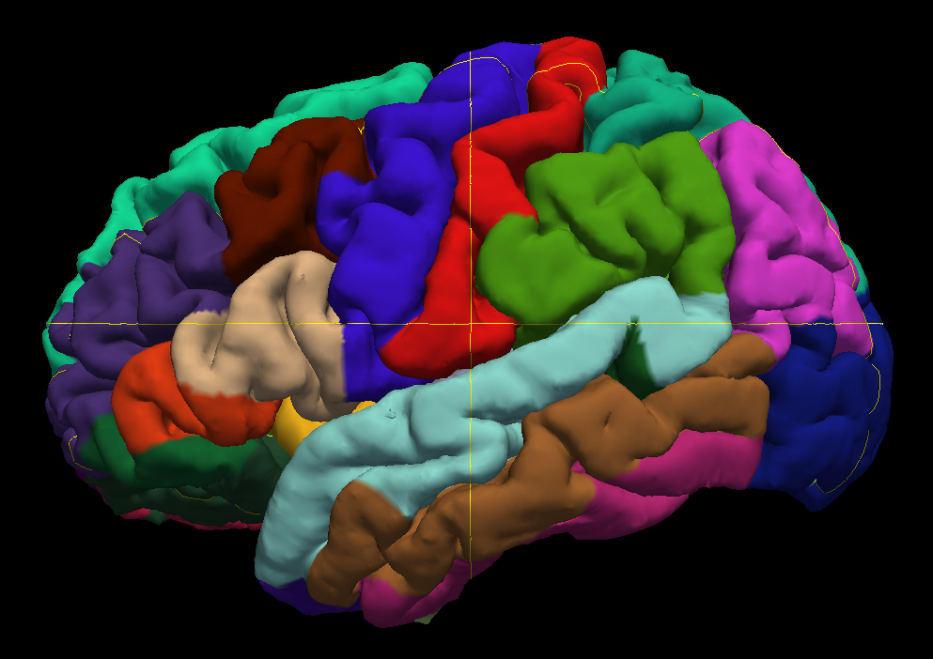
Methods: Neuropsychological Testing and MRI
Brief International Cognitive Assessment for MS (BICAMS)^{7,8}
  Brief Visuospatial Memory Test (BVMTR)
  Symbol Digit Modalities Test (SDMT)
  California Verbal Learning Test (CVLT-II)
MRI
  3T GE MRI scanner
  Standardized protocol across subjects
MRI, structure
  Lesion maps from T2-FLAIR
  T1w image conventionally processed (e.g. N4 bias field correction)
    FreeSurfer for cortical parcellation and subcortical segmentation
MRI, resting state functional; n (MS) = 74, n (HC) = 29
  TE 35ms, TR 2500ms, ~11min
⁷Langdon, et al., Multiple Sclerosis Journal , 2012; ⁸Benedict, et al., BMC Neurology, 2012
Notes:
30s. Must give sequence and parameters of fMRI written.

Slide 7
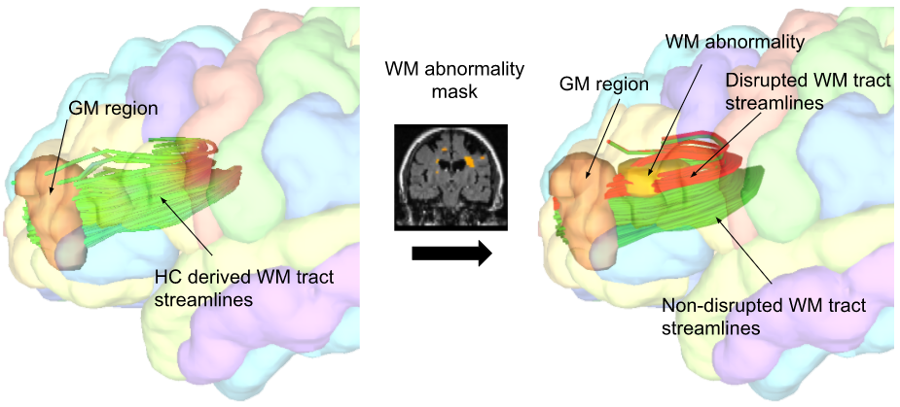
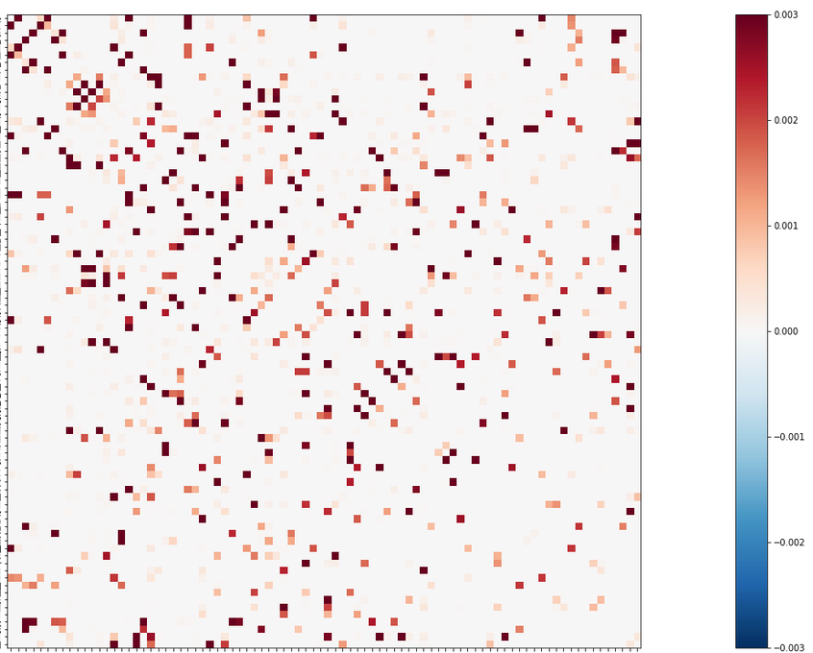
Methods: Network Modification, Structural
Key:
HC: Healthy Control
GM: Gray Matter
WM: White Matter
Tract-based structural network disruption measured using the Network Modification tool⁹
Previously described and publicly available. Measures white matter tract disruption caused by lesions between all pairs of brain regions
  Relative to database of 73 healthy control tractograms in Montreal Neurological Institute space
Applied for all pairs of 86 standard cortical & subcortical FreeSurfer-derived brain regions, resulting in 86x86 connectivity (disconnectivity) matrices
Recently applied to determine patterns of white matter tract disruption associated with decreased trait Conscientiousness in MS¹⁰
⁹Kuceyeski, et al., Brain connectivity, 2013; ¹⁰Fuchs, et al., Human Brain Mapping, in press
Notes:
45s. Here, we are using T2-FLAIR lesions.

Slide 8
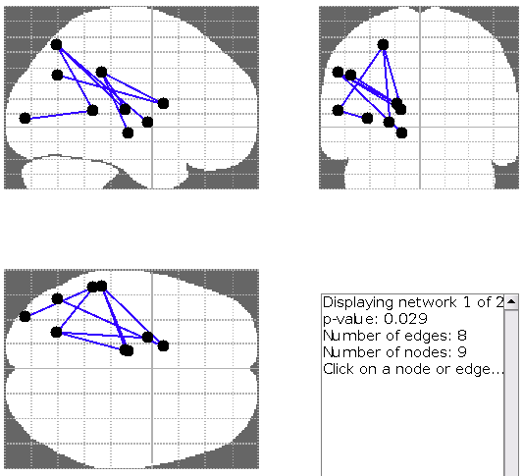
Methods: Network Based Statistics
Pairwise tract disruption analyzed using Network Based Statistics (NBS)¹¹
NBS, used to control for multiple comparisons
Finds a network of regions whose disruption is significantly associated with BVMTR, SDMT, CVLT2
Covariates: age, sex, and whole brain volume
¹¹Zalesky, et al., Neuroimage, 2010
Notes:
30s

Slide 9
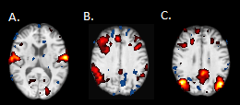
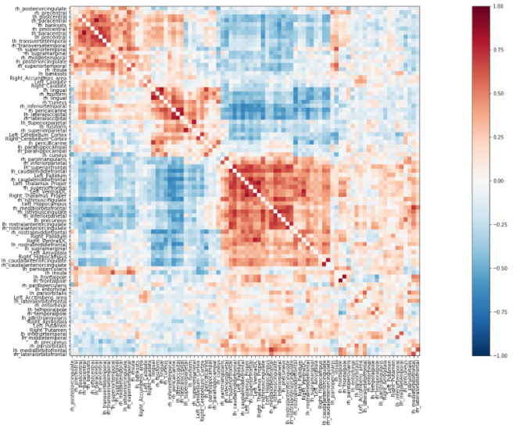
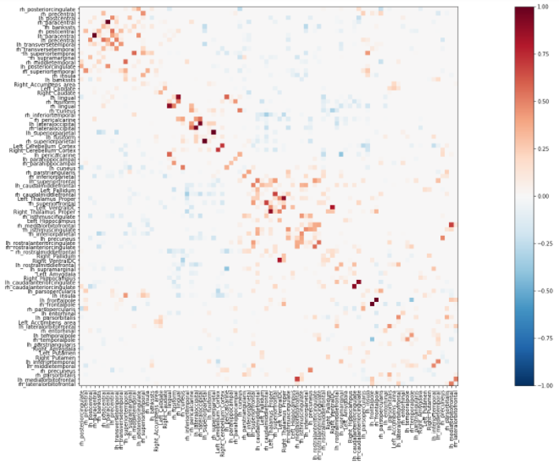
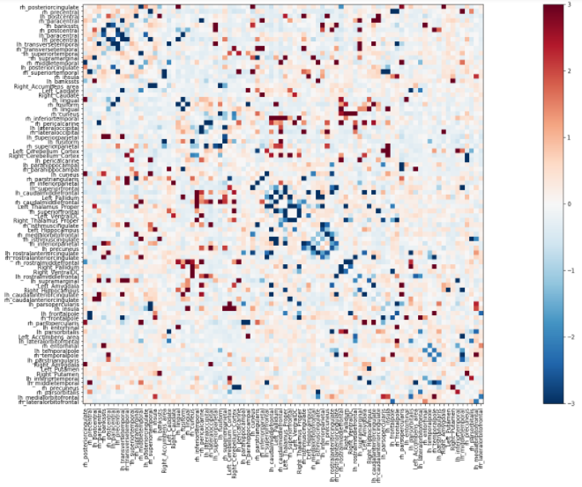
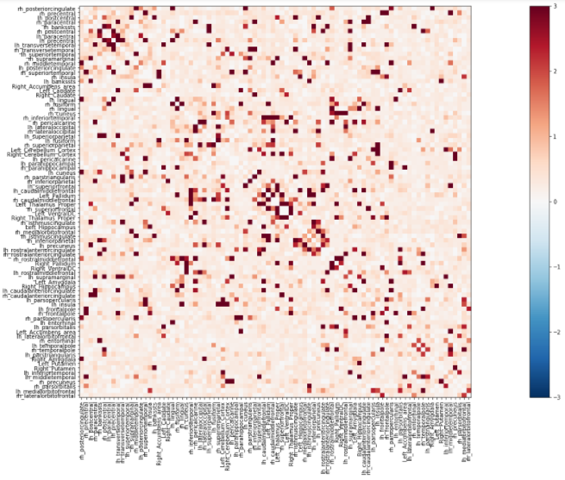
Methods: resting state fMRI
74 MS & 29 HC
Pre-Processing: Cut volumes 1 & 2, slice time correction, motion correction, intensity normalization, temporal filtering, field map unwarping, spatial smoothing, and ICA hand classification and denoising
Post-Processing: Correlation and partial correlation matrices generated for 86 GM regions
  Pairwise deviation in functional connectivity calculated as a z-score, relative to HC mean/stdev
  Absolute value taken for final analysis
Pairwise Functional Connectivity
Pairwise Deviation (z) in Functional Connectivity
Notes:
60s. RZ: what is blue and what is red.
60 seconds. Explain that fMRI was available in 75 subjects with MS and 30 age-matched HCs. See that the expected resting-state networks were present in our subjects.

Slide 10
Methods: Analysis
3 regressions models, each predicting a separate cognitive domain:
BVMTR
SDMT
CVLT-II
Independent Variables:
Age
Sex
Mean, domain-specific structural network disruption
Mean, domain-specific functional network deviation
Interaction, structure by function
Notes:
45s. RB: say “regression models” not regression.

Slide 11
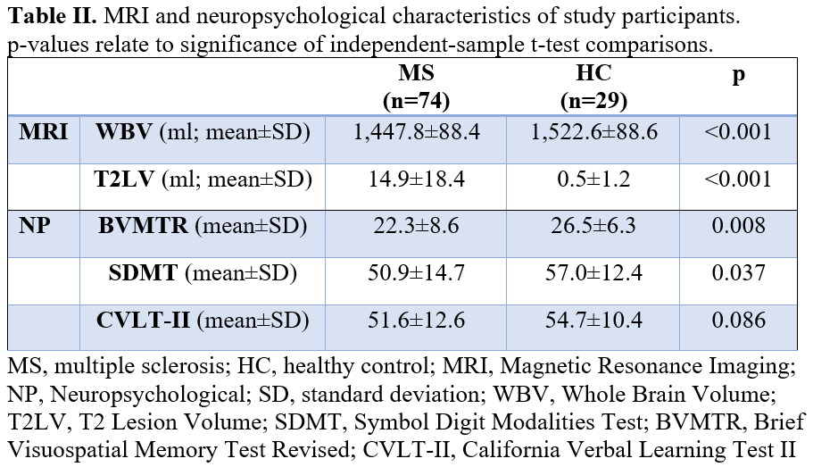
Results: MRI and neuropsychological characteristics

Slide 12
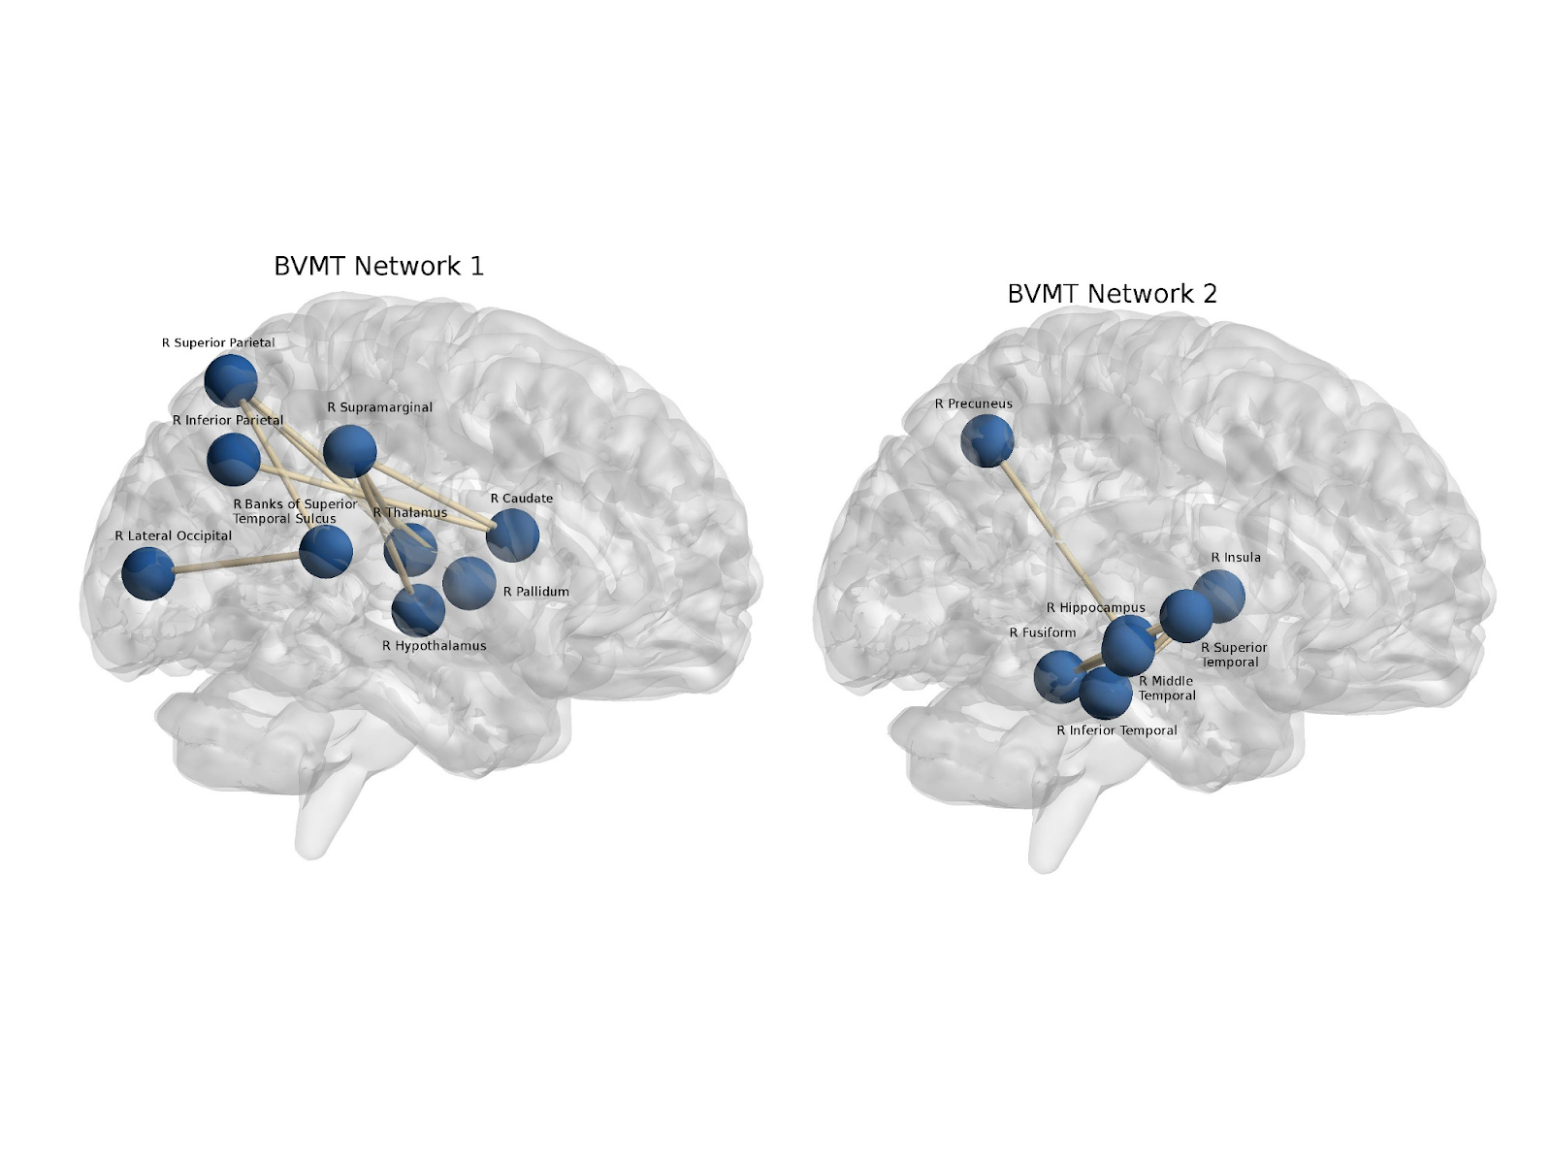
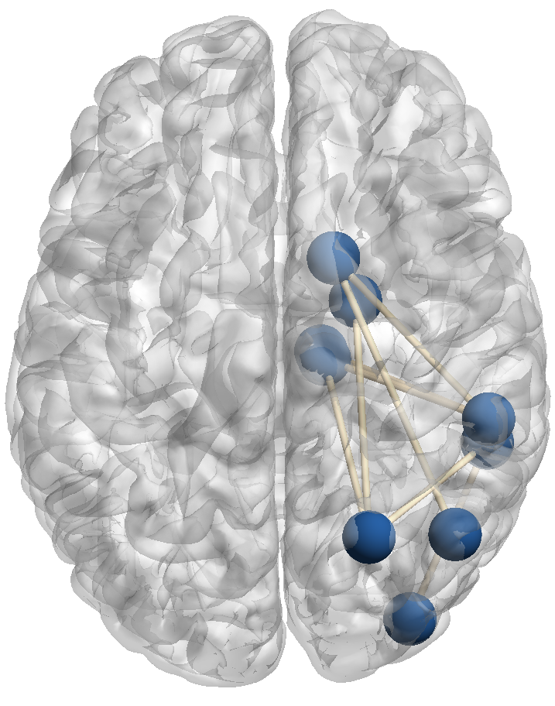
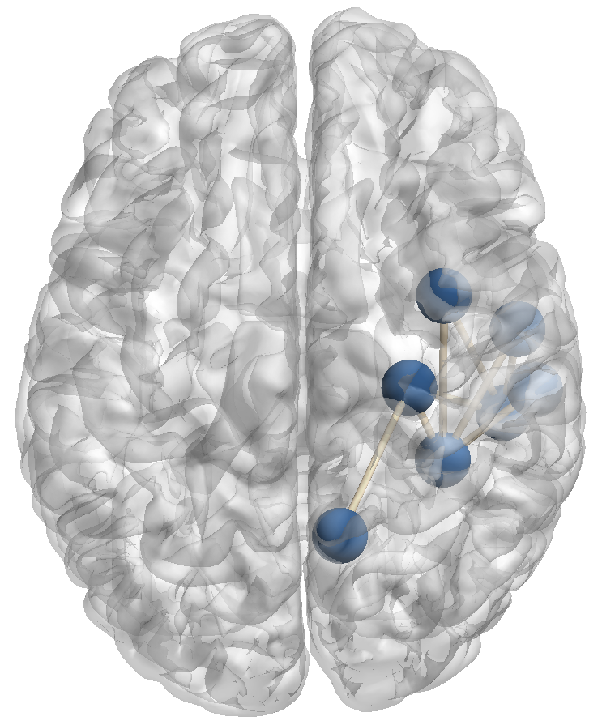
Results: Lesion Disrupted Networks Associated with BVMTR impairment
Notes:
30s. RB: All in Right hemisphere. In interest of time, not showing result for CVLT, which was less sensitive in this cohort.
NBS found. . . This is the network of brain regions whose disconnection was significantly correlated with visuospatial memory impairment, controlling for age, sex, and brain volume. This is consistent with what we would expect based on previous literature. Visual cortical. Hippocampal.
RB: please add axial view.

Slide 13
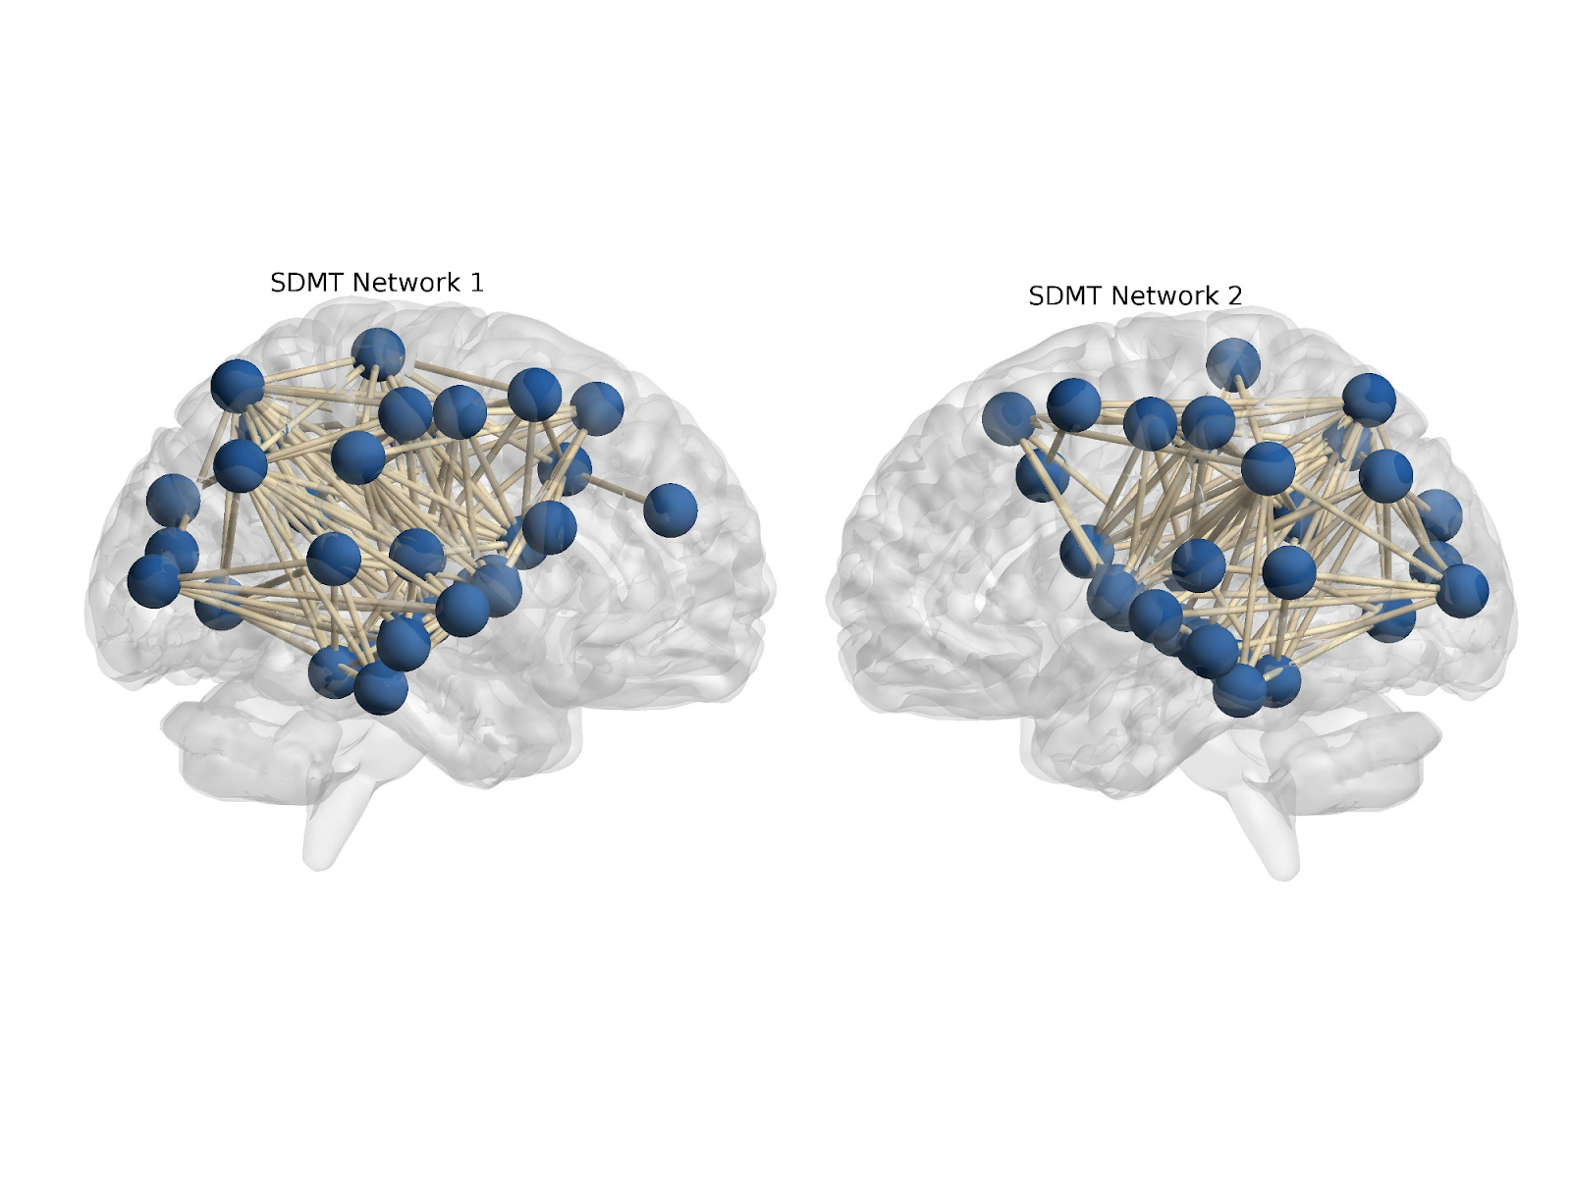
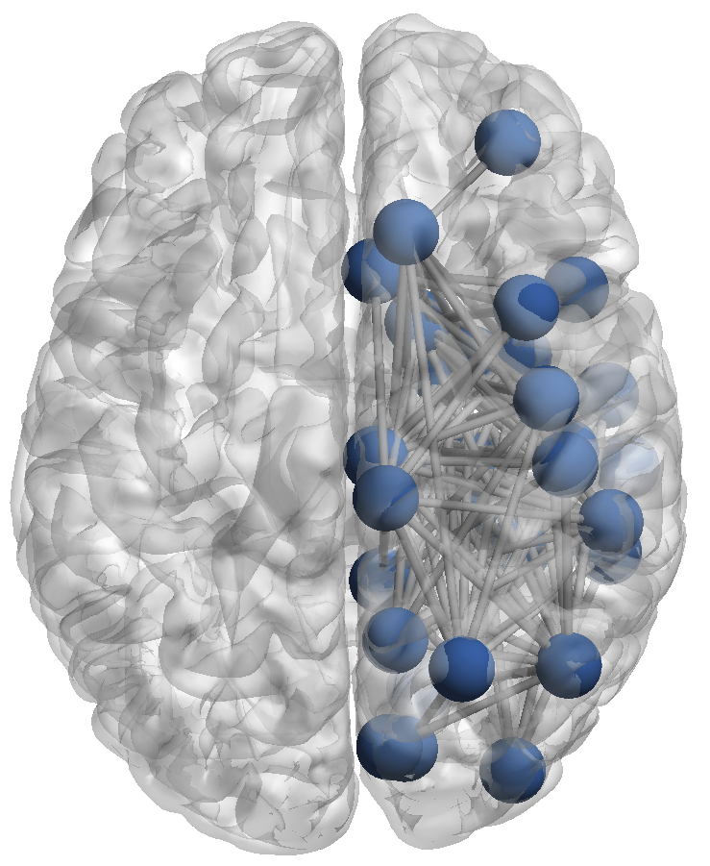
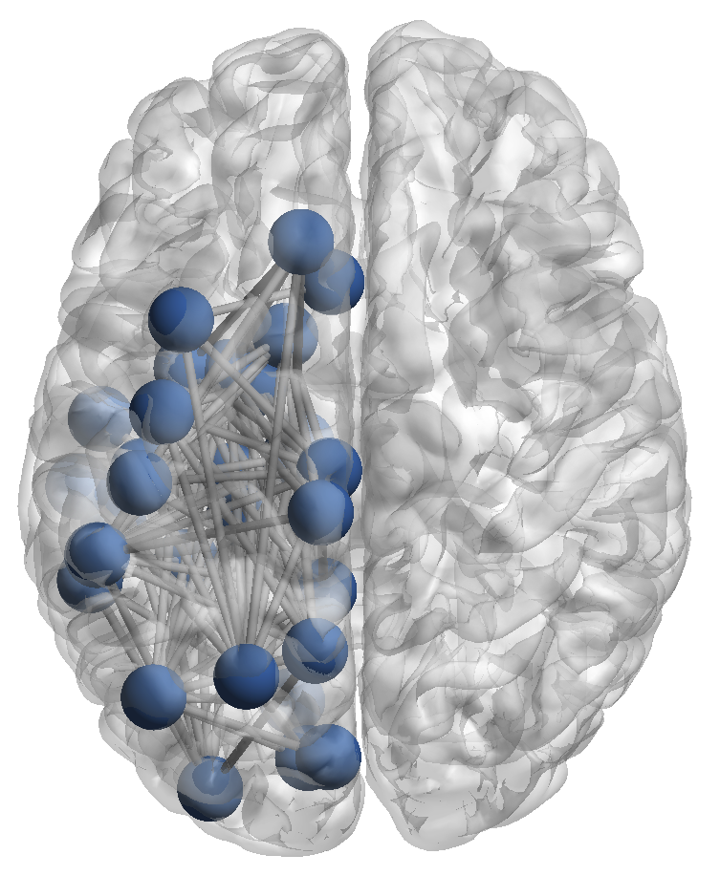
Results: Lesion Disrupted Networks Associated with SDMT impairment
Notes:
20s. much broader network of disconnection. This is as expected given that SDMT is the most sensitive to markers of pathology
10 strongest relationships are right-parietal connections with deep gray (thalamus, caudate, putamen, and hypothalamus).
RB: don’t say that cuz frontal isn’t in it. Just say sensitive. Name a few stuctures. . Cheryy pick some good ones, broad frontal-parietal. . .
28=Superiorparietal_R to 72=Putamen_R.
28=Superiorparietal_R to 70=Thalamus_Proper_R.
28=Superiorparietal_R to 71=Caudate_R.
28=Superiorparietal_R to 34=Insula_R.
30=Supramarginal_R to 71=Caudate_R.
30=Supramarginal_R to 70=Thalamus_Proper_R.
7=Inferiorparietal_R to 71=Caudate_R.
16=Paracentral_R to 34=Insula_R.
55=Postcentral_L to 56=Posteriorcingulate_L.
30=Supramarginal_R to 77=Hypothalamus_R.

Slide 14
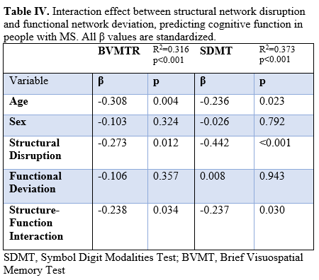
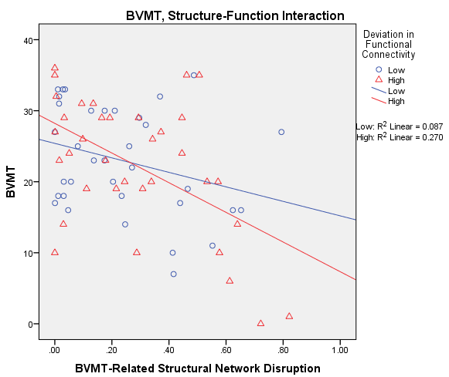
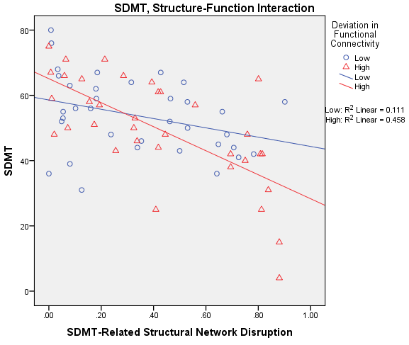
Results: Normal functional connectivity attenuates the impact of structural network damage on cognition
Notes:
60s. RB: CVLT wasn’t significant. Just a trend. In the interest of time, not talk about CVLT because effect not as strong.
Tell them the axis. Restate the hypothesis. Preserved FC attenuates. Whereas deviated functional connectivity ACCENTUATEs.
Separated by groups only for visualization purposes. High vs low. Significant interaction effect
RB: Subjects with less deviation in funcon relative to HC, more normal-like, are buffered from the effects of structural damage on cogntion.
RB: first two slides set up the background for THIS.
RB: func con might provide buffering because metric of cog reserve.

Slide 15
Conclusions
Functional connectivity moderates the impact of structural network damage on cognition
This relationship is similar to models of cognitive reserve
Maintenance of normal functional connectivity may be an MRI proxy for cognitive reserve
Our findings also validate how we think of critical cognitive measures in MS
Disruptions of salient networks are associated with BVMTR impairment
More widespread disruption networks are associated with SDMT impairment, validating why SDMT is so sensitive and useful a measure in MS
Notes:
45s. RB: last bullet . . . We have an interaction. One possibility is this and another possibility is that. Next step is longitudinal work to clarify. Emphacizwe that our results based on absolute deviation - and future work to clarify pos and neg.

Slide 16



Thanks to
Mentors:
Ralph Benedict, PhD
Michael Dwyer, PhD
Robert Zivadinov, MD, PhD
Students and Collaborators:
Bianca Weinstock-Guttman, MD
Faizan Yasin, MD
Deepa Ramasamy, MD
Dejan Jakimovski, MD
Sanjeevani Choudhery
Xian Li
Keith Carolus
Matthew Mallory
Alexander Bartnik
Devon Oship
Institutions:
Jacobs School of Medicine and Biomedical Sciences
Buffalo Neuroimaging Analysis Center
Jacobs Comprehensive Multiple Sclerosis Treatment and Research Center

