Slide 1


Cognition in Multiple Sclerosis: Evaluation, Treatment, and Insights from MS as a Network Disease
Tom Fuchs, MD PhD

Slide 2
Who am I?
ECTRIMS Post-Doctoral Fellow, MS Center Amsterdam, 2022 – present
M.D., Jacobs School of Medicine & Biomedical Sciences, 2022
Post-Doc, Jacobs Multiple Sclerosis Center, 2019-2022
Ph.D., Jacobs Multiple Sclerosis Center, 2019
Thesis: Cognitive Reserve, Conscientiousness, and the Human Brain Connectome in Multiple Sclerosis
Advisors: Ralph Benedict, Robert Zivadinov, Michael Dwyer
B.S., Binghamton University, 2013
Neuroscience & Philosophy

Slide 3
Outline
Introduction to MS
Evaluation of cognitive dysfunction in MS
Treatment of cognitive dysfunction in MS
Insights from MS as a network disease

Slide 4
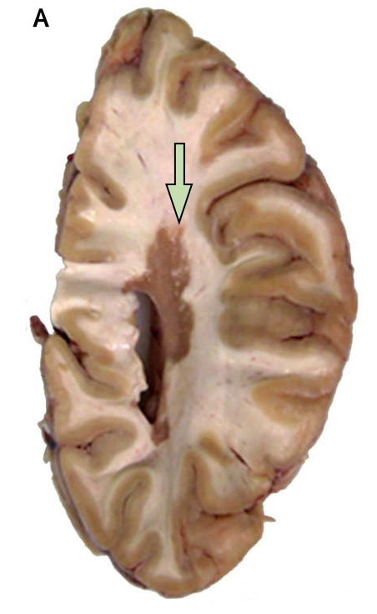
Introduction to Multiple Sclerosis

Slide 5
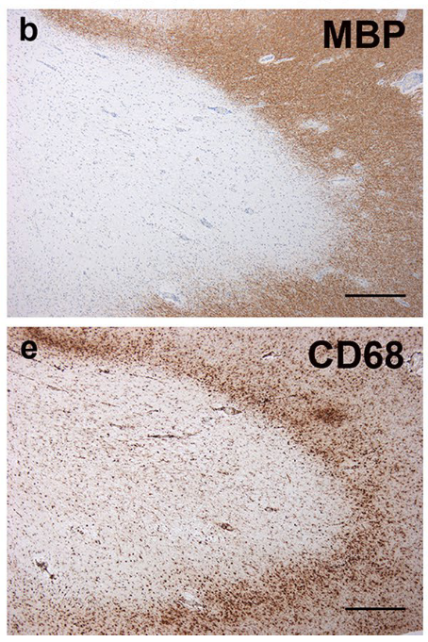
Multiple Sclerosis
Notes:
Main point: white matter. But also Gray!

Slide 6
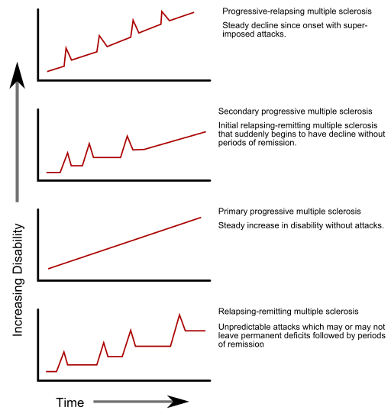
Multiple Sclerosis
Notes:
Main point: relapses but also disease worsening between relapse events!

Slide 7
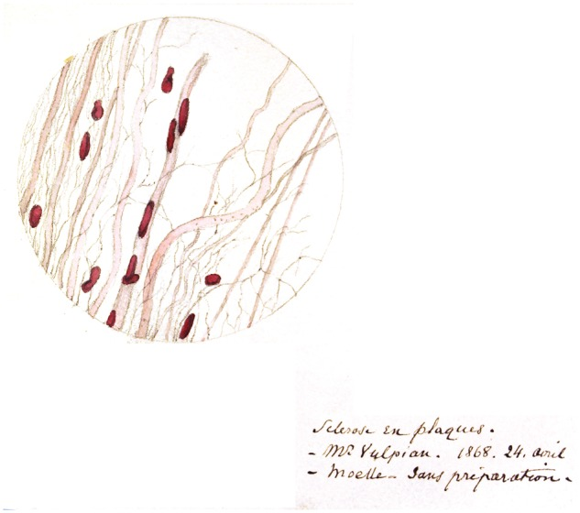
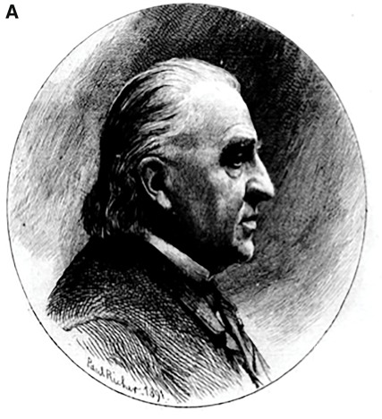
Cognition in Multiple Sclerosis
“Marked enfeeblement of the memory" and "conceptions that formed slowly".

Slide 8
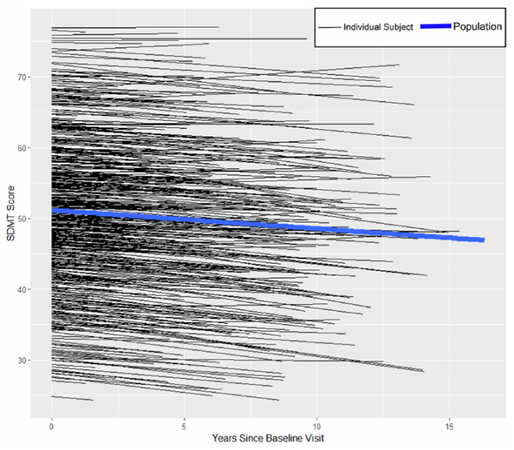
Cognitive Evaluation in Multiple Sclerosis

Slide 9
Prevalence of Cognitive Impairment in MS
Notes:
Prevalence across studies and MS types

Slide 10
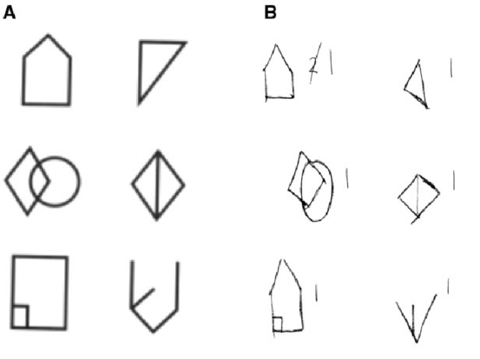
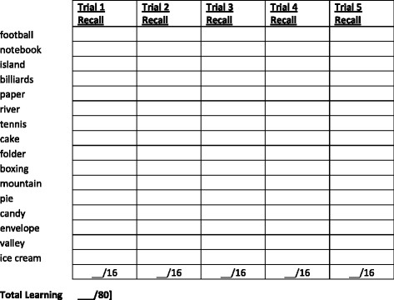
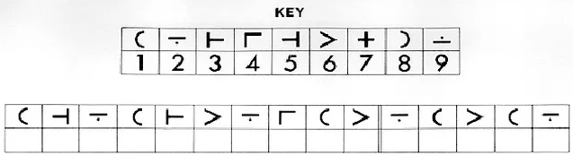
Cognitive Testing in MS
Notes:
BICAMS. Oral forms to avoid confound of physical disability is paramount in MS

Slide 11
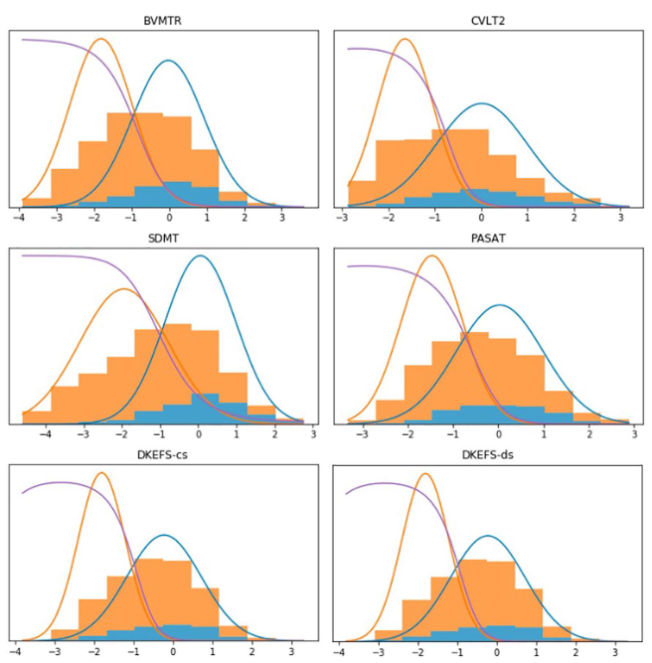
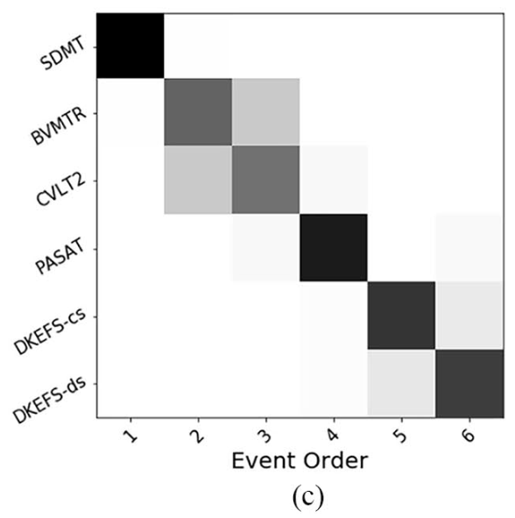
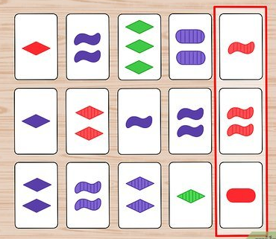
Progression of Cognitive Impairment
Notes:
Early attempts at defining a progression. Though of course – not all patients follow the same path.

Slide 12
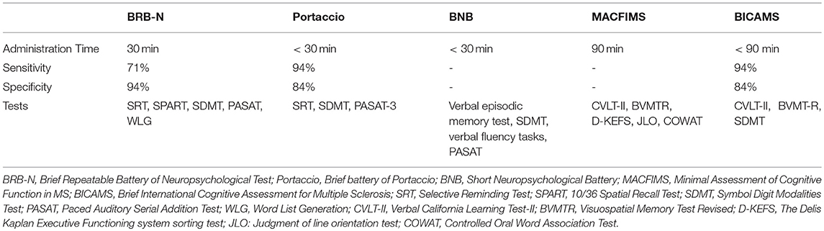
Most Tested Domains
Notes:
Main point: Different batteries reveal different things.
Lesions can be anywhere – so any cognitive dysfunction is possible, though some patterns reveal themsevels.

Slide 13
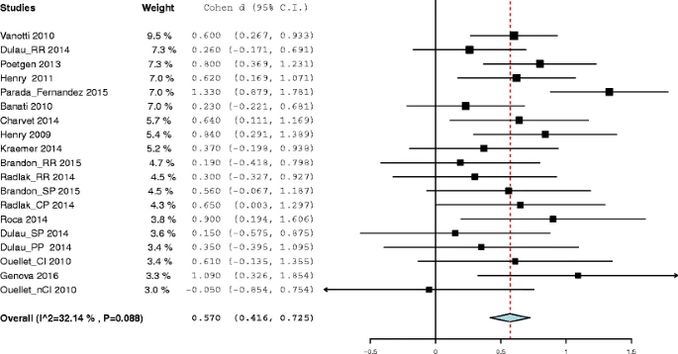
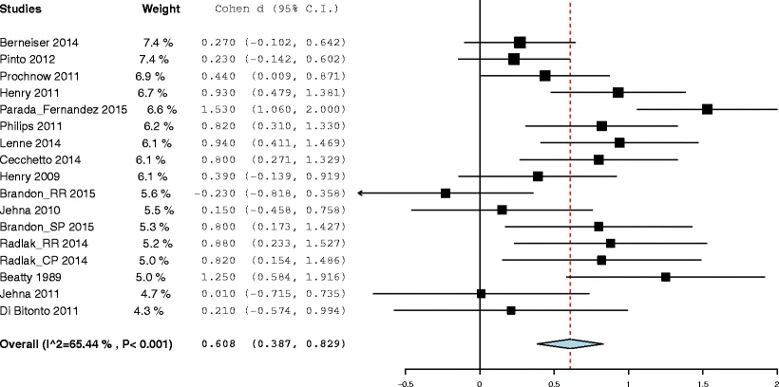
Less Commonly Tested Functions
e.g. Facial emotion recognition & emotional empathy
Notes:
But keep in mind that just because one cognitive domain is less studied doesn’t mean it is not affected in MS patients.

Slide 14
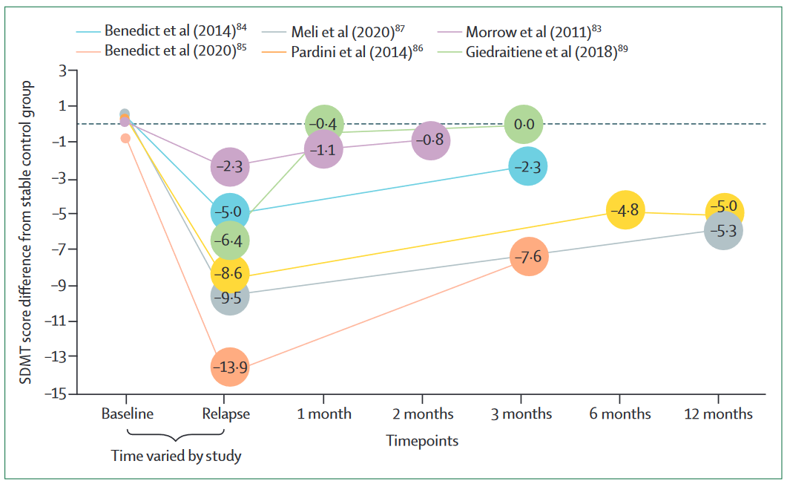
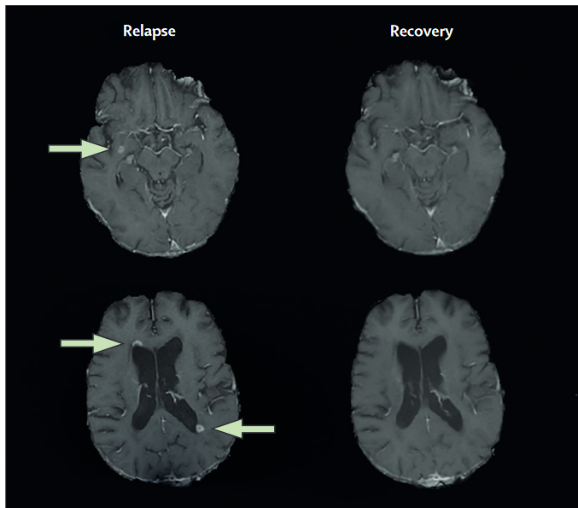
Cognition During Relapse
Notes:
Decline during relapses that improves at time of recovery.

Slide 15
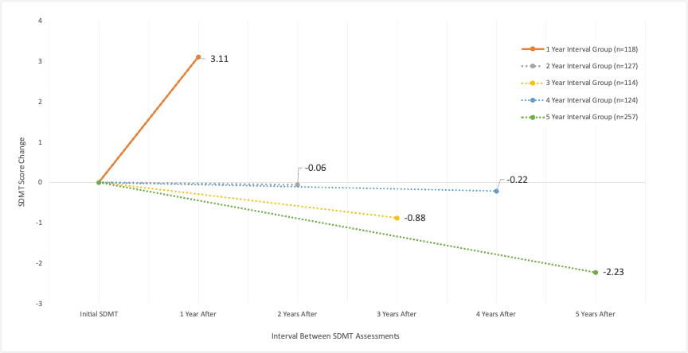
Practice Effects vs. Longitudinal Decline
Notes:
Practice effects get in the way – so must be weary of repeat testing, especially in the age of app-based testing.

Slide 16
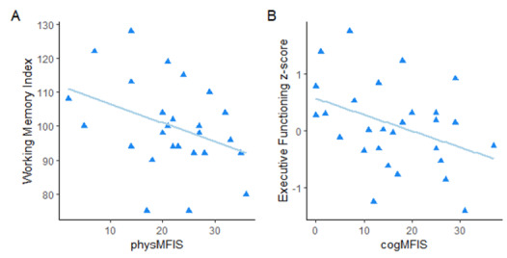
Confounds of Cognition in MS
Notes:
In MS, fatigue is a very important confound. Also depression.
Cognitive fatigue
Physical fatigue
Vigilance decrement

Slide 17

Treatment of Cognitive Impairment in MS

Slide 18
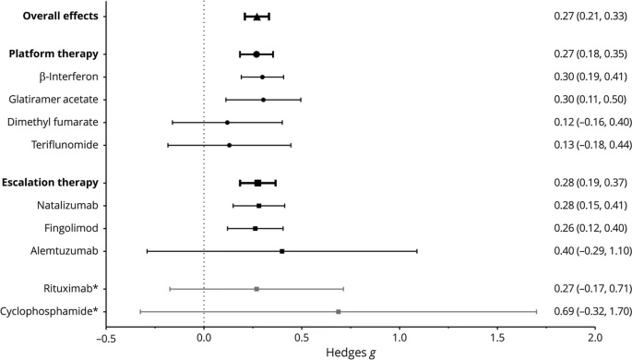
Pharmacologic Treatment
Notes:
The lack of significant differences on cognitive outcomes between first and second line DMTs was another relevant result, although unexpected. Even though possible confounding variables such as treatment duration, baseline EDSS score, sex, age, disease duration, study quality score, and years of education showed no significant influence on treatment, it is noteworthy that RRMS patients receiving second line DMTs had a lower education, longer disease duration and higher EDSS score, compared to those receiving first line therapies. This is as would be expected given that RRMS is a more active and severe disease, with a longer disease duration and thus more likely to receive effective DMTs. Accordingly, the demonstration of a similar effect between first and second line DMTs despite these clinical differences supports the potential benefits of the most effective drugs in improving cognitive functions also in RRMS patients with a more severe disease burden.

Slide 19
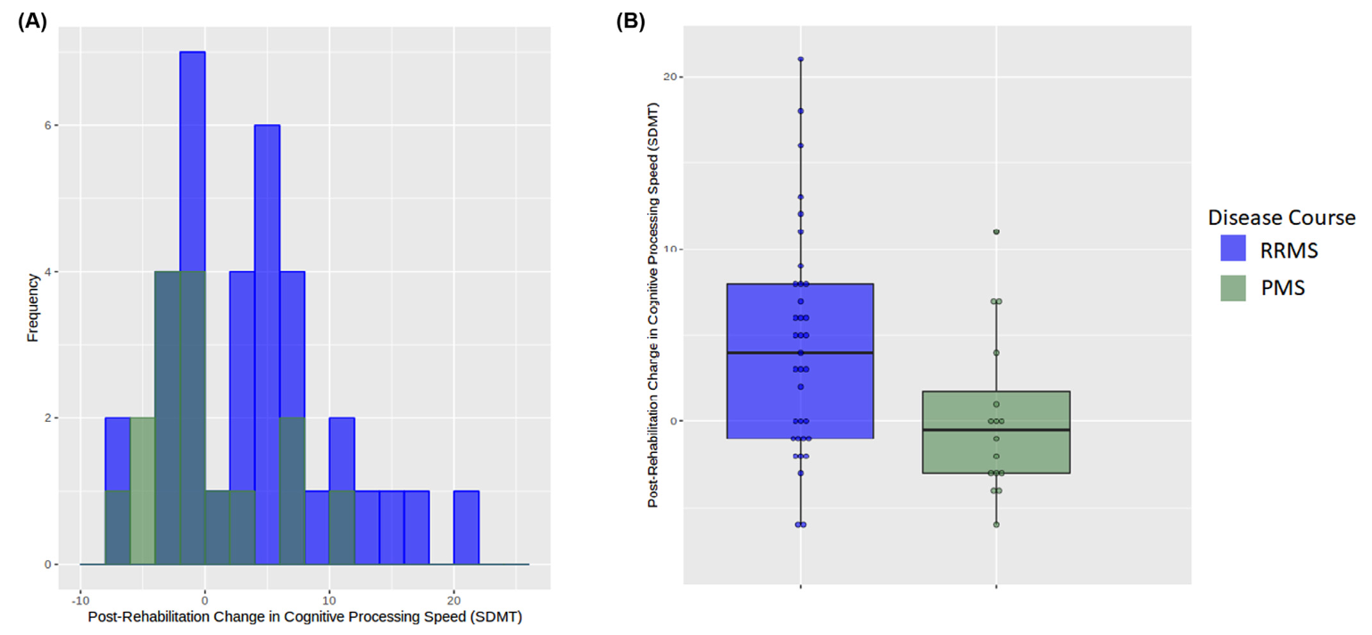
Behavioral Treatment

Slide 20
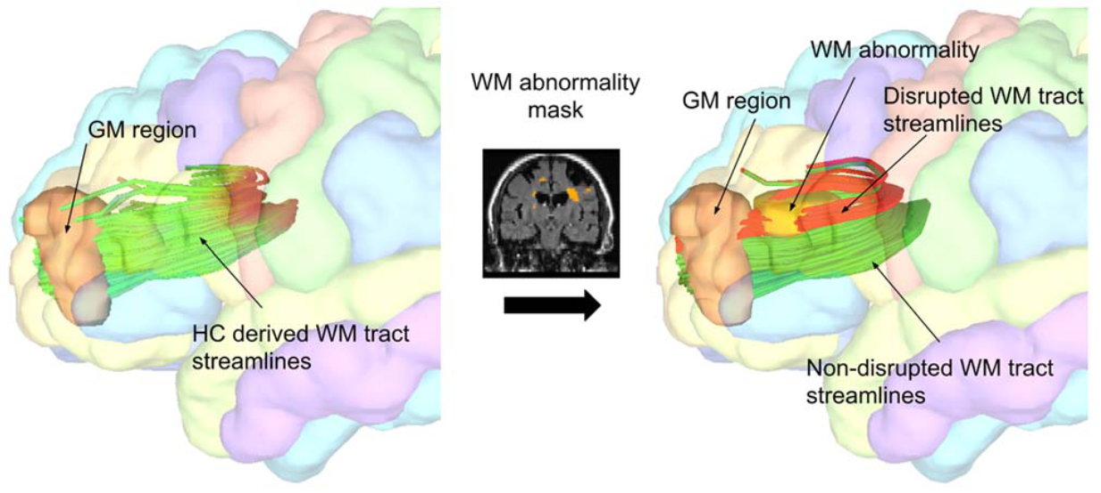
Cognition and Brain Networks

Slide 21
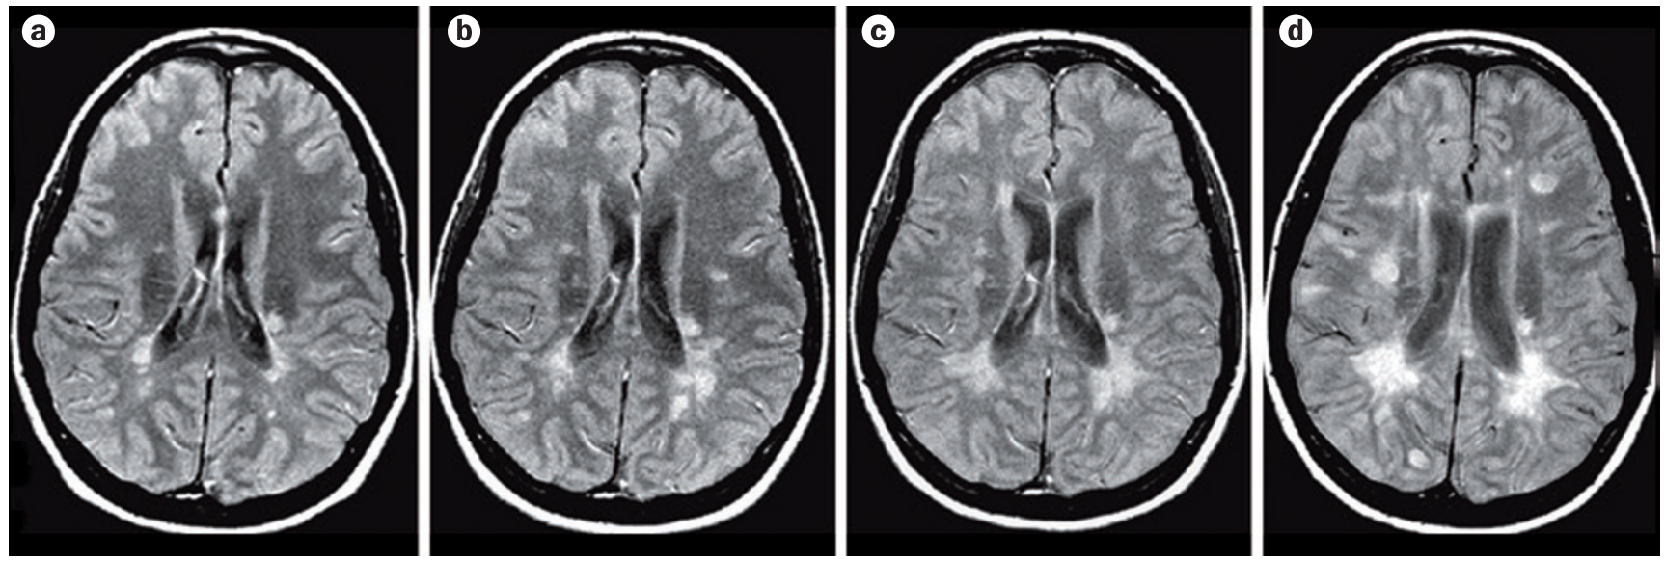
Simplest MRI Measures
Notes:
Lesions and central atrophy.

Slide 22
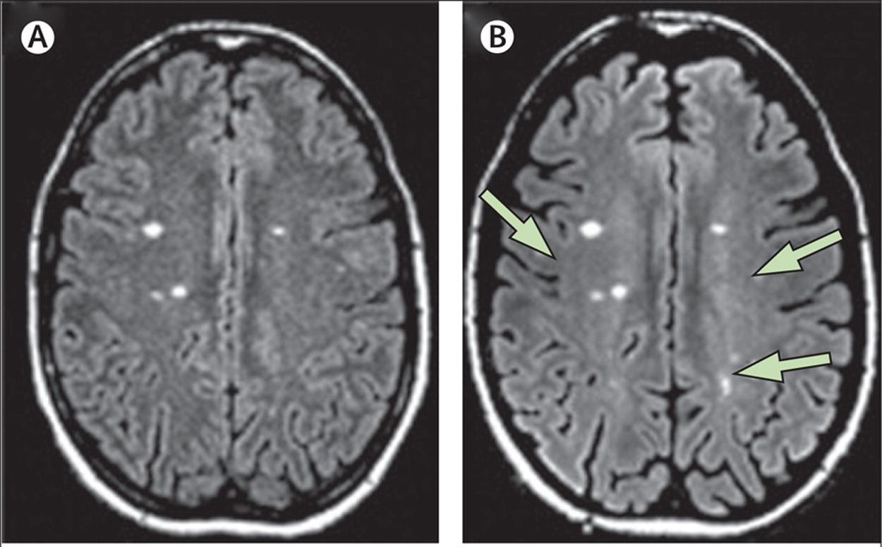
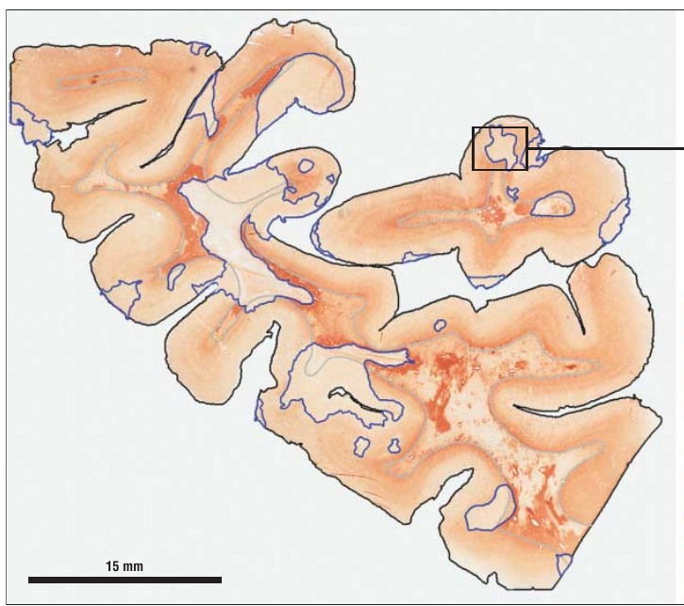
Limits of Technology
Notes:
Lesions invisible on MRI, especially if in GM.

Slide 23
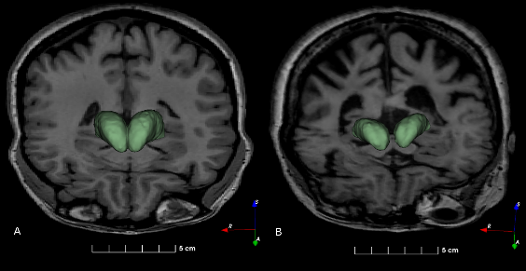
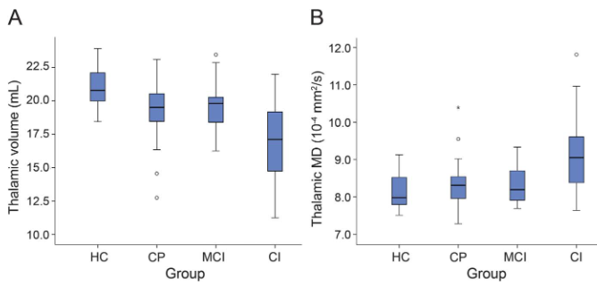
Thalamus as a Proxy Measure
Notes:
Main point is that thalamus may summarize things well for MS.

Slide 24
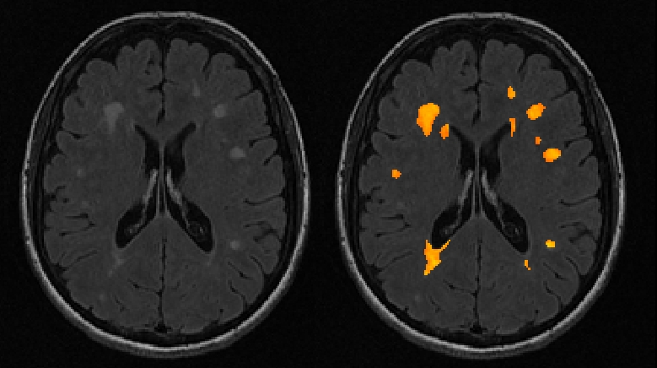
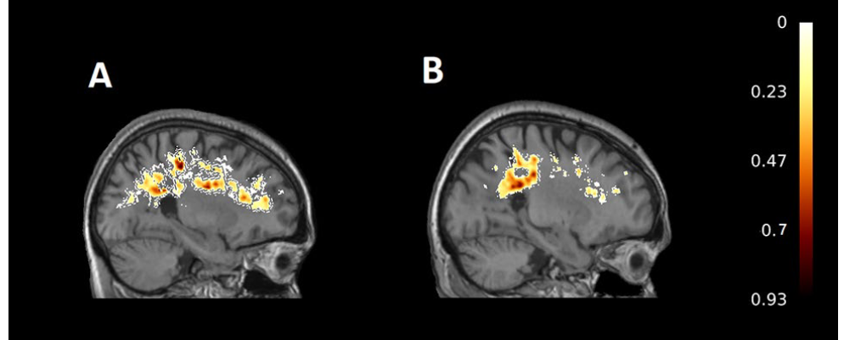
MS as a Network Disease
Notes:
But lesions in different locations make MS a complex ablation model for studying cognition.
Can use lesion locations or use WM abnormalities (here more red if lowered FA)

Slide 25
MS as a Network Disease
Notes:
And study lesion locations within frfamework of structural connectivity. Matrices! Graph theory!

Slide 26

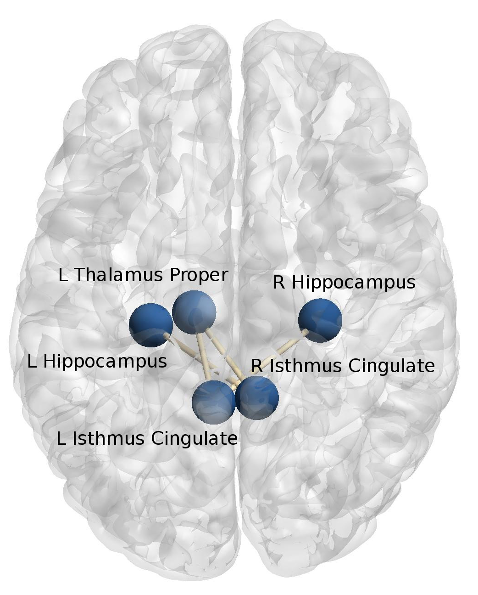
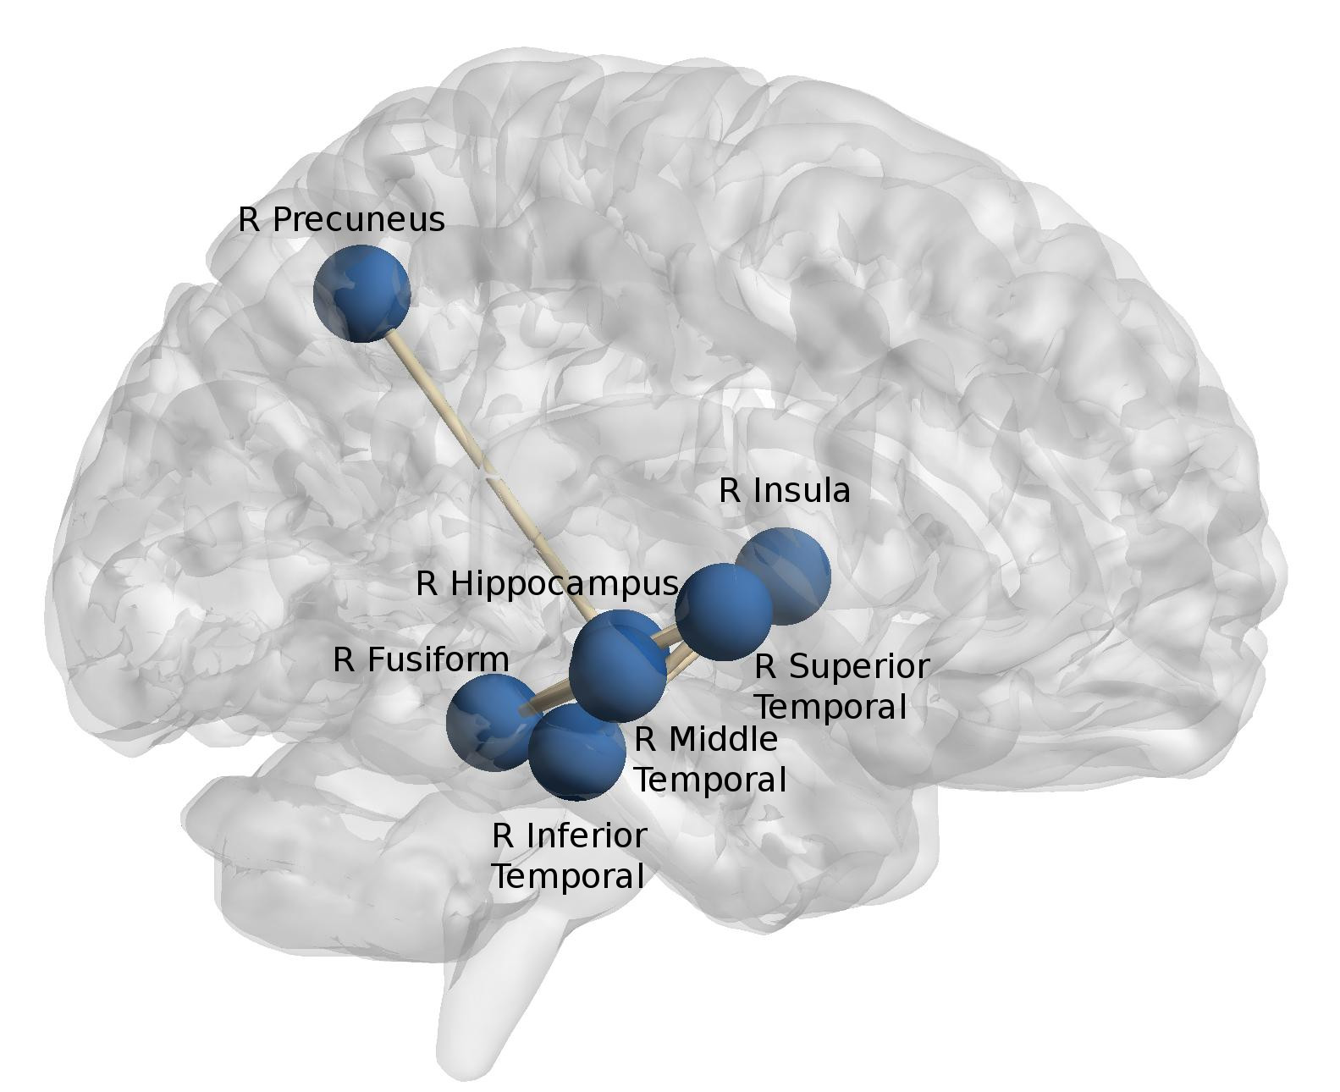
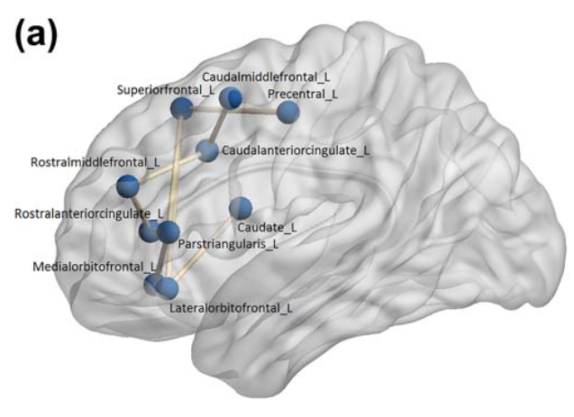
Insights from MS as a Network Disease
Notes:
Conscientiousness
CVLT (verbal memory)
Visuospatial memory

Slide 27
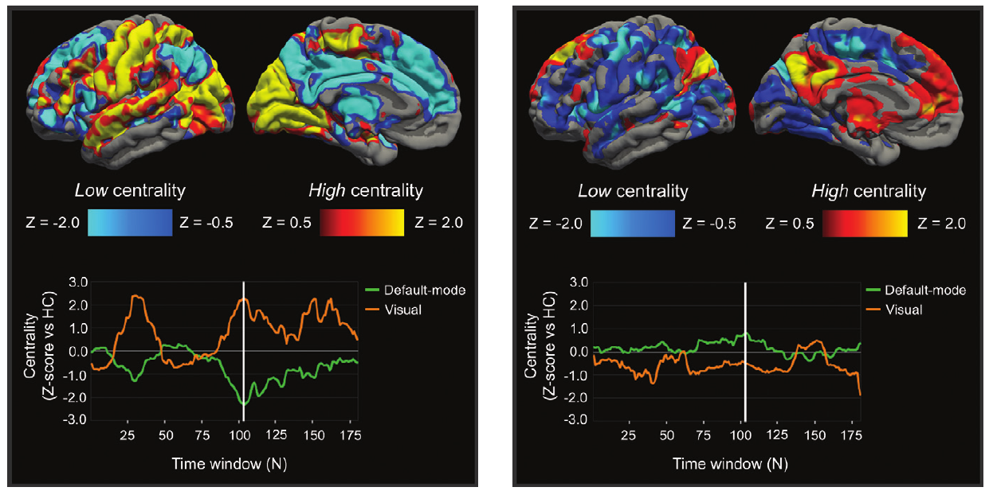
Insights from MS as a Network Disease

Slide 28
Insights from MS as a Network Disease

Slide 29
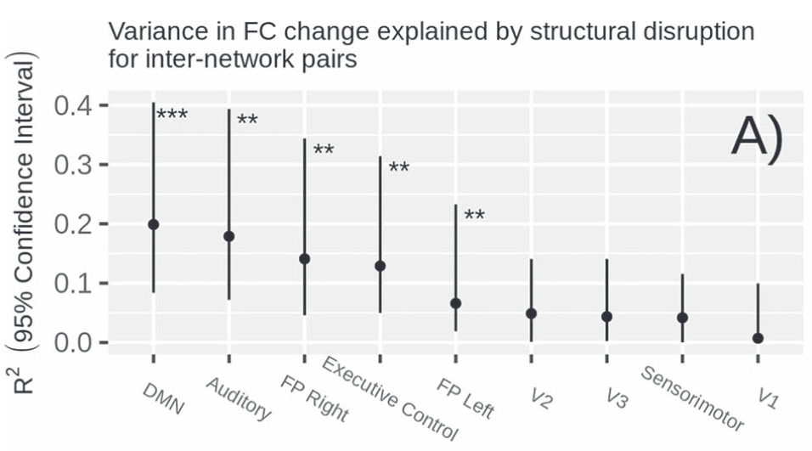
Insights from MS as a Network Disease

Slide 30



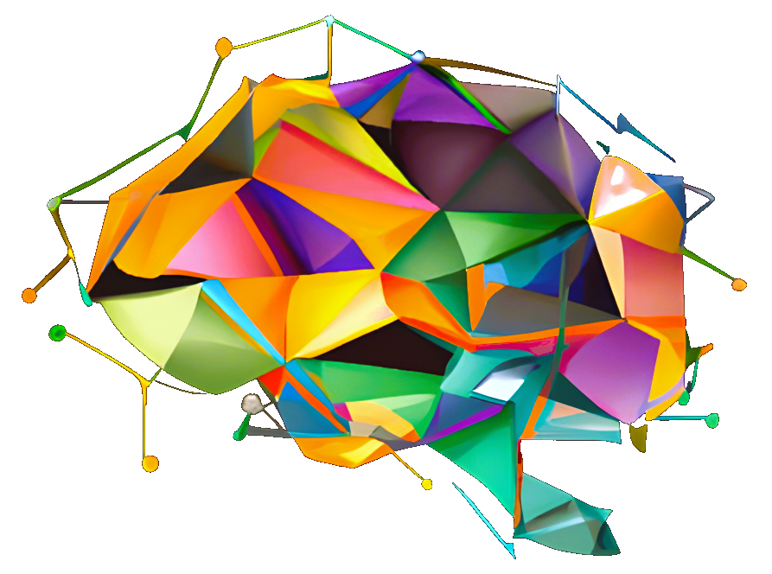
Thank You

